Slide 1
What’s this class about?
EDUC 7610 – Regression Analysis
Tyson S. Barrett, PhD

Slide 2
Welcome to the class!
This class is about learning from data
Google AI
Computer Learning to Walk
Not really this type of learning though...
Notes:
Although we won’t discuss how to do this level of machine learning, we will discuss how to learn from data

Slide 3
What do I mean by learning from data?
We are going to discuss how to use linear models (regression) to understand relationships in data and how this may generalize to the population
Everything you learned in EDUC 6600 applies here, but we will extend it (and hopefully simplify it somewhat)
Notes:
https://calpolystat2.shinyapps.io/3d_regression/

Slide 4
Comparing Regression to 6600 stuff
T-tests
Two Sample t-test
data: y by group
t = -6.6051, df = 98, p-value = 2.068e-09
95 percent confidence interval:
-2.000130 -1.075936
sample estimates:
mean in group 0 mean in group 1
-0.7976132 0.7404197
Coefficients:
Estimate Std. Error t value Pr(>|t|)
(Intercept) -0.7976 0.1562 -5.106 1.62e-06 ***
group 1.5380 0.2329 6.605 2.07e-09 ***
---
Residual standard error: 1.158 on 98 degrees of freedom
Multiple R-squared: 0.308, Adjusted R-squared: 0.301
F-statistic: 43.63 on 1 and 98 DF, p-value: 2.068e-09
Notes:
https://calpolystat2.shinyapps.io/3d_regression/

Slide 5
Comparing Regression to 6600 stuff
ANOVA
Coefficients:
Estimate Std. Error t value Pr(>|t|)
(Intercept) -0.7976 0.1562 -5.106 1.62e-06 ***
group 1.5380 0.2329 6.605 2.07e-09 ***
---
Residual standard error: 1.158 on 98 degrees of freedom
Multiple R-squared: 0.308, Adjusted R-squared: 0.301
F-statistic: 43.63 on 1 and 98 DF, p-value: 2.068e-09
Df Sum Sq Mean Sq F value Pr(>F)
group 1 58.55 58.55 43.63 2.07e-09
Residuals 98 131.52 1.34
Notes:
https://calpolystat2.shinyapps.io/3d_regression/

Slide 6
Comparing Regression to 6600 stuff
Correlations
Coefficients:
Estimate Std. Error t value Pr(>|t|)
(Intercept) -6.548e-17 7.108e-02 0.000 1
xs 7.070e-01 7.144e-02 9.897 <2e-16 ***
---
Residual standard error: 0.7108 on 98 degrees of freedom
Multiple R-squared: 0.4999
F-statistic: 97.95 on 1 and 98 DF, p-value: < 2.2e-16
t = 9.8972, df = 98, p-value < 2.2e-16
95 percent confidence interval:
0.5929508 0.7932781
sample estimates:
cor
0.7070244
Notes:
https://calpolystat2.shinyapps.io/3d_regression/

Slide 7
Comparing Regression to 6600 stuff
It was all regression all along!
We will just take what you already know and build on it
Notes:
https://calpolystat2.shinyapps.io/3d_regression/

Slide 8
Necessary Information
https://tysonbarrett.com/syllabus/educ7610

Slide 9

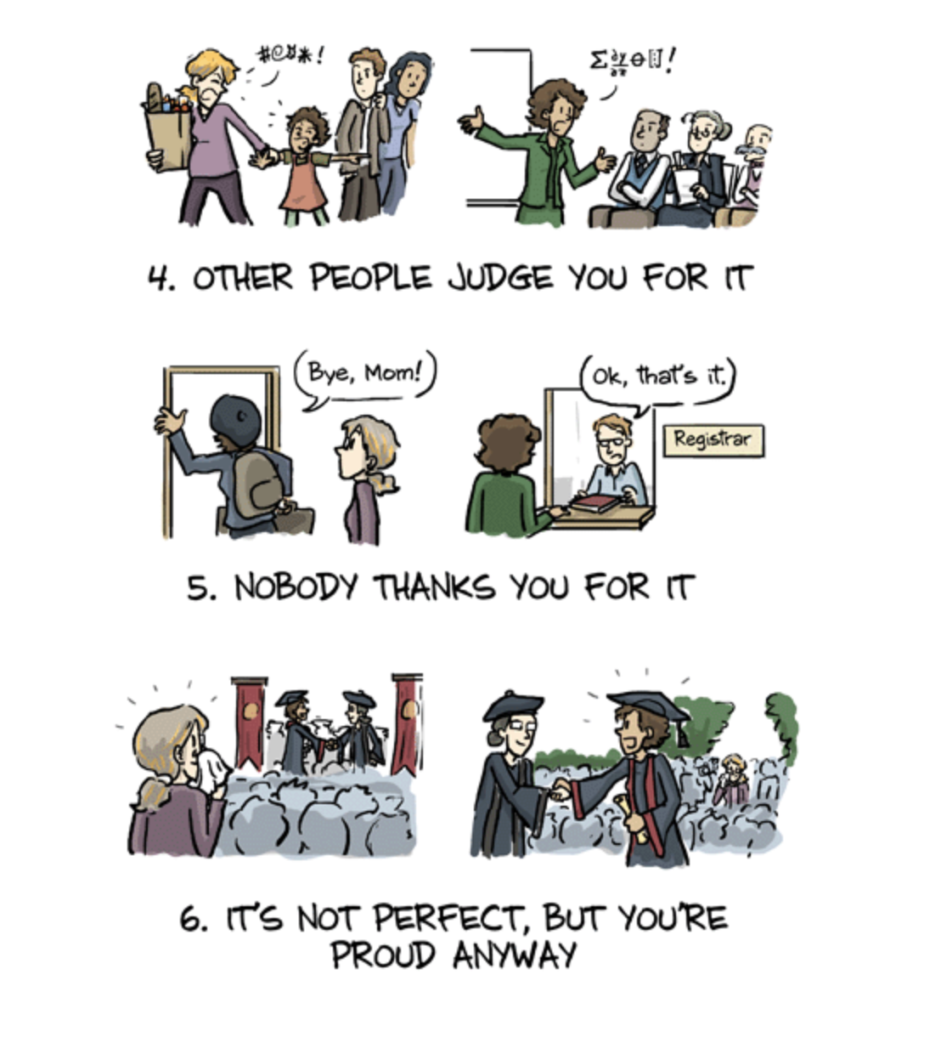
Welcome to the class!

