Slide 1
The Multiple Regression Model
EDUC 7610
$Y_{i}=β_{0}+β_{1}X_{1i} β_{2}X_{2i}+ε_{i}$
Tyson S. Barrett, PhD
Updated by Carly Fox

Slide 2
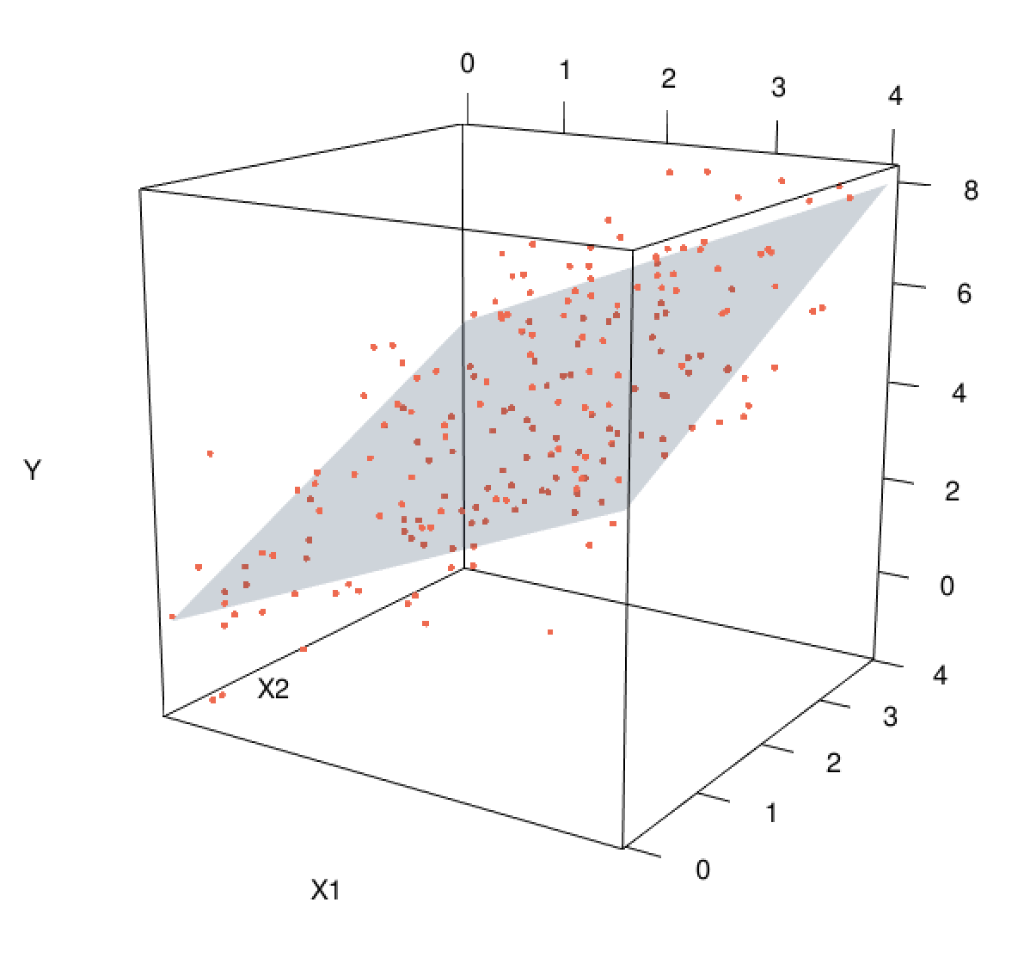
Why Multiple Regression?
2+ predictors in the same model
Allows us to “control for” the effects of other variables
Causal relationships without experiment
Can also clarify weird results (e.g., Simpson’s Paradox)
  https://youtu.be/ebEkn-BiW5k
Can look at nonlinear relationships too (later in the class)
Notes:
## Code for the figure
library(rgl)
my_surface <- function(f, n=10, ...) {
ranges <- rgl:::.getRanges()
x <- seq(ranges$xlim[1], ranges$xlim[2], length=n)
y <- seq(ranges$ylim[1], ranges$ylim[2], length=n)
z <- outer(x,y,f)
surface3d(x, y, z, ...)
}
f <- function(x1, x2) x1 + x2
n <- 200
x1 <- 4*runif(n)
x2 <- 4*runif(n)
y <- f(x1, x2) + rnorm(n)
plot3d(x1,x2,y, type="p", col="coral2", xlab="X1", ylab="X2", zlab="Y", site=5, lwd=15)
my_surface(f, alpha=.2, color = "dodgerblue3")

Slide 3
Multiple Regression
It no longer is looking for the best line but now is the best fitting plane
(2 predictors) or hyperplane (3+ predictors)
Much harder to visualize (hyperplane is essentially impossible to visualize)
But the regression estimates are still very interpretable
The math behind the model is more complex
Notes:
## Code for the figure
library(rgl)
my_surface <- function(f, n=10, ...) {
ranges <- rgl:::.getRanges()
x <- seq(ranges$xlim[1], ranges$xlim[2], length=n)
y <- seq(ranges$ylim[1], ranges$ylim[2], length=n)
z <- outer(x,y,f)
surface3d(x, y, z, ...)
}
f <- function(x1, x2) x1 + x2
n <- 200
x1 <- 4*runif(n)
x2 <- 4*runif(n)
y <- f(x1, x2) + rnorm(n)
plot3d(x1,x2,y, type="p", col="coral2", xlab="X1", ylab="X2", zlab="Y", site=5, lwd=15)
my_surface(f, alpha=.2, color = "dodgerblue3")

Slide 4
Some vocabulary
Regressors, predictors, covariates, independent variables are all essentially interchangeable
Beta Coefficients
the estimates for each predictor, the associated change in the outcome when we increase the predictor by one unit holding all the other predictors (covariates) constant
Model
A representation of Y as a linear function of the predictors
Or, an estimate of the linear relationship between your outcome (Y) and (1+) predictors

Slide 5
In Context…
Let’s say we want to predict final high school GPA from several predictors, including number of positive role models and SES
Maybe we’re particularly interested in the association of number of positive role models and final GPA, but we want to account for the effects of SES
We examine our multiple regression model and conclude:
For each additional positive role model (predictor), there is an associated 0.5-unit increase (Beta coefficient) in GPA (outcome) holding SES constant (other predictor).

Slide 6
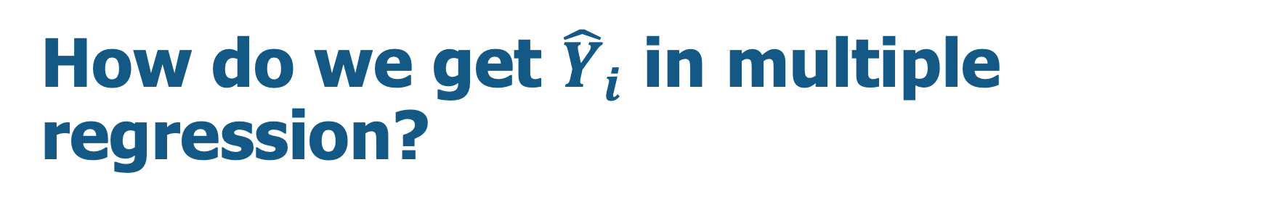

How do we get ${\hat{Y}}_{i}$ in multiple regression?
Same as with simple regression, just with more +’s
Beta Coefficient for X1
Beta Coefficient for X2
$${\hat{Y}}_{i}=β_{0}+β_{1}X_{1i}+β_{2}X_{2i}$$
outcome
intercept
Predictor 1
Predictor 2
Model

Slide 7

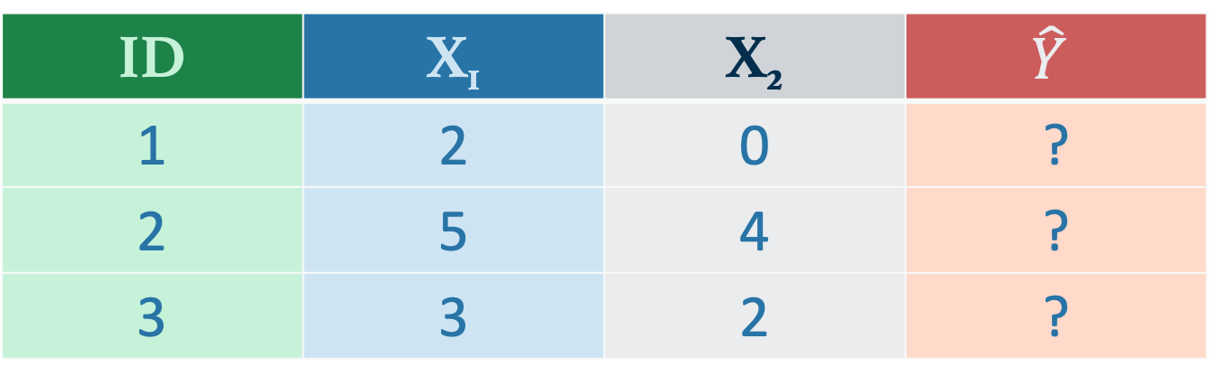
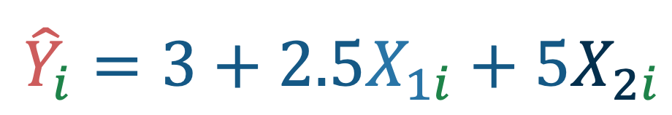
How do we get ${\hat{Y}}_{i}$ in multiple regression?
Same as with simple regression, just with more +’s
$${\hat{Y}}_{i}=3+2.5X_{1i}+5X_{2i}$$
ID | X₁ | X₂ | $$\hat{Y}$$
1 | 2 | 0 | ?
2 | 5 | 4 | ?
3 | 3 | 2 | ?

Slide 8
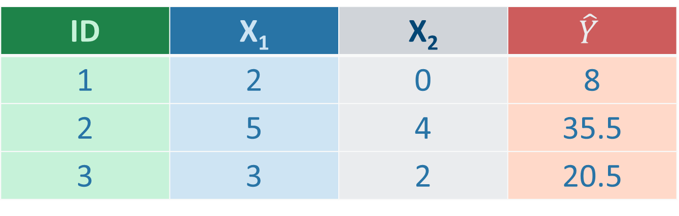
How do we get ${\hat{Y}}_{i}$ in multiple regression?
Same as with simple regression, just with more +’s
$${\hat{Y}}_{i}=3+2.5X_{1i}+5X_{2i}$$
ID | X₁ | X₂ | $$\hat{Y}$$
1 | 2 | 0 | 8
2 | 5 | 4 | 35.5
3 | 3 | 2 | 20.5

Slide 9
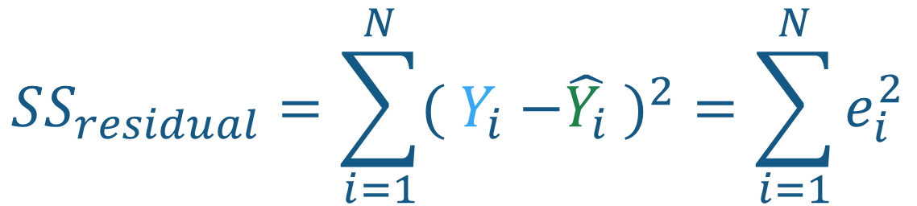
Residuals
Residuals work the same way here as they did with simple regression (i.e., they are the difference between the predicted value and the observed value of Y)
Smaller errors generally means a better model
$$SS_{residual}=\sum_{i=1}^{N}{{( Y}_{i} −{\hat{Y_{i}} )}^{2}=\sum_{i=1}^{N}{e_{i}^{2}}}$$

Slide 10
OLS and Computation
OLS regression is a ”closed form” method
Math can solve the minimization (using linear algebra)
But (if we really wanted to) we could solve for the “best-fit” line by repeatedly adjusting our beta coefficients until we minimized the error (i.e., optimization)
  Try it here:
This step-by-step (i.e., iterative) method is typically used for complex problems with large numbers of predictors and non-linear data → used in machine learning
https://www.geogebra.org/m/fTsDx9cE
Bottom line: OLS is “closed form” → has a mathematically solvable solution, so we could compute the model by hand (but we won’t, woo!)

Slide 11
OLS and Computation - Example
We realized last time that awkwardness alone maybe didn’t do the best job predicting income, so let’s add in a 2nd predictor variable (let’s say we want to control for levels of depression – we’re totally killing it creating valid constructs)
parks %>%
lm(income ~ awkw + depr,
data = .)
Coefficients:
(Intercept) awkw depr
-76.5096 -1.9945 -1.1850
Partial regression coefficients
For each one unit increase in a character’s awkwardness, there is an associated $1,994.50 decrease in yearly income, holding level of depression constant

Slide 12
Partial Regression Coefficients
Two main ways of getting partial regression estimates:
Use the residuals
Use matrix algebra (this is what R does behind the scenes)
Residuals
Algebra

Slide 13
Partial Regression Coefficients
Two main ways of getting partial regression estimates:
Use the residuals
Use matrix algebra (this is what R does behind the scenes)
Important!
What is a residual, again?
Residuals
Algebra

Slide 14

Partial Regression Coefficients
Two main ways of getting partial regression estimates:
Use the residuals
Use matrix algebra (this is what R does behind the scenes)
Residuals
Algebra
Obtain the residuals of Y ~ covariates (let’s call it Y_{r})
Obtain the residuals of X ~ covariates (let’s call it X_{r})
Run the regression Y_{r} ~ X_{r}
This is the partial regression coefficient of X predicting Y when controlling for covariates
$$B={\left(X^{′}X\right)}^{−1} X^{′}Y$$
where B is all of the partial regression estimates of the multiple regression model

Slide 15
Partial Correlation
We can also get a correlation while controlling for covariates, termed “Partial Correlation”
partial r = -0.66 (controlling for depression)
How might we interpret this correlation?
  Consider what we just learned about partial coefficients

Slide 16
Partial Correlation
Main way of getting partial correlation estimates: Use the residuals
Residuals
Obtain the residuals of Y ~ covariates (let’s call it Y_{r})
Obtain the residuals of X ~ covariates (let’s call it X_{r})
Run the correlation of Y_{r} with X_{r}
This is the partial correlation of X and Y when controlling for covariates

Slide 17
Squared Partial Correlation
How did we interpret the regular partial correlations?
When we square them, we get the:
“proportion of the variance in Y explained by X and not explained by the covariates”
Or the unique amount of the variance that X accounts for in Y
*This will have a lot to do with when we talk about R and R² in a minute

Slide 18
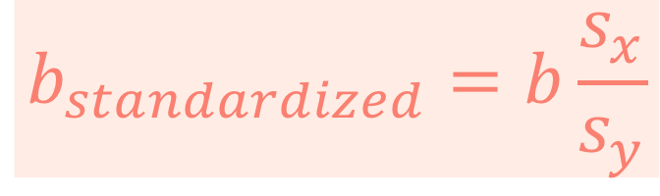
Standardized Coefficients
We can also get standardized regression effects while controlling for covariates
Coefficients:
(Intercept) awkw depr
-7.736e-17 -6.421e-01 -2.632e-01
$$b_{standardized}=b\frac{s_{x}}{s_{y}}$$

Slide 19

Standardized Coefficients
We can also get standardized regression effects while controlling for covariates
Coefficients:
(Intercept) awkw depr
< -.000001 -.642 -.263
Two important considerations:
What units would these be in?
Are they similar to the partial correlations?
$$b_{standardized}=b\frac{s_{x}}{s_{y}}$$

Slide 20
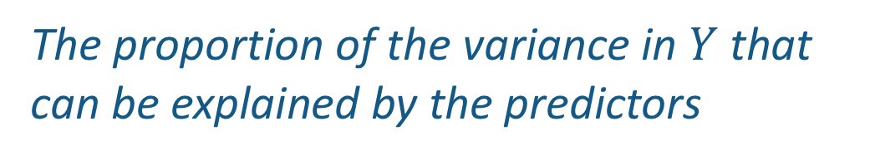
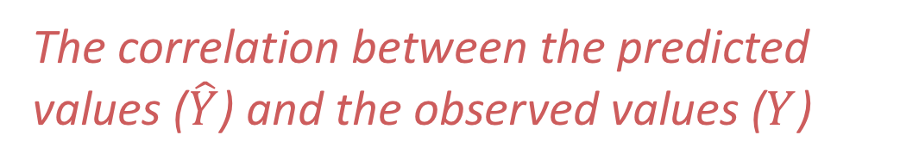
R and R²
Proportion of Variance Accounted For
The proportion of the variance in $Y$that can be explained by the predictors
Multiple Correlation
e.g., variance accounted for,
variance attributable to,
variance explained by
The correlation between the predicted values ($\hat{Y}$) and the observed values ($Y$)
Why would this be interesting to know?
Notes:
Multiple Correlation = is almost always positive
R² is always positive

Slide 21
R² and Friends
Each circle represents the variables’ variance
B
X₁
X₂
A
C
D
Y
Notes:
Page 79

Slide 22
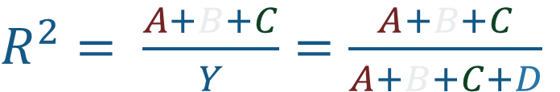
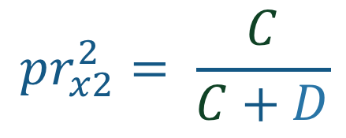
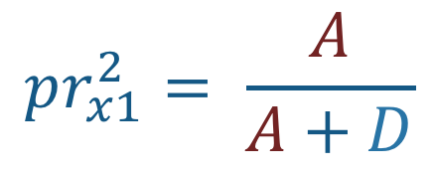
R² and Friends
$R^{2}= \frac{A+B+C}{Y}=\frac{A+B+C}{A+B+C+D}$
$$pr_{x1}^{2}= \frac{A}{A+D}$$
B
X₁
$$pr_{x2}^{2}= \frac{C}{C+D}$$
X₂
A
C
D
Y
Notes:
Page 79

Slide 23
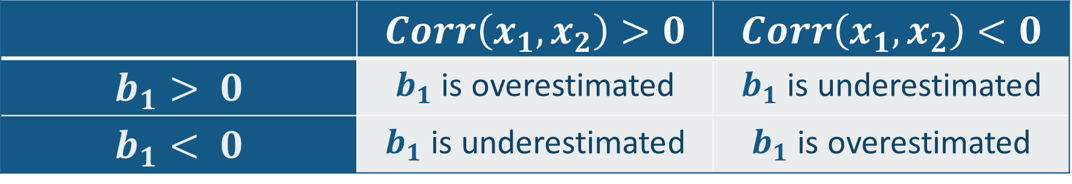
Some important things
When we should control for something but we don’t have that variable measured → can lead to Omitted Variable Bias
Covariates: Can we predict the overall way that this affects our estimate (e.g., b₁)?
It is based on the correlations between the covariate and X and the covariate and Y
 | $$Corr\left(x_{1}, x_{2}\right)>0$$ | $$Corr\left(x_{1}, x_{2}\right)<0$$
$$b_{1}> 0$$ | $b_{1}$ is overestimated | $b_{1}$ is underestimated
$$b_{1}< 0$$ | $b_{1}$ is underestimated | $b_{1}$ is overestimated
Notes:
Page 80: Covariate effects are somewhat predictable if we understand a few correlations

Slide 24
Understanding Omitted Variable Bias via Venn Diagrams
Let’s say we want to predict test scores (Y) from level of attentiveness in class (X1) and number of hours studied (X2)
Area 1 is the impact of X1 on Y
Area 3 is the impact of X2 on Y
X1
X2
2
1
3
Y

Slide 25

Understanding Omitted Variable Bias via Venn Diagrams
Let’s say we want to predict test scores (Y) from level of attentiveness in class (X1) and number of hours studied (X2)
Area 1 is the impact of X1 on Y
If we don’t include X2 in the model, maybe because we didn’t measure that variable, then we are estimating the impact of X1 on Y by areas 1 and 2, not just area 1 → an over- or under-estimation of X1 since area 2 belongs to both X1 and X2
X1
2
1
Y

Slide 26
More Practice!
Omitted Variable Bias still not clicking? Check out this blog post:
https://www.albert.io/blog/omitted-variable-bias-econometrics-review/
R-Tutorial Series: Multiple Linear Regression
https://www.r-bloggers.com/r-tutorial-series-multiple-linear-regression/
A Quick Overview of Multiple Regression:
https://www.statisticshowto.com/probability-and-statistics/regression-analysis/

Slide 27
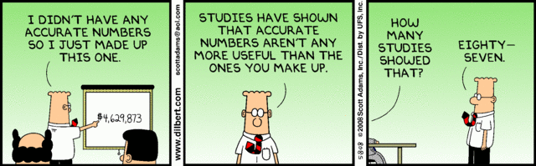
Statistics!

Slide 28
Notes:
https://calpolystat2.shinyapps.io/3d_regression/

