Slide 1
Categorical Predictors
EDUC 7610
Tyson S. Barrett, PhD
Updates by Carly Fox

Slide 2
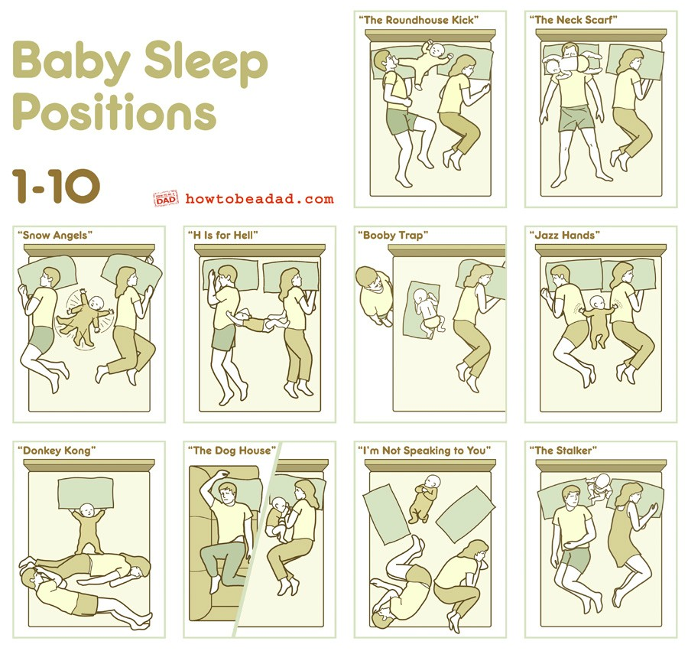
These are accurate. Very accurate.

Slide 3
Categorical Predictors
Categorical predictors (e.g., disability status) can be integrated into a regression model with very little change in how it works
Now we are estimating a difference between means instead of a slope
Y
1
2

Slide 4
Categorical Predictors
Other names for it:
ANCOVA (when covariates are included)
t-test (if only a single, two-level variable)
ANOVA (if only a single, 2+ level variable)
Y
1
2
For example, we estimate the difference in height between males and females. Could use a t-test, ANOVA, or ANCOVA. Ultimately, all are from the same “regression” family.

Slide 5
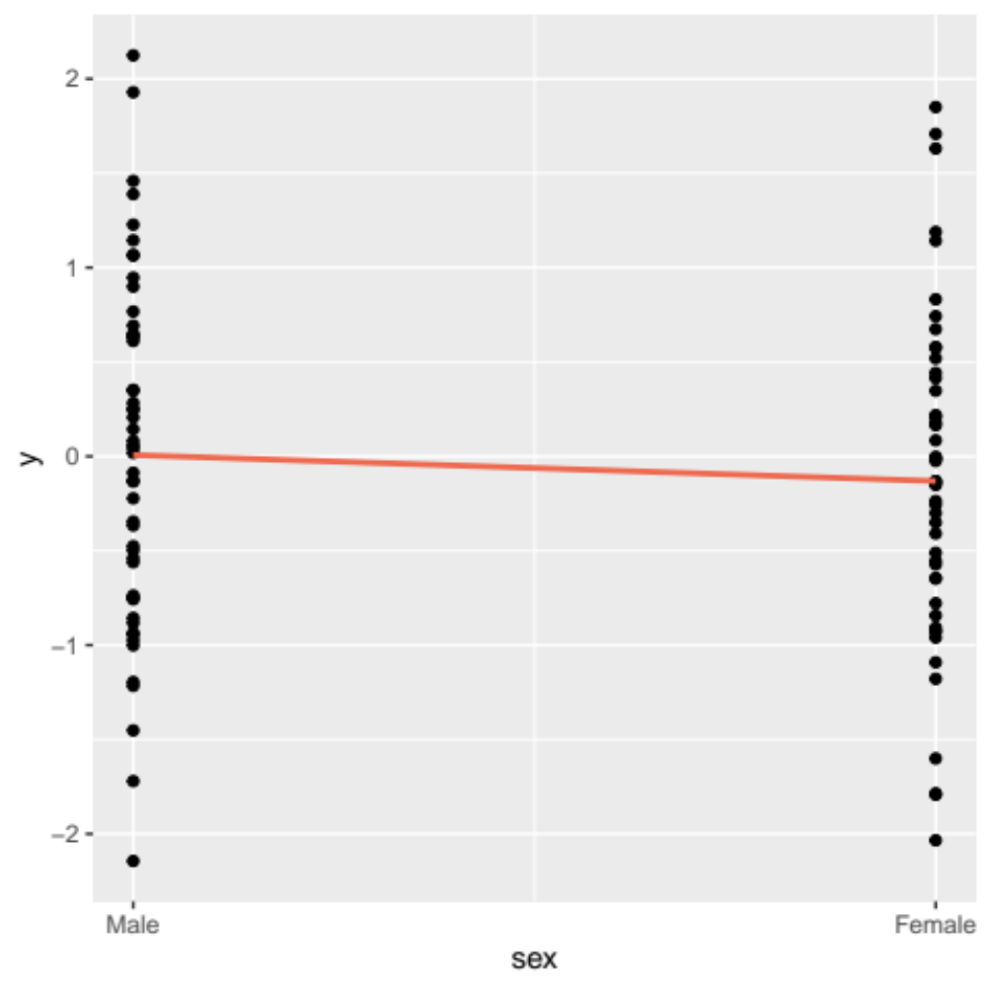
Categorical
Predictors
The line still goes through the conditional mean just like before but now that conditional mean is at a discrete point
We use DUMMY CODING to create an indicator variable (or dummy variable)
  Use 0’s and 1’s usually
  Interpretation is basically the same because we are talking about the effect of a one unit change in the predictor (i.e., a change from male to female in this case)
0
1
Notes:
df %>%
ggplot(aes(sex, y)) +
geom_point() +
geom_smooth(method = "lm",
se = FALSE,
color = "coral2") +
scale_x_continuous(breaks = c(0,1),
labels = c("Male", "Female"))

Slide 6
Interpretation of Dummy Variables
When we dummy code, there is always a reference group
In R, this is the group that isn’t mentioned (in output below, female is mentioned but not male so male is the reference group)
The estimates of the dummy variable are the mean differences from that group
  Why might we need to have a reference group?
Coefficients:
Estimate Std. Error t value Pr(>|t|)
(Intercept) 0.006949 0.126594 0.055 0.956
sexFemale -0.137779 0.180849 -0.762 0.448
How do we interpret the sex variable estimate here?
Notes:
The lowest value of the dummy code (or the first level of the factor) is the reference group by default (we can change it if we need to)

Slide 7
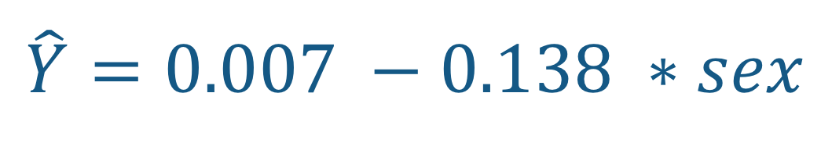
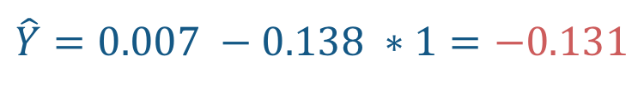
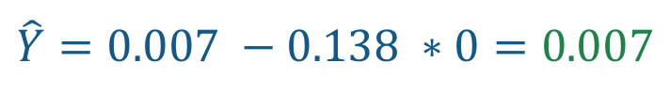
Interpretation of Dummy Variables
Let’s look at this from a predicted value perspective:
Coefficients:
Estimate Std. Error t value Pr(>|t|)
(Intercept) 0.006949 0.126594 0.055 0.956
sexFemale -0.137779 0.180849 -0.762 0.448
$$\hat{Y}=0.007 −0.138 ∗sex$$
Male
Female
When the person is male (dummy coded as 0) we get:
When the person is female (dummy coded as 1) we get:
$$\hat{Y}=0.007 −0.138 ∗0=0.007$$
$$\hat{Y}=0.007 −0.138 ∗1=−0.131$$

Slide 8
Interpretation of Dummy Variables
In other words:
Males’ and Females’ means differ by the estimate of -0.138
The predicted value of males and females differ by the estimate of -0.138
Females, on average, are 0.138 units of y lower than males
Let’s look at this from a predicted value perspective:
Coefficients:
Estimate Std. Error t value Pr(>|t|)
(Intercept) 0.006949 0.126594 0.055 0.956
sexFemale -0.137779 0.180849 -0.762 0.448
$$\hat{Y}=0.007 −0.138 ∗sex$$
Male
Female
When the person is male (dummy coded as 0) we get:
When the person is female (dummy coded as 1) we get:
$$\hat{Y}=0.007 −0.138 ∗0=0.007$$
$$\hat{Y}=0.007 −0.138 ∗1=−0.131$$
Notes:
Note that in simple regression, the intercept is the predicted value for when the dummy coded variable is zero

Slide 9

Quick note about dummy coding
If we have a variable with two levels we have a single dummy coded variable
We never make two variables
  e.g., one indicator for females and another for males
  Due to COLLINEARITY!
If we know someone is female, then we also know they are NOT male.
Inclusion of both variables would be redundant because they are perfectly
collinear.

Slide 10
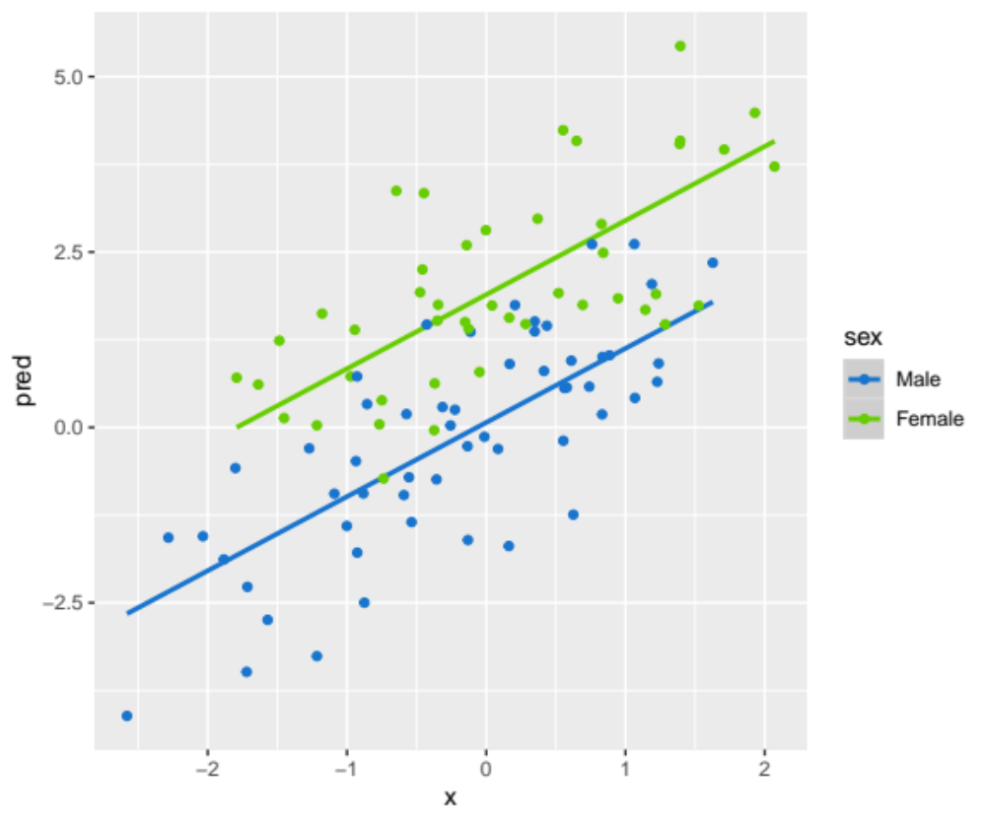
Multiple Regression with Dummy Variables
Can have dummy variables with other dummy variables and with other continuous variables
Essentially the dummy variable changes the intercept (i.e., the line is higher for females than males but the slope is the same)
  When done with 2+ covariates, the line turns into a plane
Notes:
library(tidyverse)
set.seed(843)
df <- data_frame(
x = rnorm(100),
sex = rbinom(100, 1, .5),
y = x + rnorm(100) + 2 * sex
)
df %>%
mutate(pred = predict(lm(y ~ sex + x))) %>%
mutate(sex = factor(sex, labels = c("Male", "Female"))) %>%
ggplot(aes(x, pred, group = sex, color = sex)) +
geom_smooth(method = "lm") +
geom_point(data = df %>%
mutate(sex = factor(sex, labels = c("Male", "Female"))),
aes(x, y)) +
scale_color_manual(values = c("dodgerblue3", "chartreuse3"))

Slide 11
Don’t Standardize Categorical Predictors
It just isn’t a great idea because it hurts the interpretability in several ways

Slide 12
Have you ever ...?
Tried to make a numeric variable categorical so you could use ANOVA?
Less powerful
Throws away information
Treats similar people as though they were different
Increases measurement error
What about clinical depression cut off points?
Notes:
There are times that it may be justified – such as clinical diagnoses, dichotomous by nature variables, and crazy bimodal distributions (pg. 134)

Slide 13
What is Multi-Categorical?
A categorical variable with > 2 categories
Can be represented with a set of dummy variables
k – 1 dummy variables for k levels
What is the difference between linear regression with 2+ categories and one-way ANOVA?

Slide 14
How to dummy code multi-categoricals
Let’s use the following example:
Pick a reference group (R automatically picks the “lowest” value)
Create three variables based on the non-reference groups (e.g., divorced, single, and widowed)
If that observation is divorced then the divorced variable gets a 1; otherwise a 0
Do for each of the three dummy variables
Marital Status
Married
Divorced
Single
Widowed

Slide 15
R does this automatically for us
(Intercept) groupDivorced groupSingle groupWidowed
1 1 0 0 0
2 1 0 0 0
3 1 0 0 0
4 1 0 0 0
5 1 0 0 0
6 1 0 0 0
7 1 0 0 0
8 1 0 0 0
9 1 0 0 0
10 1 0 0 0
11 1 1 0 0
12 1 1 0 0
13 1 1 0 0
14 1 1 0 0
15 1 1 0 0
16 1 1 0 0
17 1 1 0 0
18 1 1 0 0
19 1 1 0 0
20 1 1 0 0
21 1 0 1 0
22 1 0 1 0
... ... ... ... ...
group y
<fct> <dbl>
1 Married 0.650
2 Married -0.246
3 Married 0.295
4 Married 0.446
5 Married -0.397
6 Married 0.202
7 Married 0.175
8 Married -0.446
9 Married -0.579
10 Married -1.43
The first 10 observations are married individuals, married is the reference group, which means each dummy var = 0
model.matrix(y ~ group, df)
Notes:
library(tidyverse)
df <- data_frame(
group = rep(c(1,2,3,4), each = 10),
y = rnorm(40)
) %>%
mutate(group = factor(group,
labels = c("Married", "Divorced", "Single", "Widowed")))
model.matrix(y ~ group, df)

Slide 16
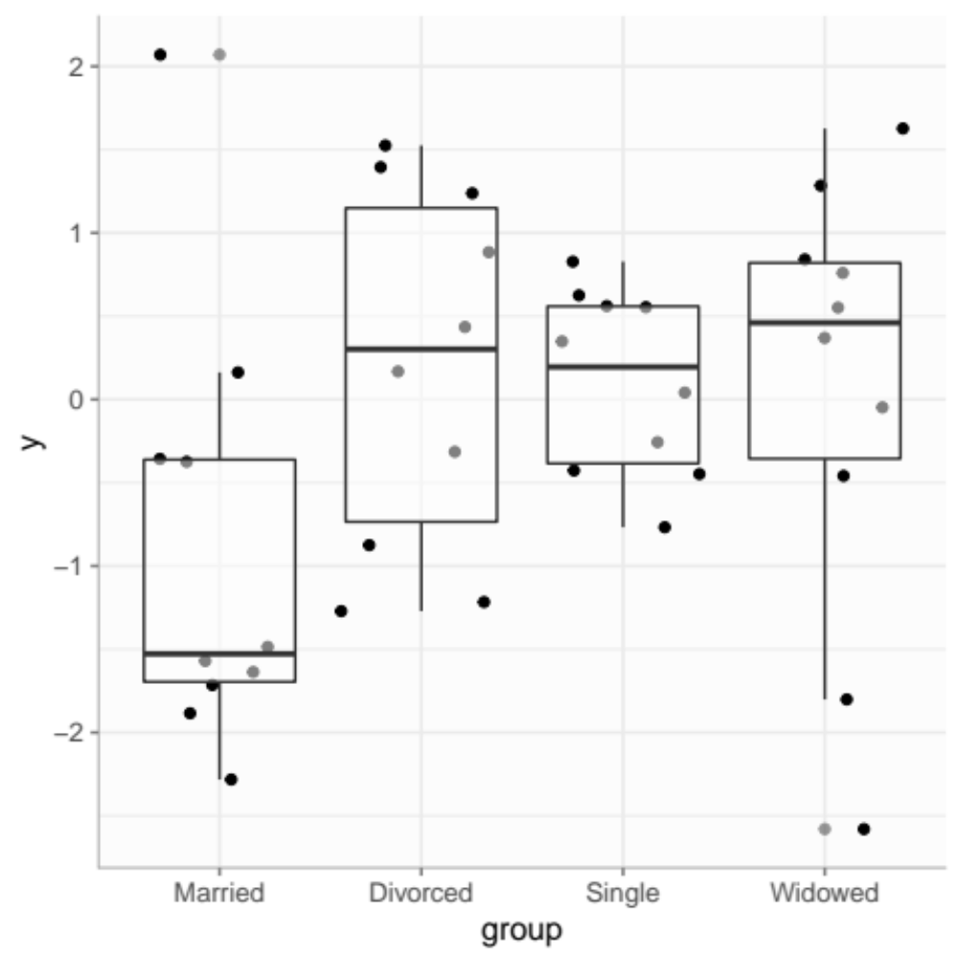

Why not just treat as continuous?
One way to treat as continuous
Coefficients:
Estimate Std. Error t value Pr(>|t|)
(Intercept) -0.8359 0.4385 -1.906 0.0642 .
group1 0.2794 0.1601 1.745 0.0891 .
These have wildly different interpretations
Another way to treat as continuous
Coefficients:
Estimate Std. Error t value Pr(>|t|)
(Intercept) 1.0400 0.5777 1.80 0.0797 .
group2 -0.3364 0.1572 -2.14 0.0389 *
And the interpretation means nothing
Notes:
library(tidyverse)
set.seed(843)
df <- data_frame(
group = rep(c(1,2,3,4), each = 10),
y = rnorm(40)
) %>%
mutate(group = factor(group,
labels = c("Married", "Divorced", "Single", "Widowed")))
df
model.matrix(y ~ group, df)
df %>%
ggplot(aes(group, y)) +
geom_jitter() +
geom_boxplot(alpha = .5) +
anteo::theme_anteo_wh()

Slide 17
Let’s use this married.txt data
──────────────────────────────────────────────────────
mstatus
1 2 3 4
n = 6 n = 5 n = 5 n = 4
satis
85.5 (6.4) 79.2 (5.5) 82.4 (6.4) 71.5 (8.1)
income
60.3 (8.4) 58.6 (5.2) 55.8 (12.4) 51.0 (11.0)
sex
0 1 (16.7%) 3 (60%) 3 (60%) 4 (100%)
1 5 (83.3%) 2 (40%) 2 (40%) 0 (0%)
──────────────────────────────────────────────────────
1 = Married
2 = Divorced
3 = Single
4 = Widowed
We can use linear regression to test the equality of means (ANOVA)
We obtain an F-statistic that is used to test the null that R = 0 (no relationship/no difference in means)

Slide 18
ANOVA with Regression
Coefficients:
Estimate Std. Error t value Pr(>|t|)
(Intercept) 85.500 2.674 31.973 6.29e-16 ***
mstatus2 -6.300 3.966 -1.588 0.13177
mstatus3 -3.100 3.966 -0.782 0.44588
mstatus4 -14.000 4.228 -3.311 0.00441 **
---
Signif. codes: 0 ‘***’ 0.001 ‘**’ 0.01 ‘*’ 0.05 ‘.’ 0.1 ‘ ’ 1
Residual standard error: 6.55 on 16 degrees of freedom
Multiple R-squared: 0.4214, Adjusted R-squared: 0.313
F-statistic: 3.885 on 3 and 16 DF, p-value: 0.02917
F-statistic and such
Is there a difference across the means?

Slide 19
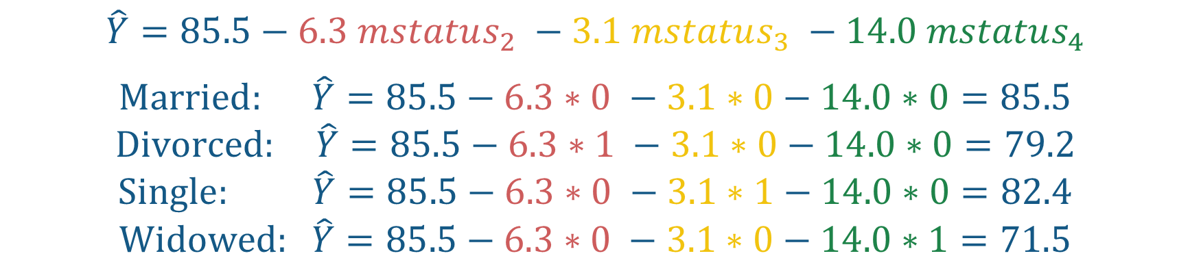
Interpreting the Regression
Coefficients:
Estimate Std. Error t value Pr(>|t|)
(Intercept) 85.500 2.674 31.973 6.29e-16 ***
mstatus2 -6.300 3.966 -1.588 0.13177
mstatus3 -3.100 3.966 -0.782 0.44588
mstatus4 -14.000 4.228 -3.311 0.00441 **
$$\hat{Y}=85.5−6.3 mstatus_{2} −3.1 mstatus_{3} −14.0 mstatus_{4}$$
$$Married: \hat{Y}=85.5−6.3∗0 −3.1∗0−14.0∗0=85.5$$
$$Divorced: \hat{Y}=85.5−6.3∗1 −3.1∗0−14.0∗0=79.2$$
$$Single: \hat{Y}=85.5−6.3∗0 −3.1∗1−14.0∗0=82.4$$
$$Widowed: \hat{Y}=85.5−6.3∗0 −3.1∗0−14.0∗1=71.5$$
*Notably, these correspond to the means we saw in the descriptive table (only in simple regression)

Slide 20
Interpreting the Regression with a covariate
Coefficients:
Estimate Std. Error t value Pr(>|t|)
(Intercept) 53.1780 7.0575 7.535 1.79e-06 ***
mstatus2 -5.3714 2.6035 -2.063 0.05685 .
mstatus3 -0.6714 2.6464 -0.254 0.80317
mstatus4 -8.9999 2.9626 -3.038 0.00831 **
income 0.5357 0.1133 4.728 0.00027 ***
Several things change in the interpretation now:
The intercept is not the mean of the reference group
  It is the mean of the reference group when the covariate is equal to zero
Each comparison is now while holding the covariate (income) constant
The covariate (income) can also be interpreted as the effect while holding the multi-categorical variable constant (marital status)

Slide 21
Interpreting the Regression with a covariate
Coefficients:
Estimate Std. Error t value Pr(>|t|)
(Intercept) 53.1780 7.0575 7.535 1.79e-06 ***
mstatus2 -5.3714 2.6035 -2.063 0.05685 .
mstatus3 -0.6714 2.6464 -0.254 0.80317
mstatus4 -8.9999 2.9626 -3.038 0.00831 **
income 0.5357 0.1133 4.728 0.00027 ***
How are the coefficients in this model interpreted?
Several things change in the interpretation now:
The intercept is not the mean of the reference group
  It is the mean of the reference group when the covariate is equal to zero
Each comparison is now while holding the covariate constant
The covariate can also be interpreted as the effect while holding the multi-categorical variable constant

Slide 22
Interpreting the Regression with a covariate
Coefficients:
Estimate Std. Error t value Pr(>|t|)
(Intercept) 53.1780 7.0575 7.535 1.79e-06 ***
mstatus2 -5.3714 2.6035 -2.063 0.05685 .
mstatus3 -0.6714 2.6464 -0.254 0.80317
mstatus4 -8.9999 2.9626 -3.038 0.00831 **
income 0.5357 0.1133 4.728 0.00027 ***
Consider: how satisfied is someone that…
Is divorced and makes 70,000 a year?
Is single and makes 50,000 a year?
Is married and makes 60,000 a year?
How are the coefficients in this model interpreted?
Several things change in the interpretation now:
The intercept is not the mean of the reference group
  It is the mean of the reference group when the covariate is equal to zero
Each comparison is now while holding the covariate constant
The covariate can also be interpreted as the effect while holding the multi-categorical variable constant

Slide 23
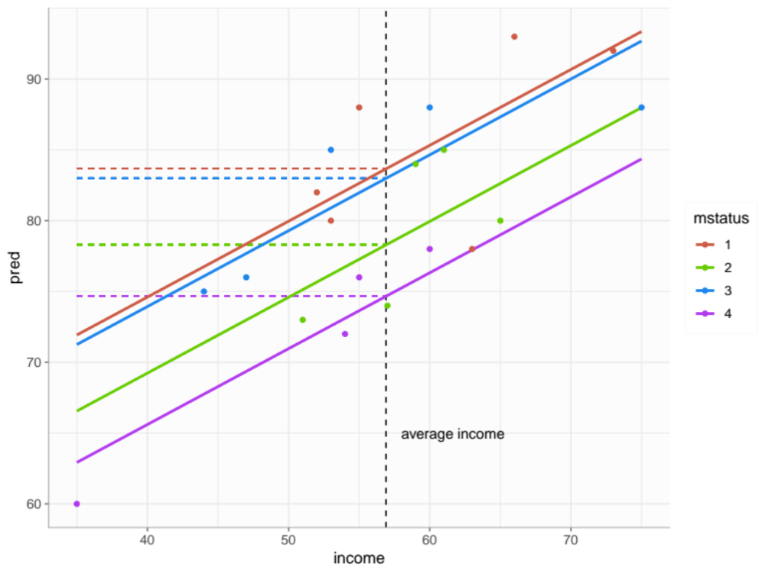
Interpreting the Regression with a covariate
Adjusted means are where the groups’ conditional means are at the average of the covariate
Notes:
married %>%
mutate(pred = predict(lm(satis ~ mstatus + income))) %>%
ggplot(aes(income, pred, group = mstatus, color = mstatus)) +
geom_vline(xintercept = mean(married$income),
linetype = "dashed") +
geom_segment(x = 35, y = 74.676,
xend = mean(married$income), yend = 74.676,
linetype = "dashed",
color = "darkorchid2") +
geom_segment(x = 35, y = 78.304,
xend = mean(married$income), yend = 78.304,
linetype = "dashed",
color = "chartreuse3") +
geom_segment(x = 35, y = 83.005,
xend = mean(married$income), yend = 83.005,
linetype = "dashed",
color = "dodgerblue2") +
geom_segment(x = 35, y = 83.676,
xend = mean(married$income), yend = 83.676,
linetype = "dashed",
color = "coral3") +
annotate("text", x = 58, y = 65, label = "average income",
hjust = 0) +
geom_smooth(method = "lm",
se = FALSE,
fullrange = TRUE) +
geom_point(aes(income, satis, color = mstatus)) +
anteo::theme_anteo_wh() +
scale_color_manual(values = c("coral3", "chartreuse3",
"dodgerblue2", "darkorchid2"))

Slide 24
Alternative Coding Systems
Read more here: https://stats.idre.ucla.edu/other/mult-pkg/faq/general/faqwhat-is-dummy-coding/
Read more here: https://stats.idre.ucla.edu/other/mult-pkg/faq/general/faqwhat-is-effect-coding/
Indicator (dummy)
Effect Coding
Different coding systems will lead to the same overall results, it will just change how the coefficients in the model are interpreted
Others exist (e.g. Sequential Coding, Helmert Coding), but let’s not worry about those for now

Slide 25
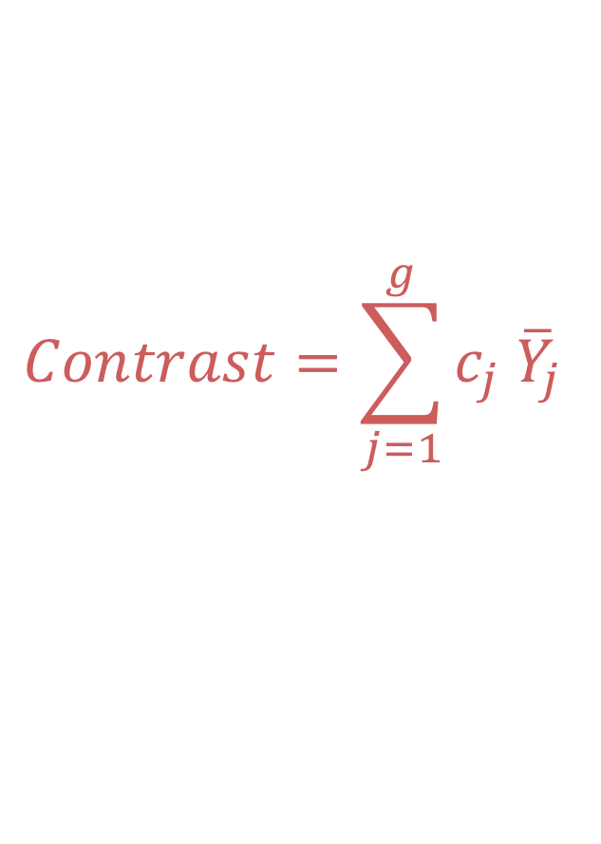

Contrasts
$$Contrast=\sum_{j=1}^{g}{c_{j} {\overline{Y}}_{j}}$$
Where c_{j} is the contrast coefficient for group j and $∑c_{j}=0$
Some questions are more complex than just comparing two groups
Are two of the groups different than another?
Are three of the groups different than two of the others?
Notes:
Examples of contrast statements

Slide 26
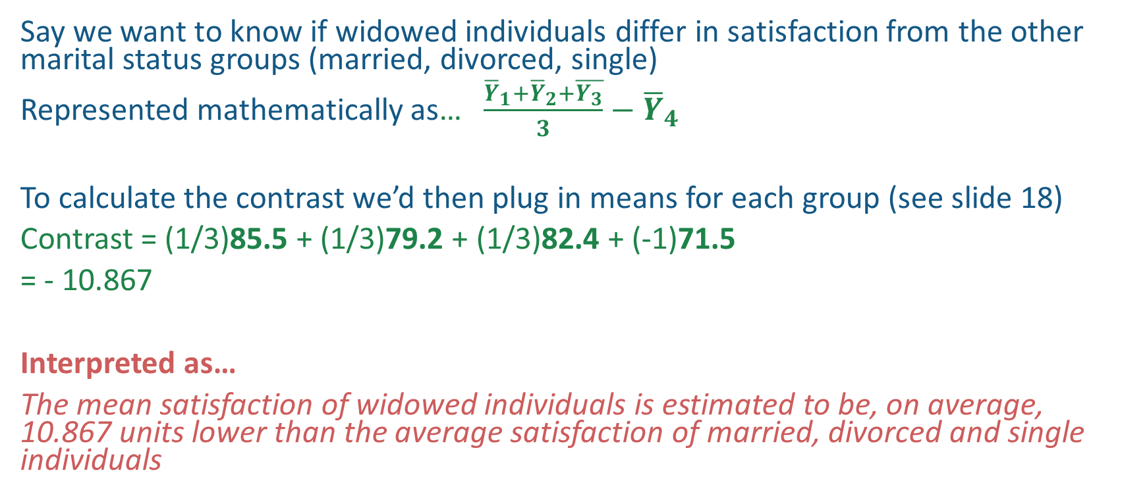
Let’s Try an Example
Say we want to know if widowed individuals differ in satisfaction from the other marital status groups (married, divorced, single)
Represented mathematically as… $\frac{{\overline{Y}}_{1}+{\overline{Y}}_{2}+\overline{Y_{3}}}{3}−{\overline{Y}}_{4}$
To calculate the contrast we’d then plug in means for each group (see slide 18)
Contrast = (1/3)85.5 + (1/3)79.2 + (1/3)82.4 + (-1)71.5
= - 10.867
Interpreted as…
The mean satisfaction of widowed individuals is estimated to be, on average, 10.867 units lower than the average satisfaction of married, divorced and single individuals
Contrast can be used to answer more complex problems as well, such as comparing sets of groups to each other and so on…

Slide 27
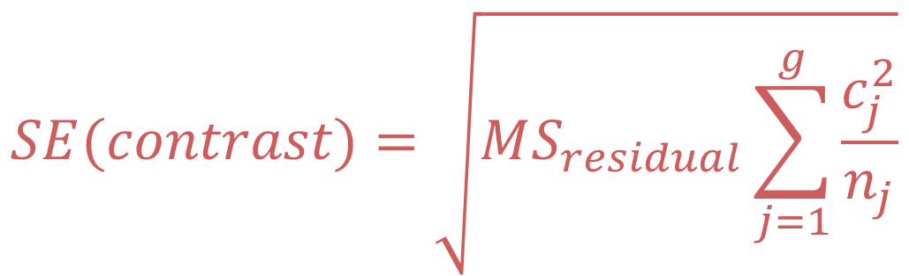
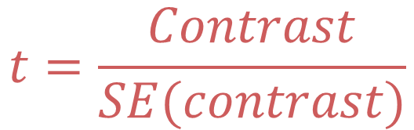
Standard Error of the Contrast
Similar to what we saw in simple regression, we can use these formulas to determine whether the contrast is statistically significant by computing the SE and the t-value
But we won’t do this by hand…
$$SE(contrast)=\sqrt{MS_{residual}\sum_{j=1}^{g}{\frac{c_{j}^{2}}{n_{j}}}}$$
$$t=\frac{Contrast}{SE(contrast)}$$
Notes:
Examples of contrast statements

Slide 28

Because we can do it in R!
m1 <- lm(satis ~ factor(mstatus), data = marr)
k <- matrix(c((1/3), (1/3), (1/3), -1), 1) Creates a matrix of the contrast coefficients
multcomp:: glht(m1, linfct = k) %>%
summary()
Simultaneous Tests for General Linear Hypothesis
Fit: lm(formula = sa satis ~ factor(mstatus), data = marr)
Linear Hypotheses:
Estimate Std. Error t value Pr(>|t|)
1 == 0 39.37 3.96 9.9 3.16e-08***
Runs a general linear hypothesis test for our contrast
Looks like the contrast is stat. sig

Slide 29
Helpful Resources
Compute contrasts in R: https://stats.idre.ucla.edu/r/faq/how-can-i-test-contrasts-in-r/
Simple R tutorial for Regression with categorical variables:
http://www.sthda.com/english/articles/40-regression-analysis/163-regression-with-categorical-variables-dummy-coding-essentials-in-r/
Different Categorical Coding Systems with Regression:
https://stats.idre.ucla.edu/spss/faq/coding-systems-for-categorical-variables-in-regression-analysis-2/

Slide 30


Slide 31


