Slide 1
Inference and Assumptions
EDUC 7610
Tyson S. Barrett, PhD
Updated by Carly Fox

Slide 2
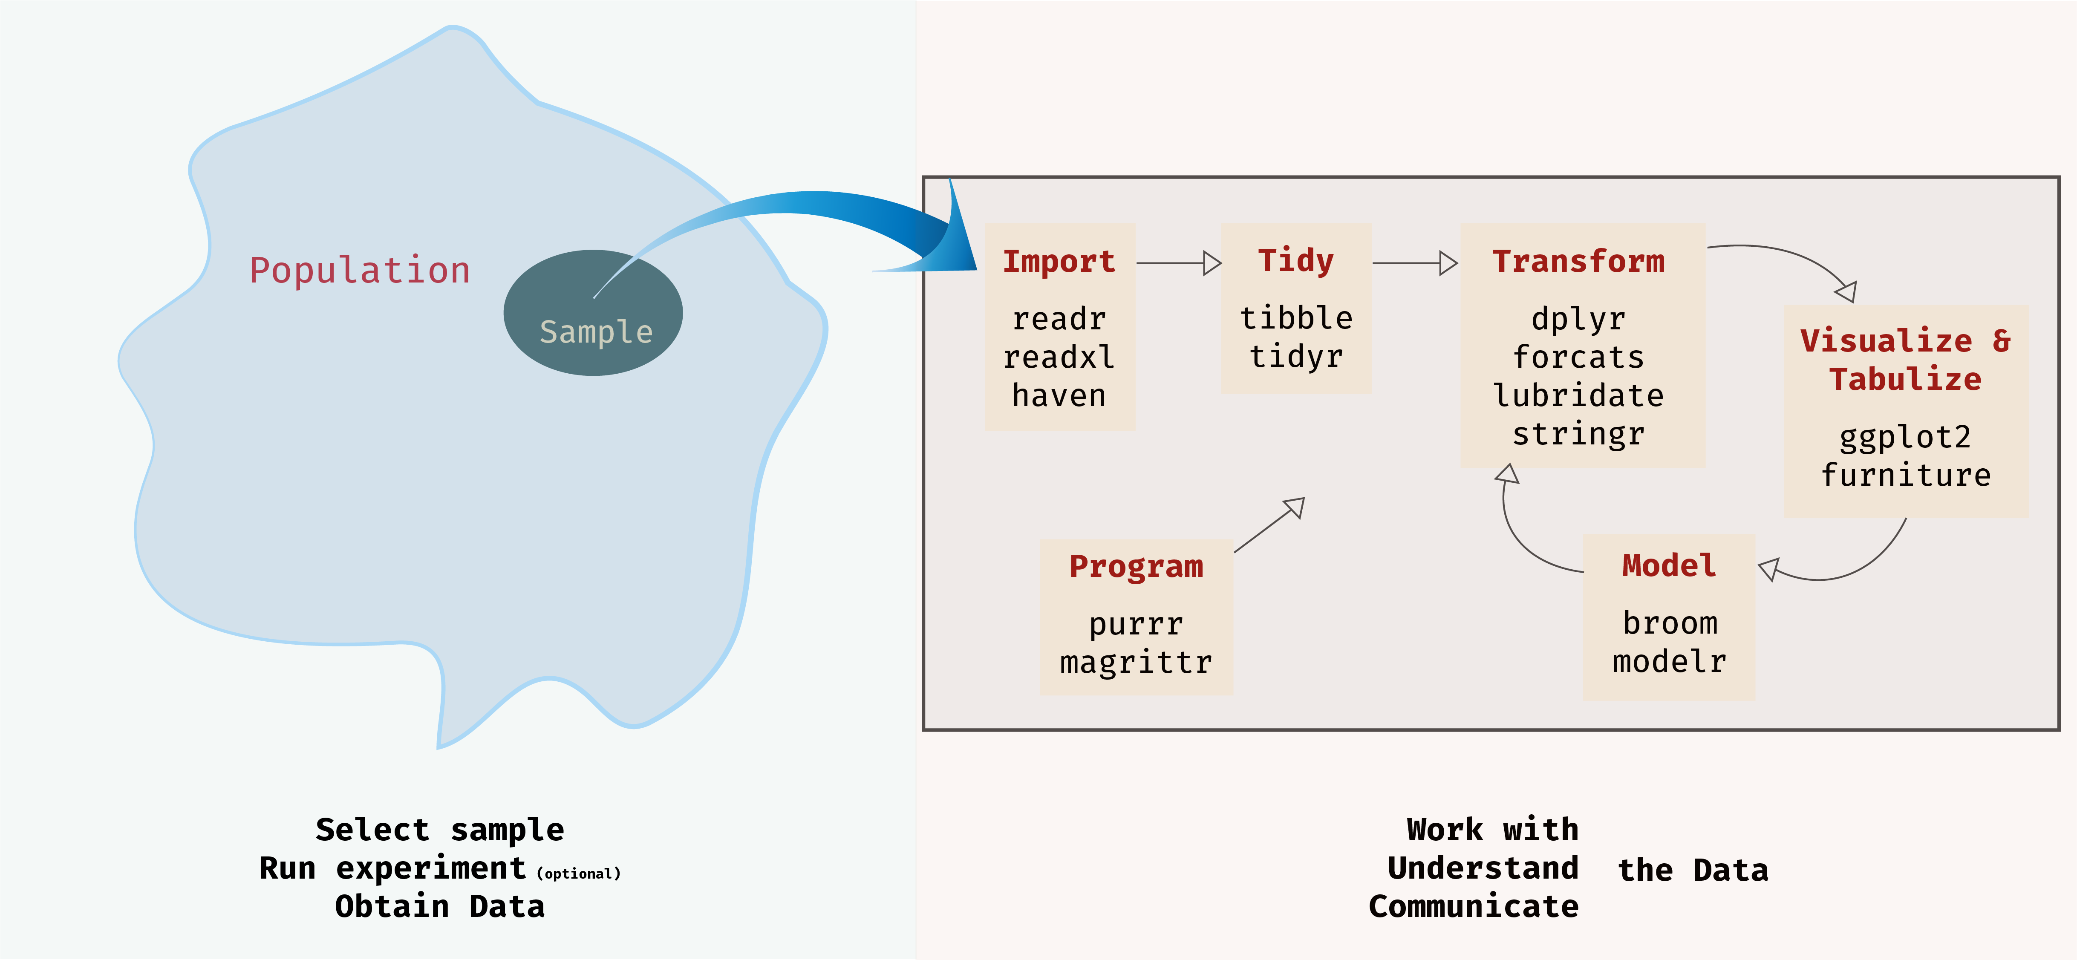
The Whole Idea
All can be done in R

Slide 3
Why Statistical Inference?
So far, we’ve used regression just to describe our sample
But our goal is to understand the population, not just our sample
There is a “true” value out there in the population
But we don’t have access to it (unless we use a census)
So we estimate it using our sample

Slide 4
Why Statistical Inference?
Is our sample going to be exactly identical to the population we pulled it from?

Slide 5
Why Statistical Inference?
Is our sample going to be exactly identical to the population we pulled it from?
Sampling Variance (Error)
Causes uncertainty in our estimates
Notes:
So why inference? Sampling variance
Error is not something “bad” or “wrong” – it is just things that we can’t explain or that we can only explain by chance

Slide 6
To infer about the population, we need to make some assumptions
1
2
Linearity – the relationship between outcome and predictors is approx. linear
Homoscedasticity – the conditional distributions of Y have equal variances
3
4
Independent Sampling – each member of our sample is independent of the other members
Conditional Distribution of Y – is normally distributed

Slide 7
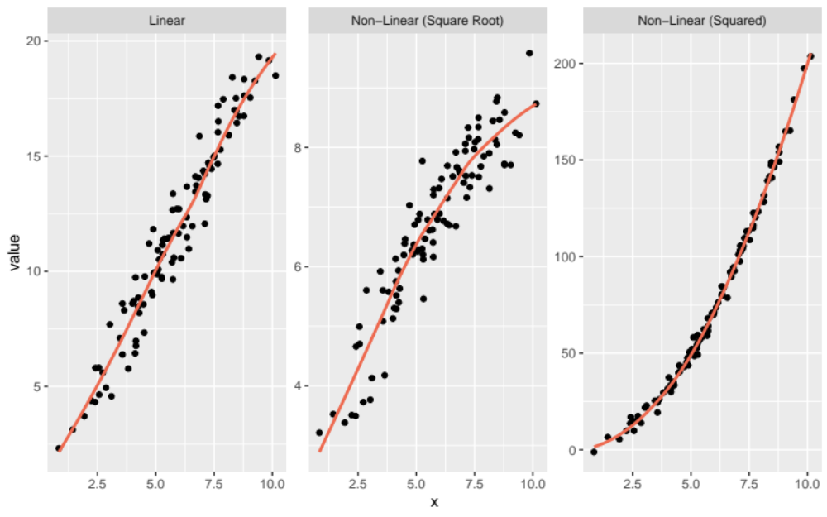
Linearity
Notes:
library(tidyverse)
set.seed(843)
df <- data_frame(
x = rnorm(100, 6, 2),
y = 2 * x + rnorm(100),
y2 = 2 * x^2 + rnorm(100, 0, 3),
y3 = 2 * sqrt(x + x) + rnorm(100, 0, .5)
)
df %>%
gather("measure", "value", y:y3) %>%
mutate(measure = case_when(measure == "y" ~ "Linear",
measure == "y2" ~ "Non-Linear (Squared)",
measure == "y3" ~ "Non-Linear (Square Root)")) %>%
ggplot(aes(x, value)) +
geom_point() +
geom_smooth(se = FALSE,
color = "coral2") +
facet_wrap(~measure, scales = "free")

Slide 8
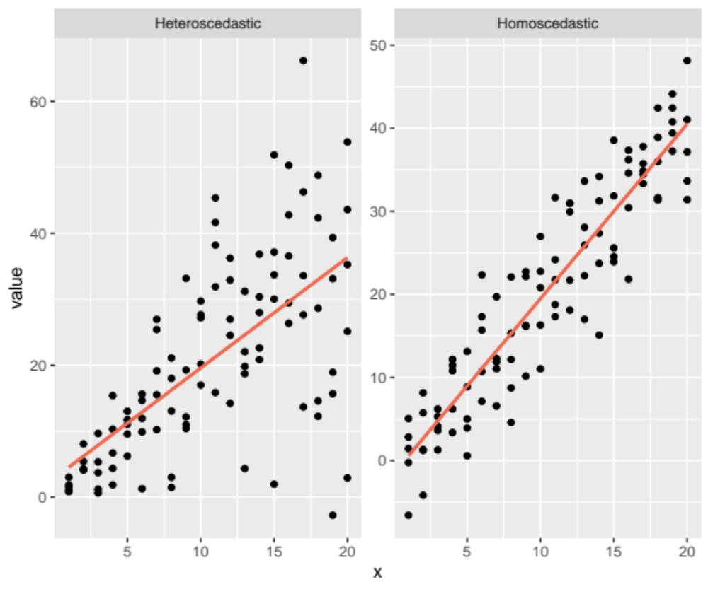
Homoscedasticity
Notes:
library(tidyverse)
set.seed(843)
df <- data_frame(
x = rep(1:20, 5),
y = 2 * x + rnorm(100, 0, 5),
y2 = 2 * x + map(x, ~rnorm(1, 0, .x)) %>%
unlist
)
df %>%
gather("measure", "value", y:y2) %>%
mutate(measure = case_when(measure == "y" ~ "Homoscedastic",
measure == "y2" ~ "Heteroscedastic")) %>%
ggplot(aes(x, value)) +
geom_point() +
geom_smooth(method = "lm",
color = "coral2",
se = FALSE) +
facet_wrap(~measure, scales = "free")

Slide 9
Conditional Distribution of Y
At each point of x, there is an assumed normal distribution around the line
Central Limit Theorem helps us here (samples above 30 don’t rely on this assumption as much)

Slide 10
Independent Sampling
Each member of our sample (e.g., person, class, animal) must be independent of the others
No influence from one member to another
Name some situations where this would be violated
When this is violated, we can use multilevel modeling techniques

Slide 11
What about violations of these assumptions?
1
2
Linearity – if this is violated we can try different specifications (e.g., square or square root of a predictor); otherwise, violating this is disastrous
Homoscedasticity – can mess with your standard errors; can use special estimators (sandwich estimator, robust SEs)
3
4
Independent Sampling – can sometimes really mess up your results (simpson’s paradox); use multilevel modeling to fix
Conditional Distribution of Y –often not too bad in larger samples

Slide 12
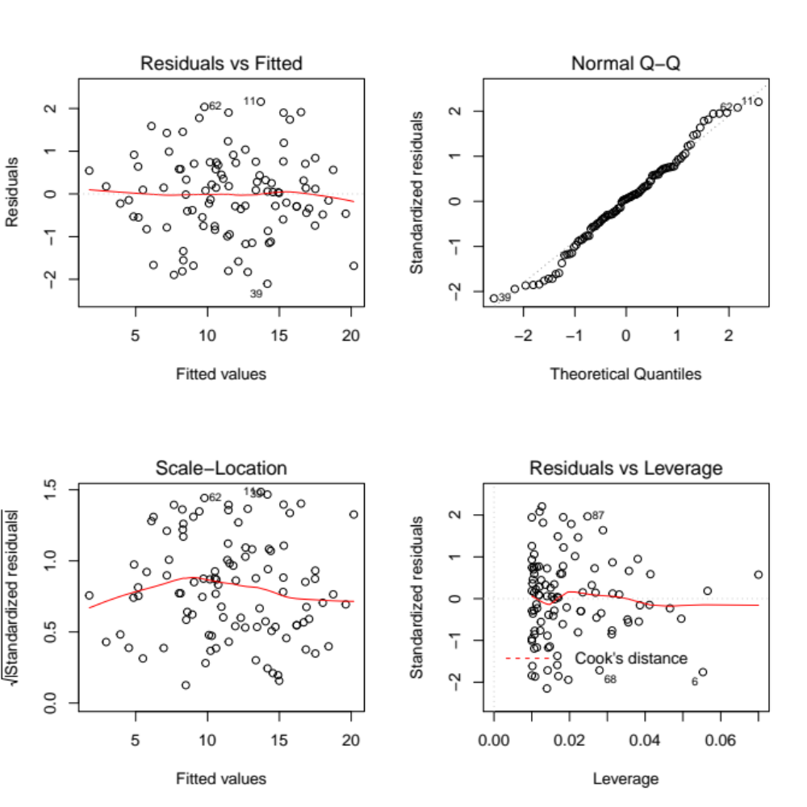
Assumptions and Residuals
All of the assumptions can be framed in terms of the residuals
Residuals are normal, homoscedastic, have a mean of zero at all points of x, and are uncorrelated
= i.i.d. (independently and identically distributed)
Notes:
This is how we will check the assumptions – by looking at the residuals

Slide 13
Let’s Try an Example…
A child language researcher wants to determine whether the length of child’s story (word count) is a significant predictor of its narrative quality. They run a simple regression and get the following results:
Coefficients:
Estimate Std. Error t value Pr(>|t|)
(Intercept) 3.955 0.297 13.21 <2e-16 ***
Word_count 0.053 0.003 16.76 <2e-16 ***
The results indicate that word count is a significant predictor, but before we make any conclusions, the assumptions need to be assessed

Slide 14
Checking Assumptions in R
We can check the assumptions by plotting the residuals in R, using the plot() function
Model1 <- lm(Narr_Quality ~ Word_count, data = Narrs)
par(mfrow = c(2,2))
plot(Model1)
This will produce 4 plots:
Residual vs Fitted = checks linearity, look for a horizontal line w/o distinct patterning
Normal Q-Q = checks normality, look for residuals following the straight dashed line
Scale Location = checks homoscedasticity, look for horizontal line with equally spread points
Residual vs Leverage = checks for influential points, don’t worry about this too much for now

Slide 15
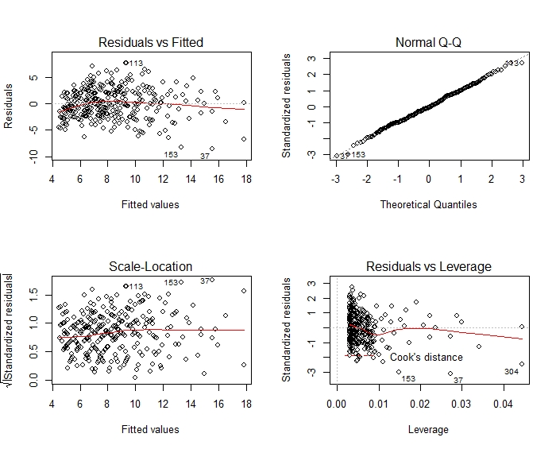
It seems like the model is not violating any of the assumptions (woo)!
Residuals follow
the line,
normality looks
good
Line is roughly
horizontal with no
distinct pattern;
Linearity seems okay
It seems we have
some influential
points, but again
we won’t worry
about that for
now
Line is roughly
horizontal with
Somewhat
equal distribution
of residuals;
homoscedasticity
seems okay

Slide 16

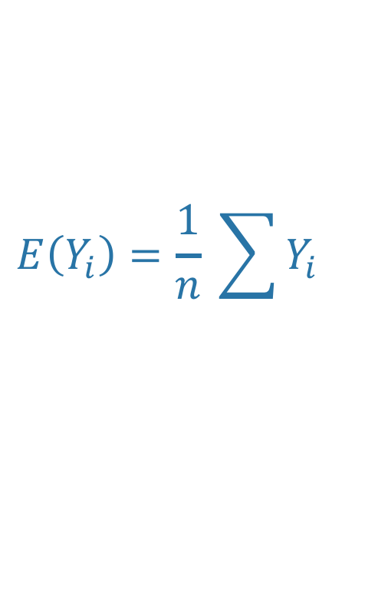


Quick Aside about Vocab and Notation
If we did something a thousand times, what value do we expect?
Expected Value
$$E\left(\overline{Y}\right)$$
$$E(b_{j})$$
$$E(Y)$$
Unbiased Estimation
An estimate that arrives at the expected value
$$E\left(Y_{i}\right)=\frac{1}{n} \sum{Y_{i}}$$

Slide 17
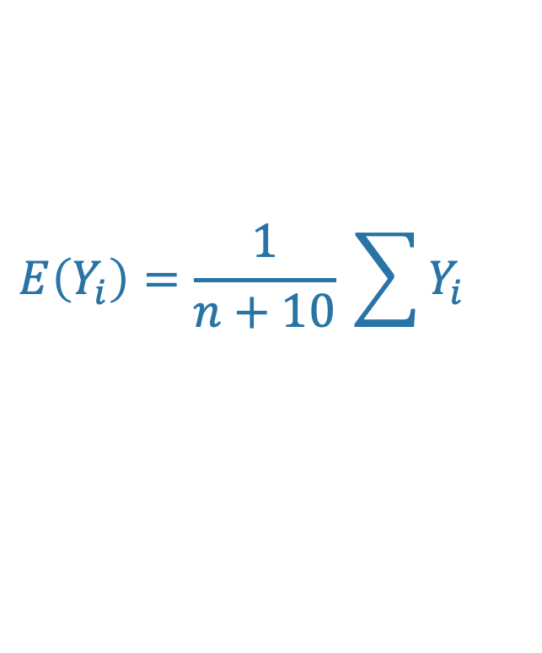
Quick Aside about Vocab and Notation
Is the following unbiased?
Regression is an UNBIASED estimator of the population value
$$E\left(Y_{i}\right)=\frac{1}{n+10} \sum{Y_{i}}$$
We could show this mathematically
No. It is dividing by too much. It is biased.
But what if we got a sample of 1 million, would it be off by much?

Slide 18
Ordinary Least Squares Regression is B.L.U.E.
It is the most precise (the smallest accurate standard errors)
Best
Linear
Unbiased
Estimator
It is unbiased (it estimates the population value)
It is a linear model
Everything we are doing with regression is an estimate
Note: Maximum likelihood regression is very similar

Slide 19
So what does all this mean?
Regression provides us with the “best” linear, accurate way to understand a population using a sample

Slide 20
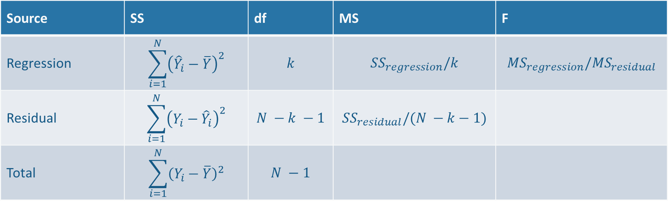
Regression Results in ANOVA form
Regression results include the information we’d normally report with an ANOVA
Remember that ANOVA is just a special case of regression?
Source | SS | df | MS | F
Regression | $$\sum_{i=1}^{N}{{\left({\hat{Y}}_{i}−\overline{Y}\right)}^{2}}$$ | $$k$$ | $${SS}_{regression}/k$$ | $${MS}_{regression}/{MS}_{residual}$$
Residual | $$\sum_{i=1}^{N}{{\left(Y_{i}−{\hat{Y}}_{i}\right)}^{2}}$$ | $$N −k −1$$ | $${SS}_{residual}/(N −k−1)$$
Total | $$\sum_{i=1}^{N}{{\left(Y_{i}−\overline{Y}\right)}^{2}}$$ | $$N −1$$

Slide 21
What do we want to be able to infer?
1
R²
2
Regression Coefficients
3
Conditional Means

Slide 22
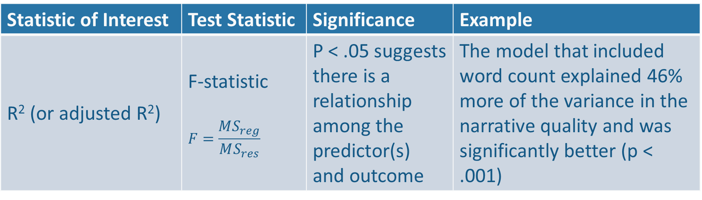
Inference: R²
This tests the entire model
Do the predictor(s) together have a relationship with the outcome?
Common to discuss the model as a whole before discussing the individual predictors
Statistic of Interest | Test Statistic | Significance | Example
R² (or adjusted R²) | F-statistic $$F=\frac{MS_{reg}}{MS_{res}}$$ | P < .05 suggests there is a relationship among the predictor(s) and outcome | The model that included word count explained 46% more of the variance in the narrative quality and was significantly better (p < .001)
Notes:
Notably R² is biased in that it only tells us the amount of variance explained in that sample, not in the population. However, it is still extensively used (sometimes in conjunction with the adjusted R²).

Slide 23
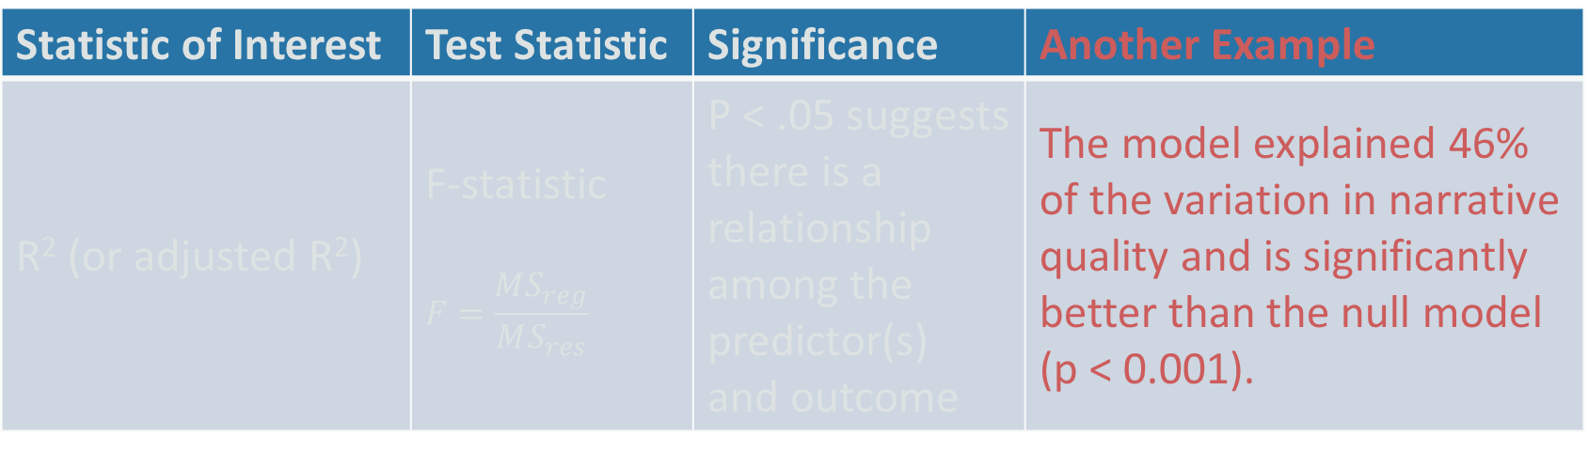
Inference: R²
The Null Hypothesis: Model is no better than comparison model (either a null model or another ”nested” model)
The Alternative: Model is better than comparison
Statistic of Interest | Test Statistic | Significance | Another Example
R² (or adjusted R²) | F-statistic $$F=\frac{MS_{reg}}{MS_{res}}$$ | P < .05 suggests there is a relationship among the predictor(s) and outcome | The model explained 46% of the variation in narrative quality and is significantly better than the null model (p < 0.001).

Slide 24
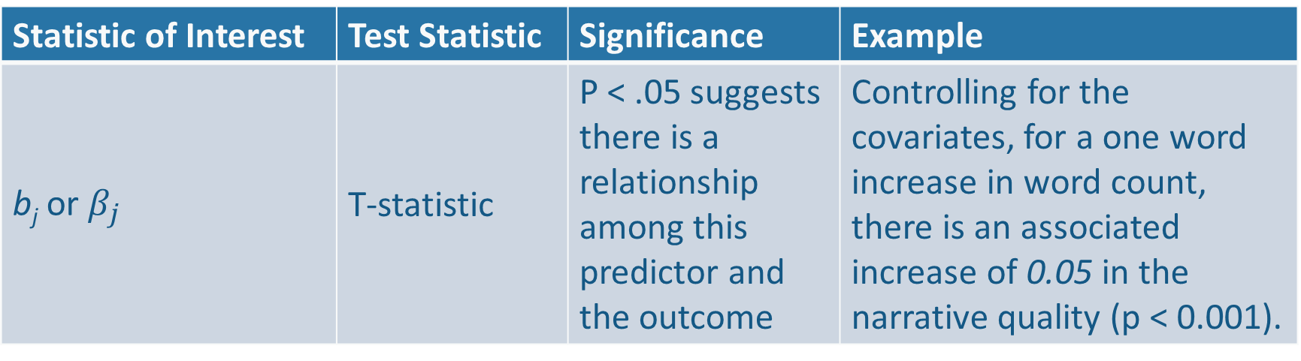
Inference: Regression Coefficients
This tests each individual predictor
Does each predictor have a relationship with the outcome?
Most common way of interpreting regression
Statistic of Interest | Test Statistic | Significance | Example
b_{j} or $β_{j}$ | T-statistic | P < .05 suggests there is a relationship among this predictor and the outcome | Controlling for the covariates, for a one word increase in word count, there is an associated increase of 0.05 in the narrative quality (p < 0.001).

Slide 25
Inference: Regression Coefficients
This tests each individual predictor
Does each predictor have a relationship with the outcome?
Most common way of interpreting regression
We do the same tests for the standardized coefficients as well (just with standardized variables instead of the raw ones)

Slide 26
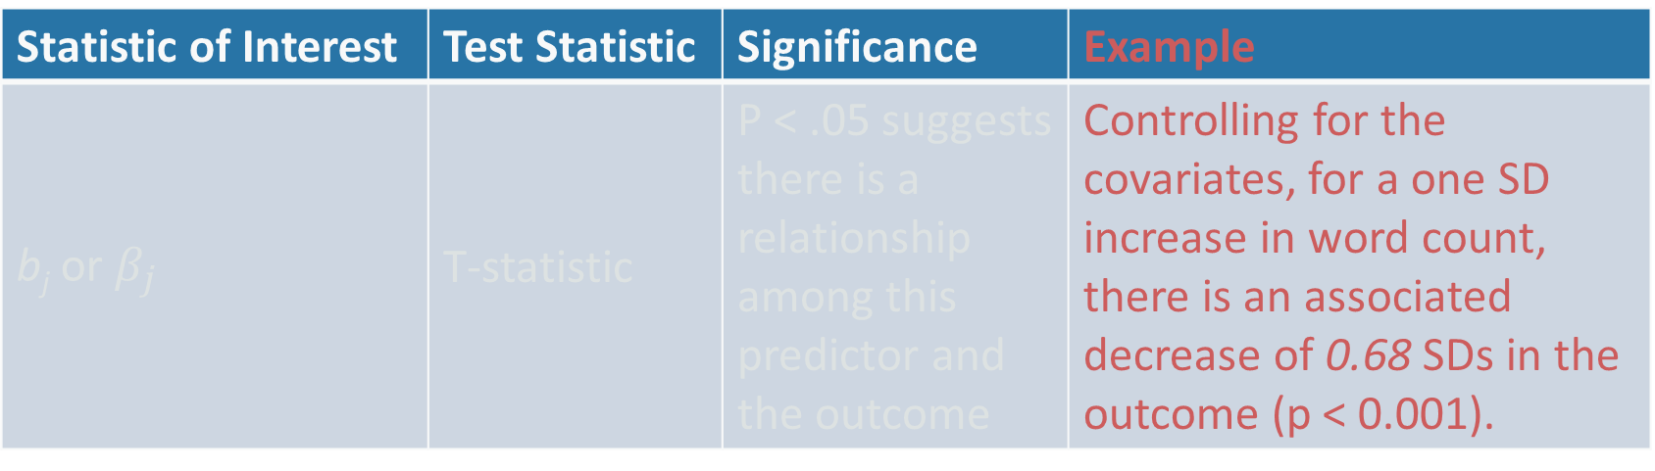
Inference: Regression Coefficients
This testing each individual predictor
Do each predictor have a relationship with the outcome?
Most common way of interpreting regression
Statistic of Interest | Test Statistic | Significance | Example
b_{j} or $β_{j}$ | T-statistic | P < .05 suggests there is a relationship among this predictor and the outcome | Controlling for the covariates, for a one SD increase in word count, there is an associated decrease of 0.68 SDs in the outcome (p < 0.001).
We do the same tests for the standardized coefficients as well (just with standardized variables)

Slide 27
Inference: Regression Coefficients
Important Pieces of the Coefficients
The Estimate
The Standard Error of the Estimate
  Testing the null hypothesis
  Confidence Intervals

Slide 28

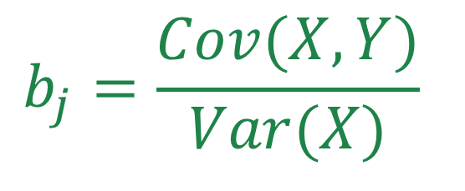
Inference: Regression Coefficients
The Estimate
Simple
$$b_{j}=\frac{Cov(X,Y)}{Var(X)}$$
Multiple
$$all b_{j}s={\left(X^{′}X\right)}^{−1} X^{′}Y$$

Slide 29
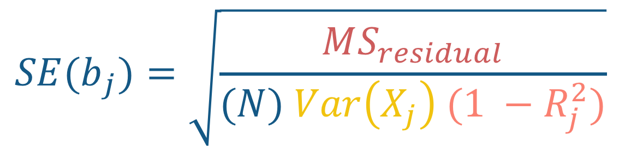
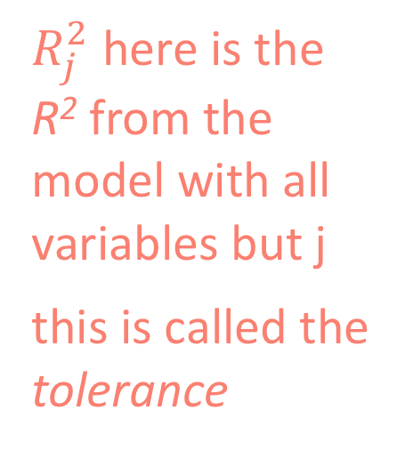
Inference: Regression Coefficients
estimate of variance of the residuals
The Standard Error
$${SE(b}_{j})=\sqrt{\frac{MS_{residual}}{(N) Var\left(X_{j}\right) (1 −R_{j}^{2})}}$$
$R_{j}^{2}$ here is the R² from the model with all variables but j
this is called the tolerance
Sample size used in analysis
Variance of that predictor
Notes:
Pg 107

Slide 30
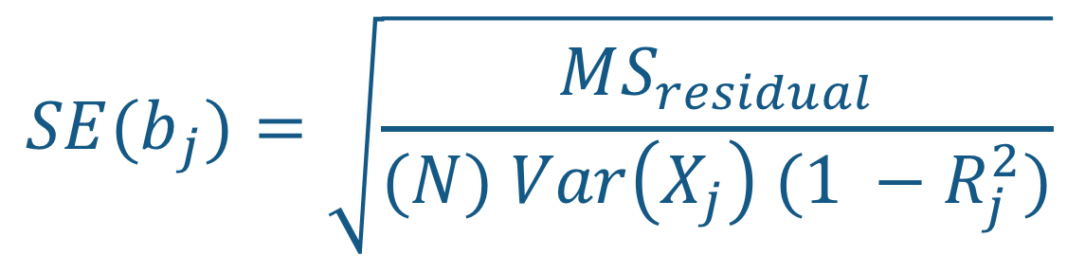
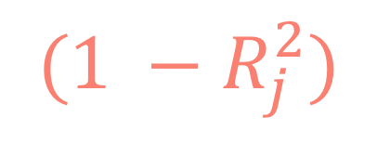
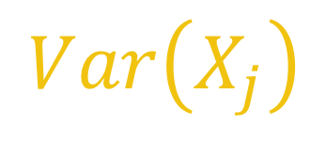


Inference: Regression Coefficients
The Standard Error
$${SE(b}_{j})=\sqrt{\frac{MS_{residual}}{(N) Var\left(X_{j}\right) (1 −R_{j}^{2})}}$$
$$MS_{residual}$$
$$Var\left(X_{j}\right)$$
What increases the SE?
$$N$$
$$(1 −R_{j}^{2})$$

Slide 31
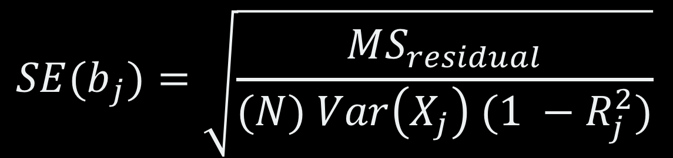
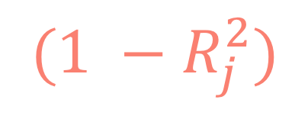
Inference: Regression Coefficients
The Standard Error
$$(1 −R_{j}^{2})$$
= The Tolerance of X_{j}
$${SE(b}_{j})=\sqrt{\frac{MS_{residual}}{(N) Var\left(X_{j}\right) (1 −R_{j}^{2})}}$$
A measure of the independence of X_{j} from the other predictors (i.e., measures the collinearity)

Slide 32
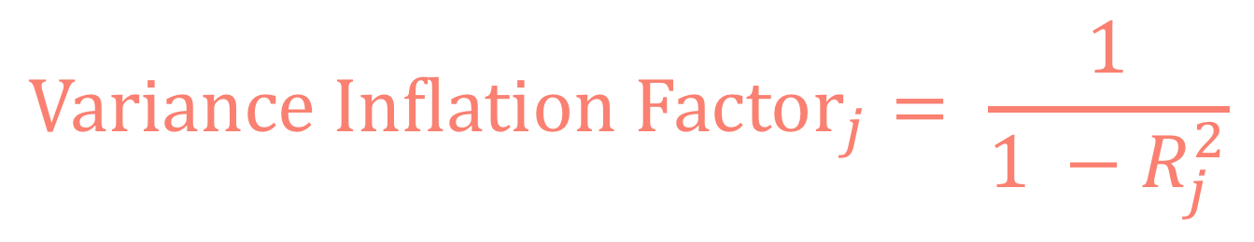
Inference: Regression Coefficients
The Standard Error
$$(1 −R_{j}^{2})$$
= The Tolerance of X_{j}
$${SE(b}_{j})=\sqrt{\frac{MS_{residual}}{(N) Var\left(X_{j}\right) (1 −R_{j}^{2})}}$$
A measure of the independence of X_{j} from the other predictors (i.e., measures the collinearity)
$$Variance Inflation Factor_{j}= \frac{1}{1 −R_{j}^{2}}$$
Small = Better
Notes:
As R²_{j} increases, VIF_{j} increases a lot

Slide 33
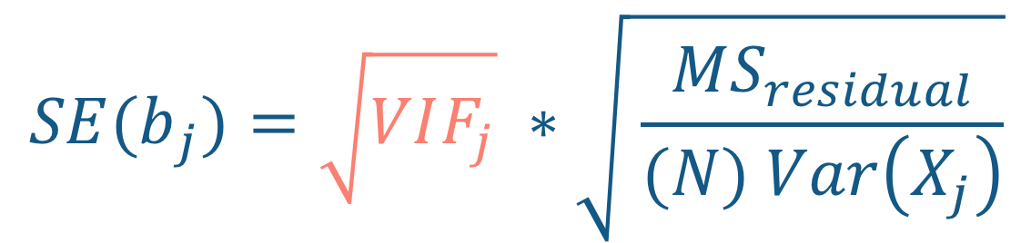
Inference: Regression Coefficients
The Standard Error
$${SE(b}_{j})=\sqrt{\frac{MS_{residual}}{(N) Var\left(X_{j}\right) (1 −R_{j}^{2})}}$$
$${SE(b}_{j})=\sqrt{VIF_{j}} ∗\sqrt{ \frac{MS_{residual}}{(N) Var\left(X_{j}\right)}}$$
Notes:
Example: if VIF = 1.5 that means the SE is 1.5 times larger than it would be if X wasn’t correlated with the other variables at all

Slide 34
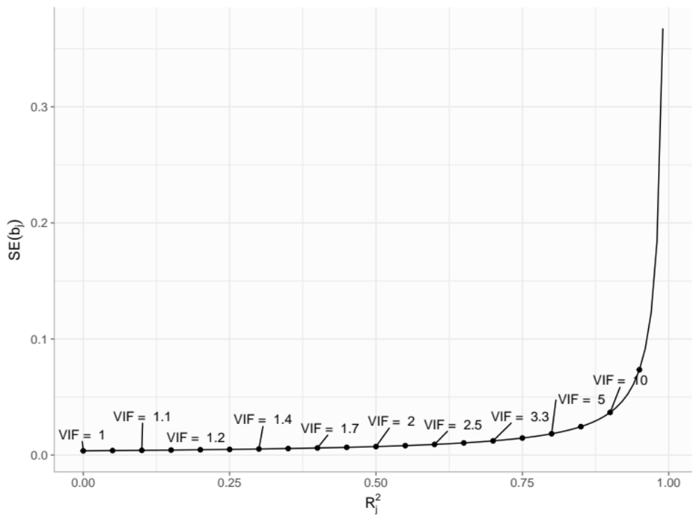
The Standard Error when VIF (or R_{j}²) is increased
Notes:
library(tidyverse)
ms <- 10
n <- 100
x <- rnorm(100, 0, 5)
R2 <- seq(0,.99, by = .01)
se <- ms/(n * var(x) * (1 - R2))
df <- data_frame(se = se,
r2 = R2,
vif = 1 / (1 - R2))
df %>%
ggplot() +
geom_line(aes(r2, se)) +
geom_point(data = df %>%
mutate(vif = case_when(rep(c(TRUE, FALSE, FALSE, FALSE, FALSE), length(vif)/5) ~ vif)) %>%
filter(!is.na(vif)),
aes(x = r2, y = se)) +
ggrepel::geom_text_repel(data = df %>%
mutate(vif = case_when(rep(c(TRUE, FALSE, FALSE, FALSE,
FALSE, FALSE, FALSE, FALSE, FALSE, FALSE), length(vif)/10) ~ vif)) %>%
filter(!is.na(vif)),
aes(x = r2, y = se, label = paste("VIF = ", round(vif,1))),
nudge_y = .02) +
anteo::theme_anteo_wh() +
labs(y = expression(SE(b[j])),
x = expression(R[j]^2))

Slide 35
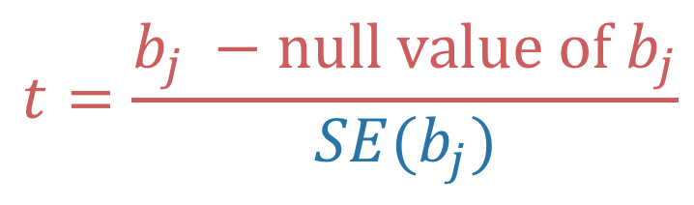
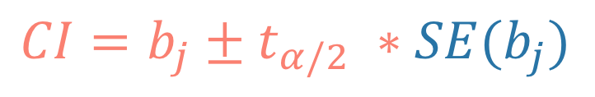
Inference: Regression Coefficients
Using the Standard Error we can now do two important things
Null Hypothesis Test
Confidence Interval
$$t=\frac{b_{j} −null value of b_{j}}{SE(b_{j})}$$
$$CI=b_{j}±t_{α/2} ∗SE(b_{j})$$
Using either we can test the null hypothesis and make inferences about the population
Notes:
Null value of b_{j} is usually 0

Slide 36
Inference: Conditional Means
First thing, let’s talk about centering
Centering a variable means subtracting a centering-value from it
We can mean center
We can median center
We can center on any value we choose
When we do this, it changes the interpretation of the intercept
Notes:
Normal interpretation of intercept: the predicted value of the outcome when all predictors are zero (often not a meaningful value)

Slide 37

Inference: Conditional Means
To obtain $SE\left({\hat{Y}}_{G}\right)$ where G is a specific set of points
Center each variable at that specific set of points
For example, we may want to know the language ability of a child and obtain the confidence interval of that estimate for a someone that is 8 years old and whose mother has 15 years of schooling (some college)
Notes:
For this example, we will subtract 8 from the age variable and 15 from the educ variable and then run a regression. The intercept now provides us with the information about the SE.

Slide 38
Need More Help?
More on the Assumptions of Regression:
https://www.jmp.com/en_us/statistics-knowledge-portal/what-is-regression/simple-linear-regression-assumptions.html
R Tutorial for Checking Assumptions:
http://www.sthda.com/english/articles/39-regression-model-diagnostics/161-linear-regression-assumptions-and-diagnostics-in-r-essentials/
More on Conditional Means and Centering:
https://afni.nimh.nih.gov/pub/dist/doc/htmldoc/STATISTICS/center.html

Slide 39
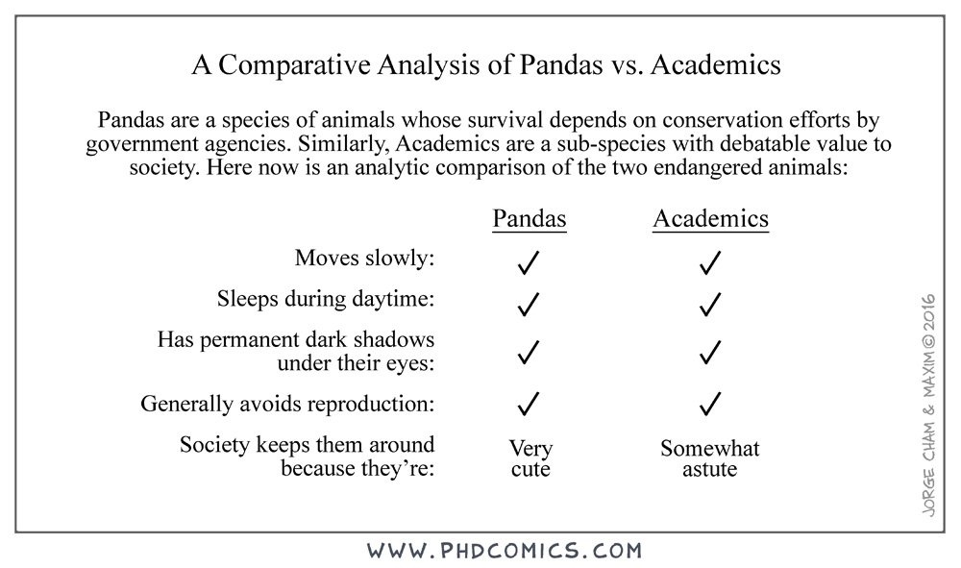

Slide 40

Notes:
By Dann Petty on Unsplash.com

