Slide 1
Diagnostics
EDUC 7610
Tyson S. Barrett, PhD
Updated by Carly Fox

Slide 2
This is one of the most important topics
The regression results’ validity depend on whether the assumptions of the model hold or not
Assumptions of the model:
Linear relationship
Homoscedasticity of residuals
Normally-distributed residuals with mean 0
No omitted variables
Independence of residuals
Variance of X > 0
✅
❌
HOLDS?
VIOLATED?
Notes:
library(tidyverse)
set.seed(843)
df <- data_frame(
x1 = runif(100),
x2 = rbinom(100, 1, .5),
y = x1 + x2 + 2*x1*x2 + rnorm(100)
)
df %>%
mutate(x2_cat = factor(x2)) %>%
ggplot(aes(x1, y, group = x2_cat, color = x2_cat)) +
geom_point() +
geom_smooth(method = "lm")

Slide 3
This is one of the most important chapters
The regression results validity depend on whether the assumptions of the model hold or not
Violations usually occur because of Extreme Cases
High Leverage
High Influence
High Distance
Notes:
Terminology is not standardized which can make communicating these three issues more difficult

Slide 4
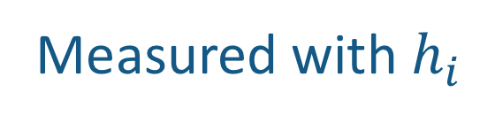
Leverage
The atypicalness of a case’s pattern of values on the regressors in the model
A point with high leverage could be:
A 55-year-old pregnant female
A high-income individual receiving welfare assistance
In a general population, is being 55 strange by itself? What about pregnant?
In a general population, is having a high-income strange by itself? What about being on welfare assistance?
We must consider the combination of the variables to know if it has high leverage
Measured with $h_{i}$
“case i’s hat value”
Notes:
Can be used to adjust for heteroscedasticity (page 624)

Slide 5
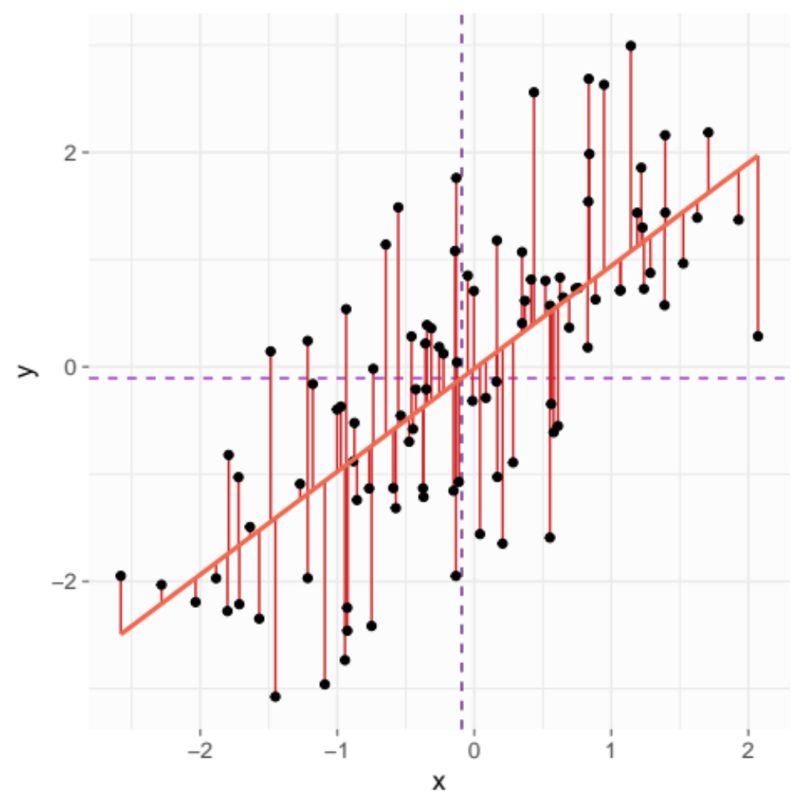
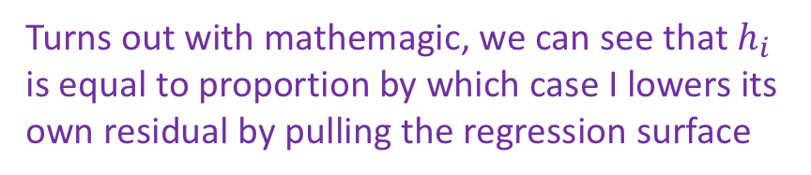
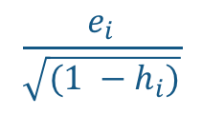
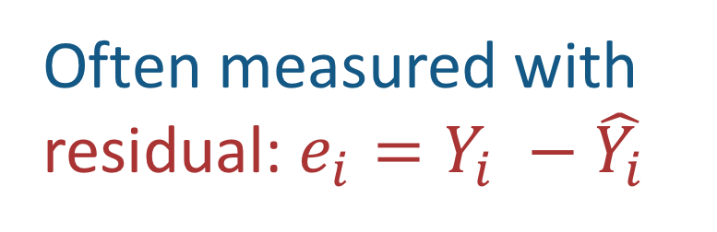
Distance
How far case i’s $Y_{i}$ value deviates from ${\hat{Y}}_{i}$
Often measured with residual: $e_{i}=Y_{i} −\hat{Y_{i}}$
But an outlier pulls the $\hat{Y_{i}}$ so we can adjust it using $h_{i}$
$$\frac{e_{i}}{\sqrt{(1 −h_{i})}}$$
Turns out with mathemagic, we can see that $h_{i}$ is equal to proportion by which case I lowers its own residual by pulling the regression surface

Slide 6
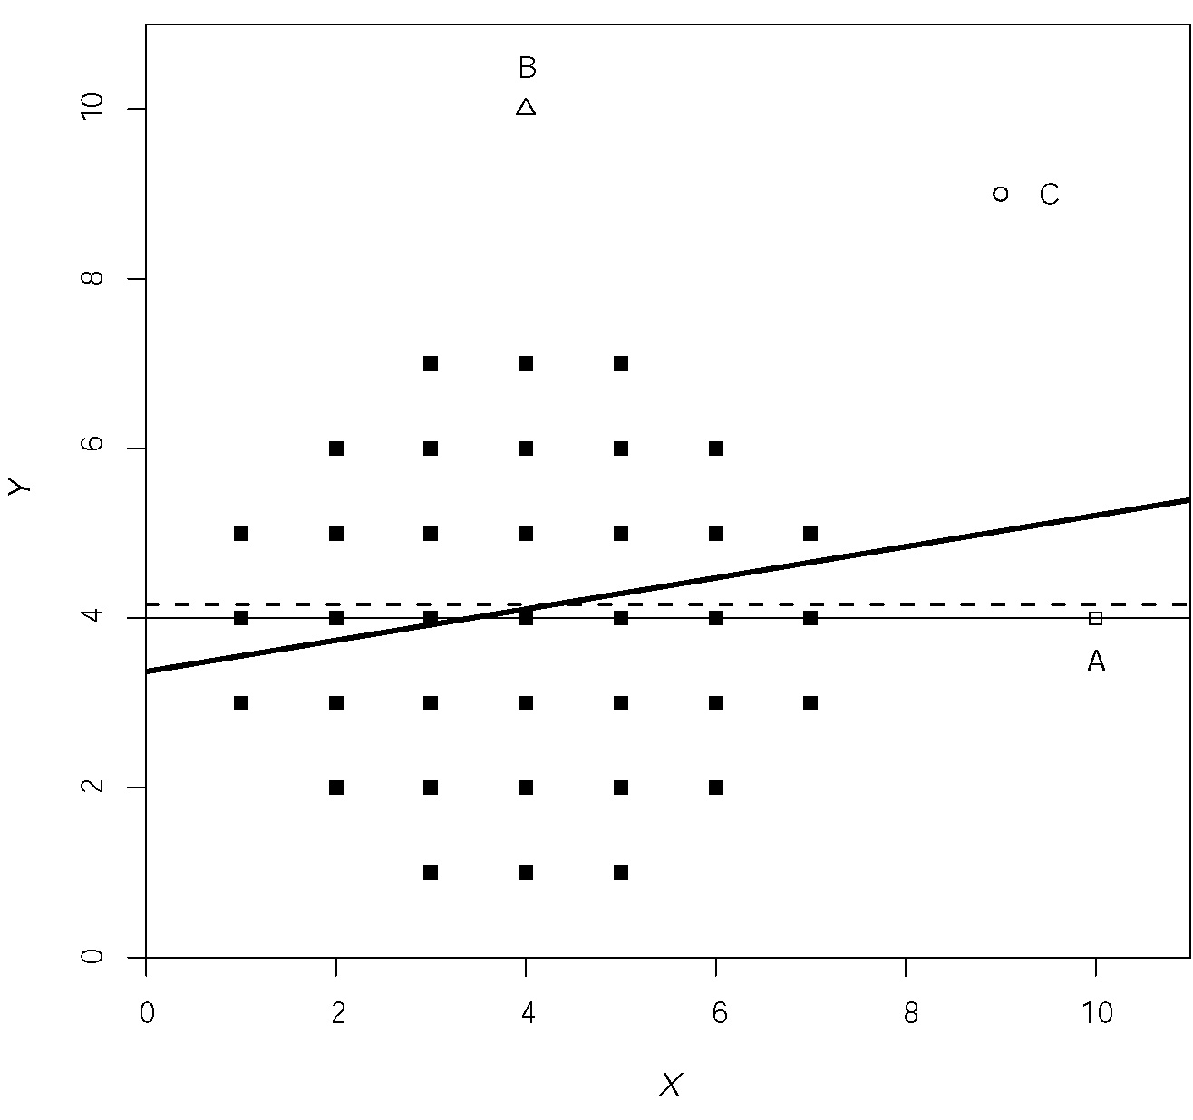
Influence
The extent to which its inclusion changes the regression solution or some aspect of it
Which extreme point (A, B, or C) changes the solution the most?

Slide 7
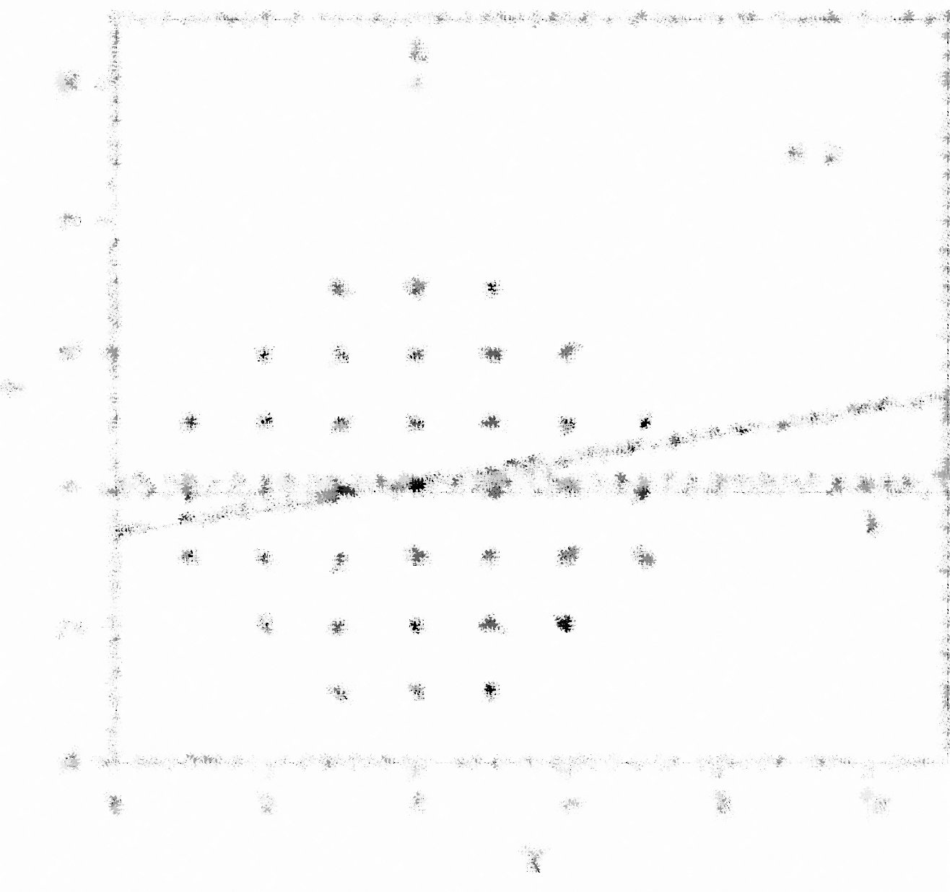
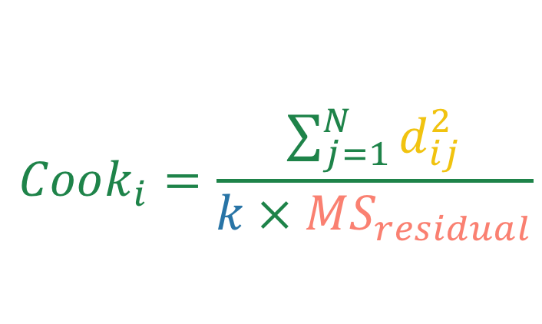
Influence
The extent to which its inclusion changes the regression solution or some aspect of it
Which extreme point (A, B, or C) changes the solution the most?
Measured with Cook’s Distance
the change in the value of case j’s residual when case i is deleted from the model
$$Cook_{i}=\frac{\sum_{j=1}^{N}{d_{ij}^{2}}}{k × MS_{residual}}$$
number of regressors
The error variance from the model
Notes:
Total is how it affects all coefficients
Partial is how it affects a single coefficient

Slide 8
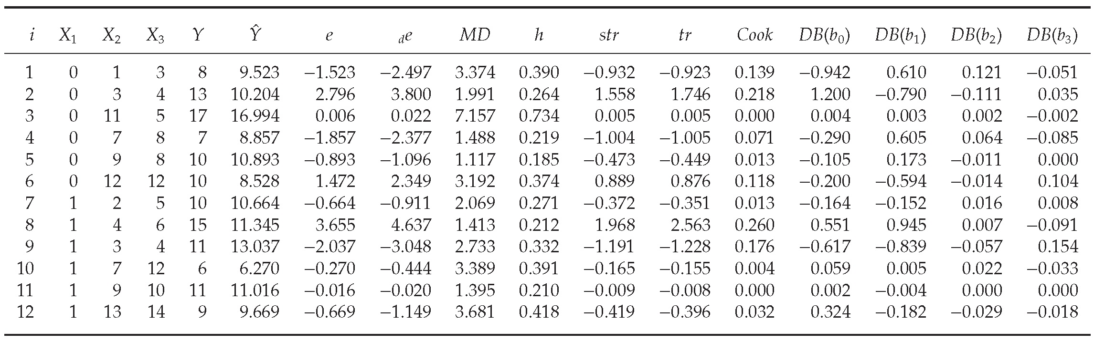
Approaching Diagnostics
Diagnostic statistics are estimates of different features of the observations
Anything look weird in this data? Any extreme values?
Eye-balling a data set (especially larger ones) is not very productive
Notes:
Page 492

Slide 9

Approaching Diagnostics
Diagnostic statistics are estimates of different features of the observations
regular residual
Instead, let’s use the diagnostics
Which has a high distance?
residual with this case removed from $Y_{i}$
Notes:
Page 492

Slide 10
Approaching Diagnostics
Diagnostic statistics are estimates of different features of the observations
Measures leverage
Which has a high leverage?
Measures leverage and ranges from 1/N to 1
Notes:
Page 492

Slide 11
Approaching Diagnostics
Diagnostic statistics are estimates of different features of the observations
Measures influence
Which has a high influence?
Notes:
Page 492

Slide 12
Assumptions
We’ve already talked about four basic assumptions of regression, we make explicit two implicit ones below
Assumptions of the model:
Linear relationship
Homoscedasticity of residuals
Normally-distributed residuals with mean 0
No omitted variables
Independence of residuals
Variance of X > 0
Note: there are a lot of “tests” for these assumptions but they usually have their own assumptions so we won’t discuss them here
Notes:
What movie is that picture from?

Slide 13
Assumptions
We’ve already talked about four basic assumptions of regression, we make explicit two implicit ones below
Assumptions of the model:
Linear relationship
Homoscedasticity of residuals
Normally-distributed residuals with mean 0
No omitted variables
Independence of residuals
Variance of X > 0
Omitted variables is largely theoretically based
Can show up as weird residuals (maybe we are missing an effect)
Remember discussion on Omitted Variable Bias
We’ll see this in the next slide
This is easy to test: are there at least two values in X?

Slide 14
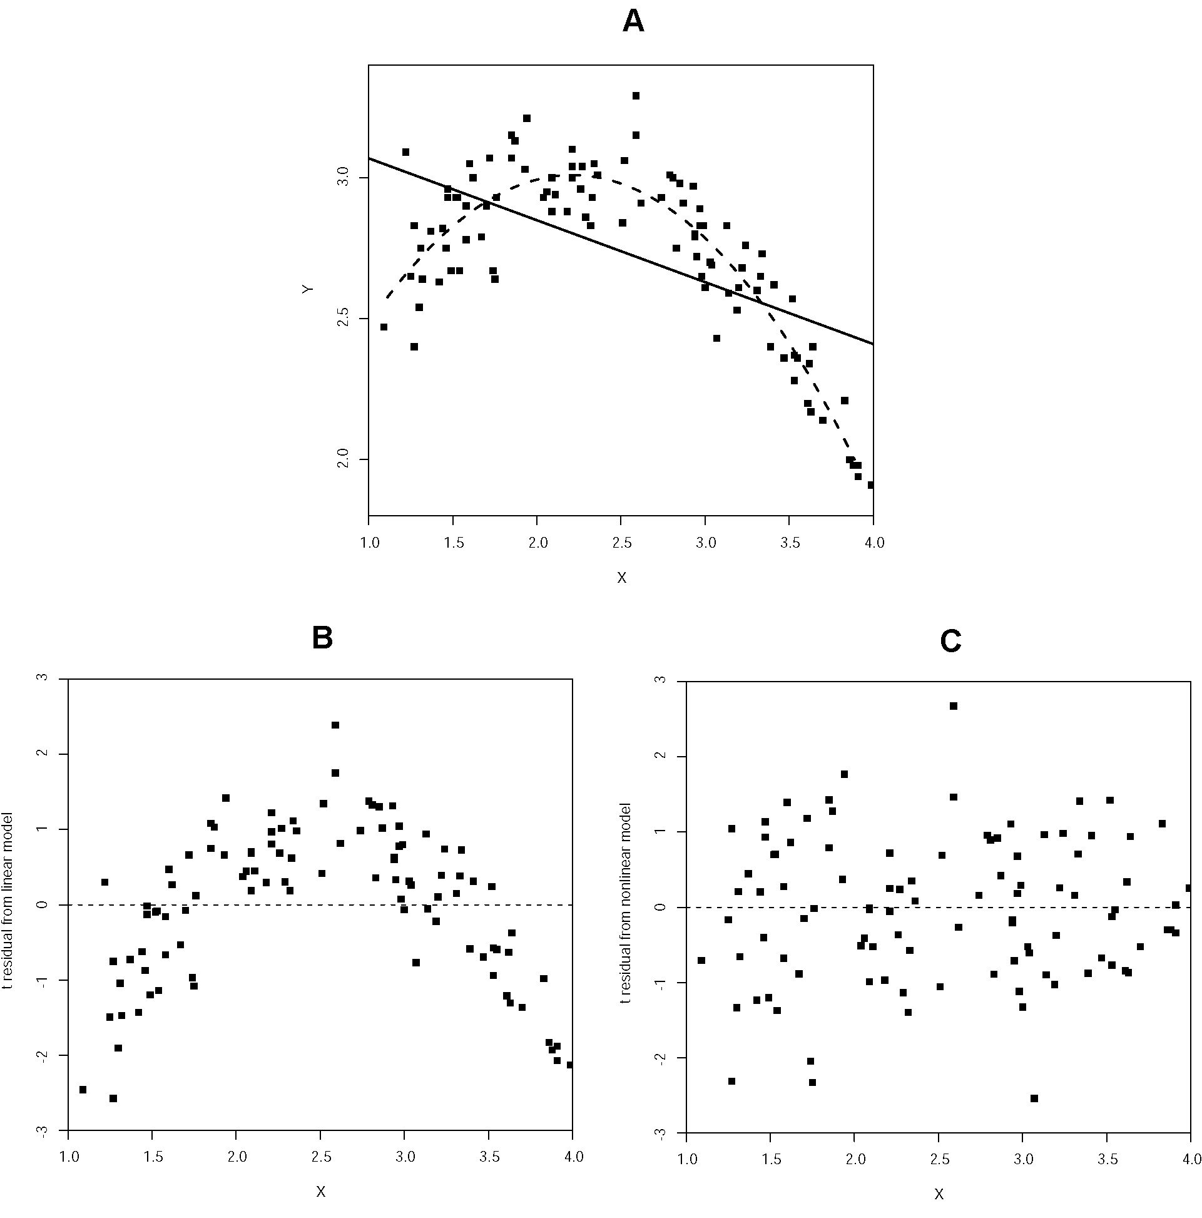
Assumptions
The book provides four basic assumptions of regression, we make explicit two implicit ones below
Assumptions of the model:
Linear relationship
Homoscedasticity of residuals
Normally-distributed residuals with mean 0
No omitted variables
Independence of residuals
Variance of X > 0
Residuals were not good until we added a quadratic effect (omitted variable bias)
Use a scatterplot of t-residuals against X

Slide 15
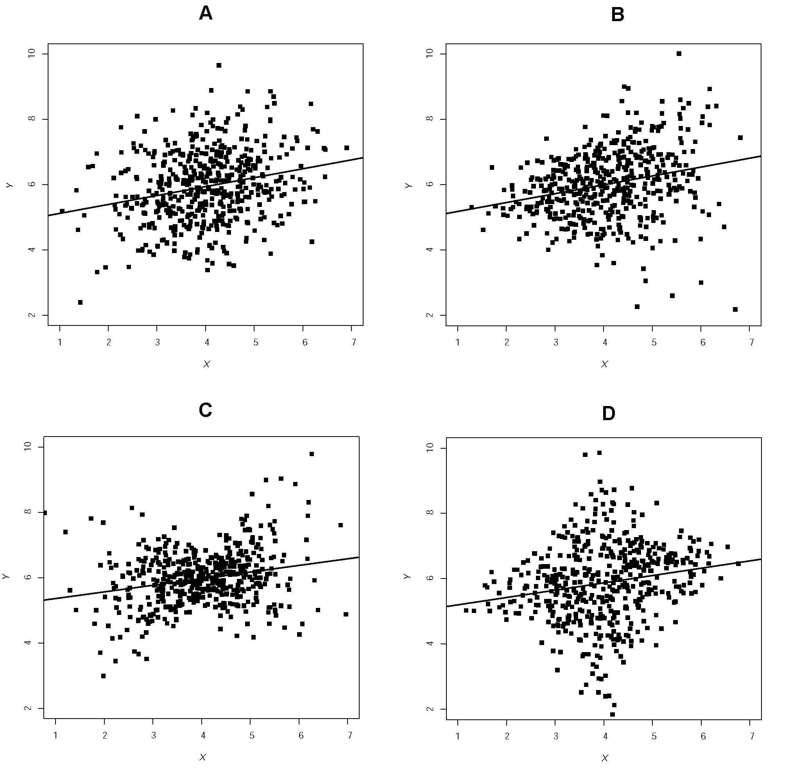
Assumptions
The book provides four basic assumptions of regression, we make explicit two implicit ones below
Assumptions of the model:
Linear relationship
Homoscedasticity of residuals
Normally-distributed residuals with mean 0
No omitted variables
Independence of residuals
Variance of X > 0
Scatterplots of residuals on X or Y on X

Slide 16
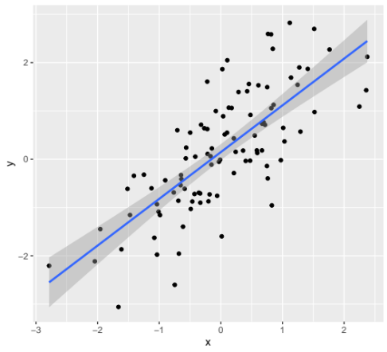
Assumptions
The book provides four basic assumptions of regression, we make explicit two implicit ones below
Assumptions of the model:
Linear relationship
Homoscedasticity of residuals
Normally-distributed residuals with mean 0
No omitted variables
Independence of residuals
Variance of X > 0
This one is somewhat tricky but important:
The residuals at each point of x are normally distributed is the assumption
Are more points closer to the line than far away?
Notes:
library(tidyverse)
data <- data_frame(
x = rnorm(100),
y = x + rnorm(100)
)
data %>%
ggplot(aes(x, y)) +
geom_point() +
geom_smooth(method = "lm")
lm(y ~ x, data = data) %>%
plot()

Slide 17
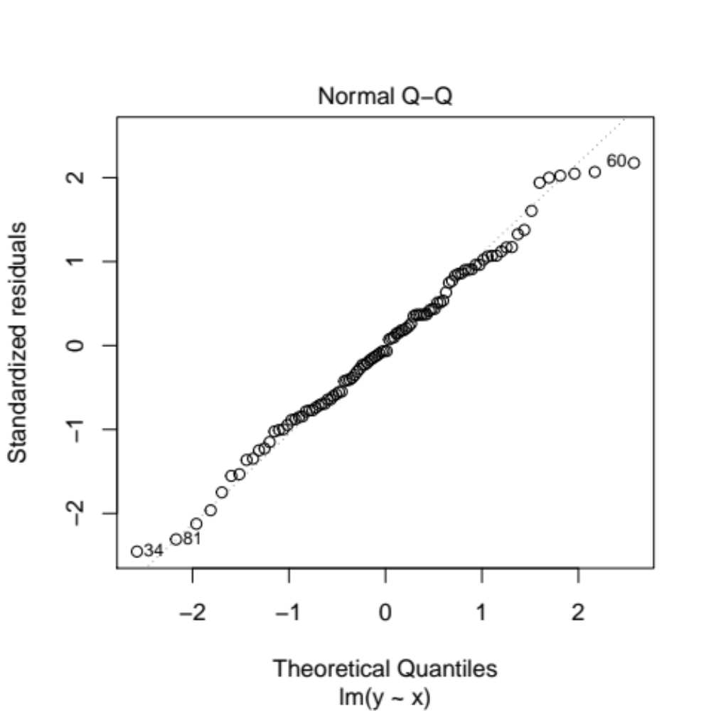
Assumptions
The book provides four basic assumptions of regression, we make explicit two implicit ones below
Assumptions of the model:
Linear relationship
Homoscedasticity of residuals
Normally-distributed residuals with mean 0
No omitted variables
Independence of residuals
Variance of X > 0
This one is somewhat tricky but important:
The residuals at each point of x are normally distributed is the assumption
Are more points closer to the line than far away?
Usually tested with a Q-Q plot

Slide 18
Assumptions
The book provides four basic assumptions of regression, we make explicit two implicit ones below
Assumptions of the model:
Linear relationship
Homoscedasticity of residuals
Normally-distributed residuals with mean 0
No omitted variables
Independence of residuals
Variance of X > 0
Generally theoretical in nature
Are the observations (participants) independent?
Are the observations connected in some way?
Time-series almost always violate this assumption because previous time points are correlated with current ones
In many cases, we can use Multilevel Modeling here

Slide 19
Dealing with Irregularities
There are generally four basic ways to deal with irregularities, we add a fifth
Correction
Correct the error that lead to the extreme value
Robustification
Use an alternative approach that is less sensitive to the extreme value
Transformation
Transform the outcome or predictors using a monotonic transformation (log, square root, etc.)
Generalized Linear Models
A family of approaches that can assess categorical, ordinal, and otherwise strange outcomes
we’ll discuss them much more in the following units
Elimination
Remove the extreme value
I recommend if you do this to report the results both with and without the extreme value in any publication

Slide 20
Let’s Try an Example…
Let’s say our friend the child language researcher now wants to see if story length (outcome) can be predicted by narrative quality (predictor); this time they decide to use sentence count as their measure of length (why not)
lm(Sentence_count ~ StoryGrammar, data = Nars)%>%
summary()
Coefficients:
Estimate Std. Error t value Pr(>|t|)
(Intercept) 2.410 0.606 3.975 8.69e-05***
StoryGrammar 0.950 0.067 14.222 < 2e-16***
Wow! That p-value
is basically 0, but before we get too excited, let’s check the residuals

Slide 21
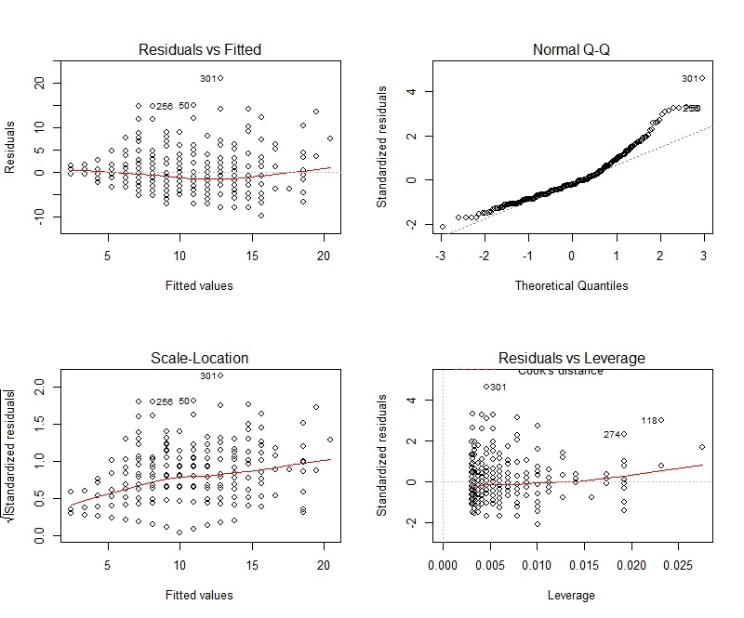
Uh oh, that
doesn’t look like
a normal
distribution
There are also
some extreme
outliers and
leverage points…
And some
evidence of
heteroscedasticity

Slide 22
So what can we do?
Let’s try applying a log transformation, this can help with normalizing distributions, heteroscedasticity and sometimes extreme points
lm(log(Sentence_count) ~ StoryGrammer, data = Nars) %>%
summary()
Coefficients:
Estimate Std. Error t value Pr(>|t|)
(Intercept) 1.367 0.058 23.63 <2e-16***
StoryGrammar 0.097 0.006 15.26 <2e-16***
Great! The relationship is still statistically significant, but let’s go check those residuals…
Note. The estimate is not interpretable in the same way now that it has had log transformation

Slide 23
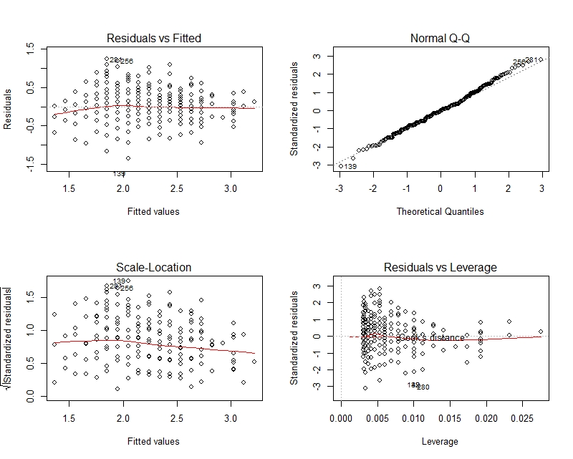
The residuals
look much more
normally
distributed!
There are still
some leverage
points, but none
fall outside of 3
SDs
The line is closer
to a horizontal,
and shows better
homoscedasticity
of residuals

Slide 24
Note…
In this case, a log transformation worked pretty well in addressing the violated assumptions
BUT, this often won’t be the case (depending on the data) and may require more data manipulation or alternative methods (e.g., robustification, generalized linear models)
However, this hopefully highlighted the importance of PLOTTING YOUR RESIDUALS and NEVER assuming your data has not violated assumptions
  In this example, the significance of the results did not change, but this won’t always be the case, violating assumptions can lead to both false positive and false negatives

Slide 25
Robustification
Use an alternative approach that is less sensitive to the extreme value
Two main ways of robustifying
1
Use alternative way of estimating coefficients
2
Use alternative way of estimating the standard error (or, more generally speaking, the uncertainty)
We’ll talk about this one

Slide 26
Robustification
Use an alternative approach that is less sensitive to the extreme value
Heteroscedasticity-Consistent Standard Errors
Bootstrapping
Permutation
Adjusts the SE’s to be less sensitive to extreme values using sandwich estimators
Resamples from the sample with replacement to come up with an empirical distribution of the estimate
Can obtain SE’s, CI’s, and p-values
Works with any statistic
Randomly shuffles the data and re-runs the model many times
The proportion of these shuffled models that are as big or bigger than the original model gives us info on p-values
Works with any statistic
They are consistent (gets closer and closer to the right value as sample size increases)
Many versions, HC3 and HC4 are best

Slide 27
Robustification
Use an alternative approach that is less sensitive to the extreme value
Heteroscedasticity-Consistent Standard Errors
Bootstrapping
Permutation
Adjusts the SE’s to be less sensitive to extreme values using sandwich estimators
Resamples from the sample with replacement to come up with an empirical distribution of the estimate
Can obtain SE’s, CI’s, and p-values
Works with any statistic
Randomly shuffles the data and re-runs the model
The proportion of these shuffled models that are as big or bigger than the original model gives us info on p-values
Works with any statistic
Can use whether or not homoscedasticity exists
They are consistent (gets closer and closer to the right value as sample size increases)
Many versions, HC3 and HC4 are best

Slide 28
Remember:
No model is “correct” but some models are useful

Slide 29
Check Out These Resources!
Blogpost Explaining Bootstrapping vs Permutation Testing:
https://mattkmiecik.com/post-Bootstrapping-and-Permutation-Testing-Shiny-App.html
Outliers vs High Leverage Observations Explained:
https://online.stat.psu.edu/stat462/node/170/
Data Transformations in R & When to Use them:
https://www.datanovia.com/en/lessons/transform-data-to-normal-distribution-in-r/

Slide 30
Assumptions…

Slide 31
Notes:
Escalante Petrified Forest State Park

