Slide 1
Interactions (Moderation)
EDUC 7610
Tyson S. Barrett, PhD
Updates by Carly Fox

Slide 2
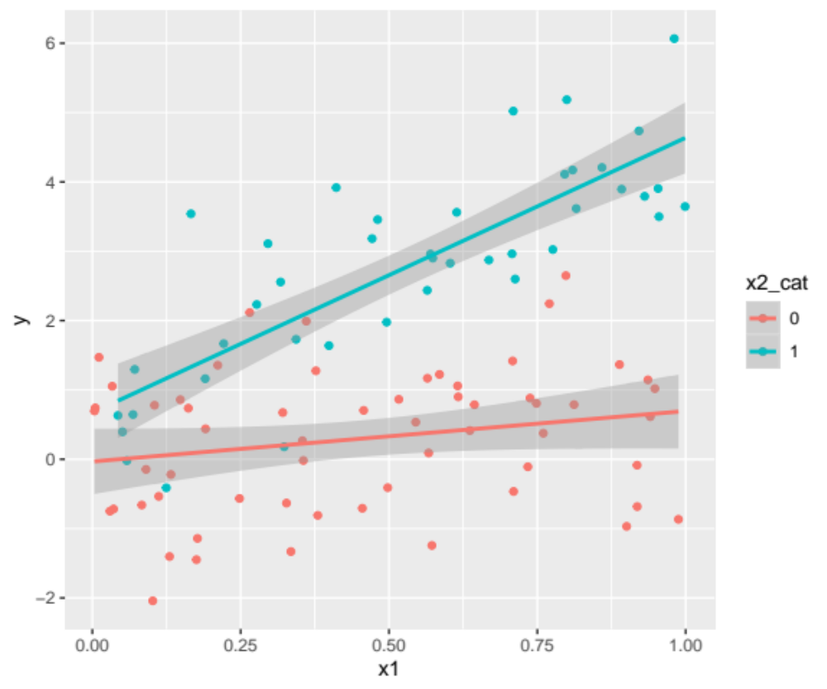
What is meant by “interaction”?
When the relationship between a predictor and the outcome depends on another variable
Also called “moderation”
When called moderation, one of the variables is called the moderator
This is an example of an interaction between a continuous predictor and a dichotomous moderator
Notes:
library(tidyverse)
set.seed(843)
df <- data_frame(
x1 = runif(100),
x2 = rbinom(100, 1, .5),
y = x1 + x2 + 2*x1*x2 + rnorm(100)
)
df %>%
mutate(x2_cat = factor(x2)) %>%
ggplot(aes(x1, y, group = x2_cat, color = x2_cat)) +
geom_point() +
geom_smooth(method = "lm")

Slide 3
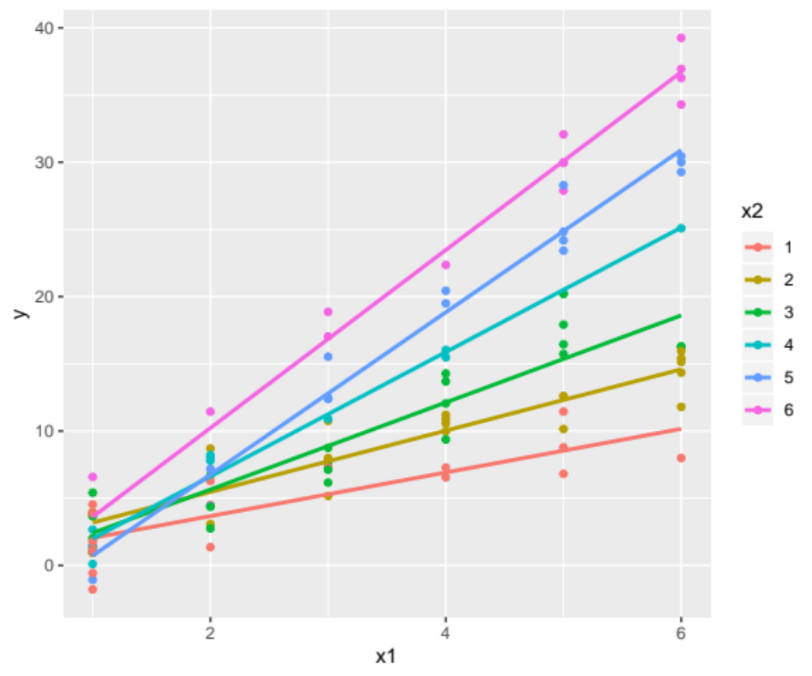
The Symmetry of Interaction
Either variable can be considered the “predictor” and the “moderator”
  Usually depends on the research question/story to be told
  The interpretation still means the same thing but can sound very different
Notes:
library(tidyverse)
set.seed(843)
df <- data_frame(
x1 = runif(100),
x2 = rbinom(100, 1, .5),
y = x1 + x2 + 2*x1*x2 + rnorm(100)
)
df %>%
mutate(x2_cat = factor(x2)) %>%
ggplot(aes(x1, y, group = x2_cat, color = x2_cat)) +
geom_point() +
geom_smooth(method = "lm")

Slide 4
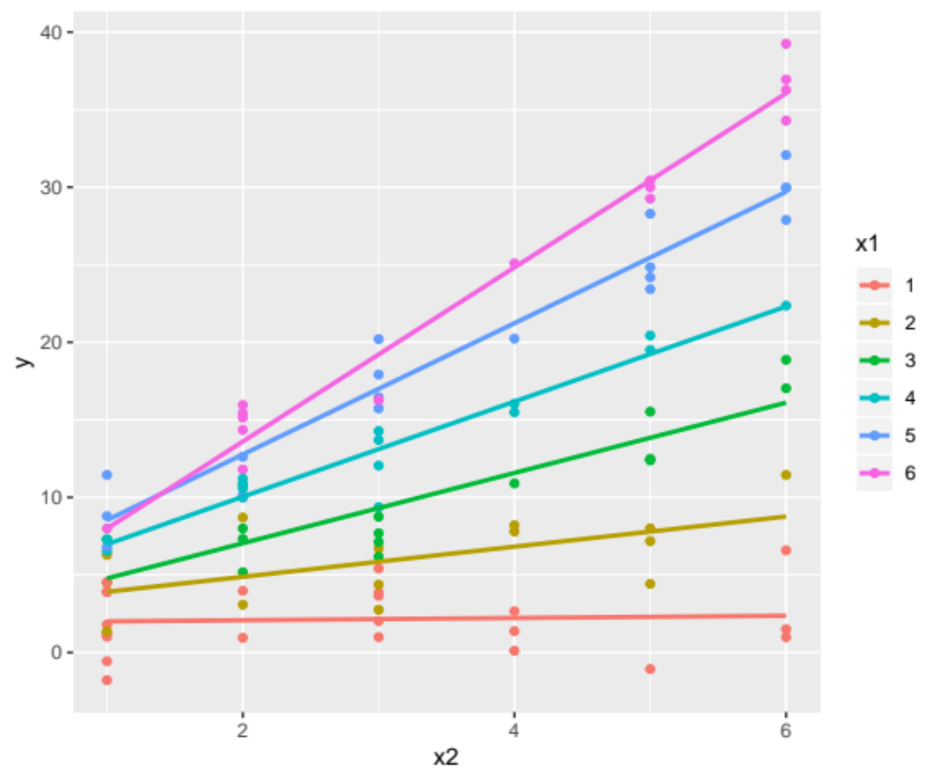
The Symmetry of Interaction
Either variable can be considered the “predictor” and the “moderator”
  Usually depends on the research question/story to be told
  The interpretation still means the same thing but can sound very different
Same interaction, different predictor/moderator distinction
Notes:
library(tidyverse)
set.seed(843)
df <- data_frame(
x1 = runif(100),
x2 = rbinom(100, 1, .5),
y = x1 + x2 + 2*x1*x2 + rnorm(100)
)
df %>%
mutate(x2_cat = factor(x2)) %>%
ggplot(aes(x1, y, group = x2_cat, color = x2_cat)) +
geom_point() +
geom_smooth(method = "lm")

Slide 5
Types of Interactions
Two-way interactions can be between:
Two numeric variables
A dichotomous variable and a numeric variable
Two dichotomous variables
A multi-categorical variable and a numeric variable
Two multi-categorical variables

Slide 6
Types of Interactions
Two-way interactions can be between:
Two numeric variables
A dichotomous variable and a numeric variable
Two dichotomous variables
A multi-categorical variable and a numeric variable
Two multi-categorical variables
Examples
The effect of the treatment on the outcome may depend on the sex of the participant
The effect of smoking on heart condition may depend on age
The effect of education on income may depend on the economic climate
Could we reverse the way that we said each of these?
Yes

Slide 7
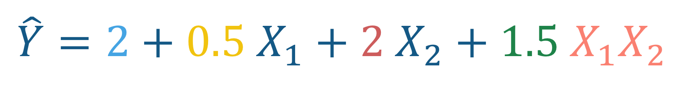
General interpretation of coefficients
Doesn’t matter if they are numeric or categorical
$$\hat{Y}=2+0.5 X_{1}+2 X_{2}+1.5 X_{1}X_{2}$$

Slide 8
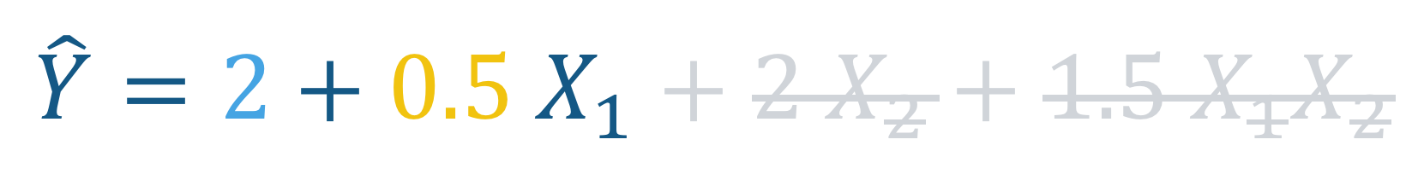
General interpretation of coefficients
Doesn’t matter if they are numeric or categorical
When X₂ is zero:
$$\hat{Y}=2+0.5 X_{1}+2 X_{2}+1.5 X_{1}X_{2}$$
Meaning when X₂ is zero, the effect of a one unit increase in X₁ is associated with a 0.5 unit increase in Y

Slide 9
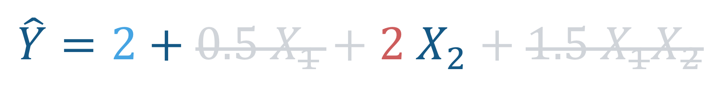
General interpretation of coefficients
Doesn’t matter if they are numeric or categorical
When X₁ is zero:
$$\hat{Y}=2+0.5 X_{1}+2 X_{2}+1.5 X_{1}X_{2}$$
Meaning when X₁ is zero, the effect of a one-unit increase in X₂ is associated with a 2 unit increase in Y

Slide 10
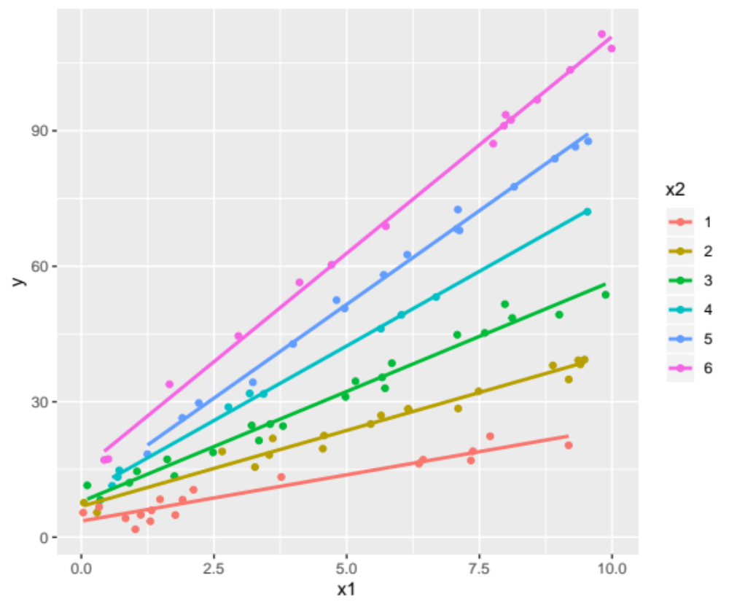
General interpretation of coefficients
Doesn’t matter if they are numeric or categorical
The difference in the slopes is 1.5 on average
$$\hat{Y}=2+0.5 X_{1}+2 X_{2}+1.5 X_{1}X_{2}$$
All of these interpretations can be with additional covariates, “holding the covariates constant”

Slide 11
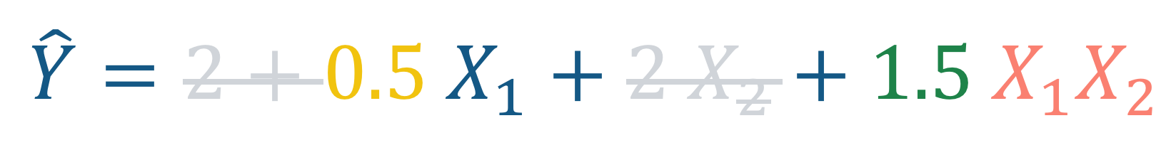
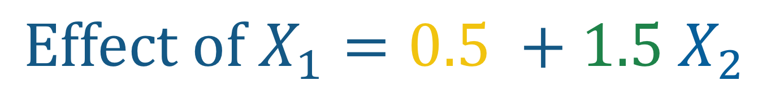
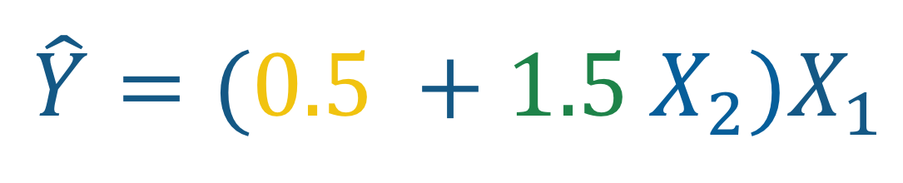
General interpretation of coefficients
Doesn’t matter if they are numeric or categorical
The total effect of X₁ is:
$$\hat{Y}=2+0.5 X_{1}+2 X_{2}+1.5 X_{1}X_{2}$$
$$\hat{Y}=(0.5 +1.5 X_{2})X_{1}$$
$$Effect of X_{1}=0.5 +1.5 X_{2}$$

Slide 12
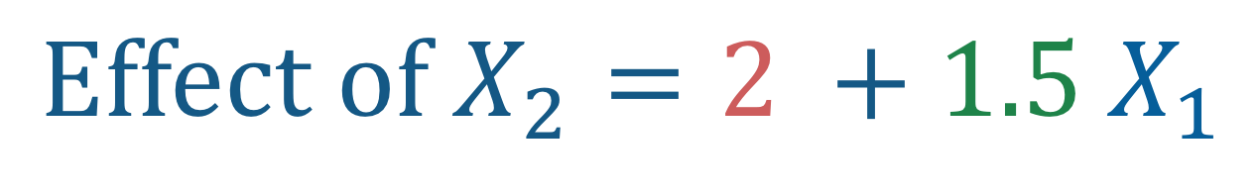
General interpretation of coefficients
Doesn’t matter if they are numeric or categorical
The total effect of X₁ is:
The same idea holds for the effect of X₂
$$\hat{Y}=2+0.5 X_{1}+2 X_{2}+1.5 X_{1}X_{2}$$
$$\hat{Y}=(0.5 +1.5 X_{2})X_{1}$$
$$Effect of X_{2}=2 +1.5 X_{1}$$
$$Effect of X_{1}=0.5 +1.5 X_{2}$$

Slide 13

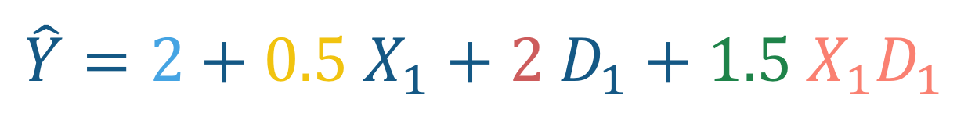
A General Example: Numeric ($X_{1}$) with Dichotomous ($D_{1}$)
$$\hat{Y}=2+0.5 X_{1}+2 D_{1}+1.5 X_{1}D_{1}$$
The conditional effect of D₁ when X₁ equals zero
Cross-product (interaction)
The intercept (the average Y value when all variables are zero)
quantifies how much the conditional effect of X₁ changes as D₁ changes by one unit
The conditional effect of X₁ when D₁ equals zero
Notes:
To make b1 and b2 more meaningful, the dummy variable should be coded as 0 and 1

Slide 14
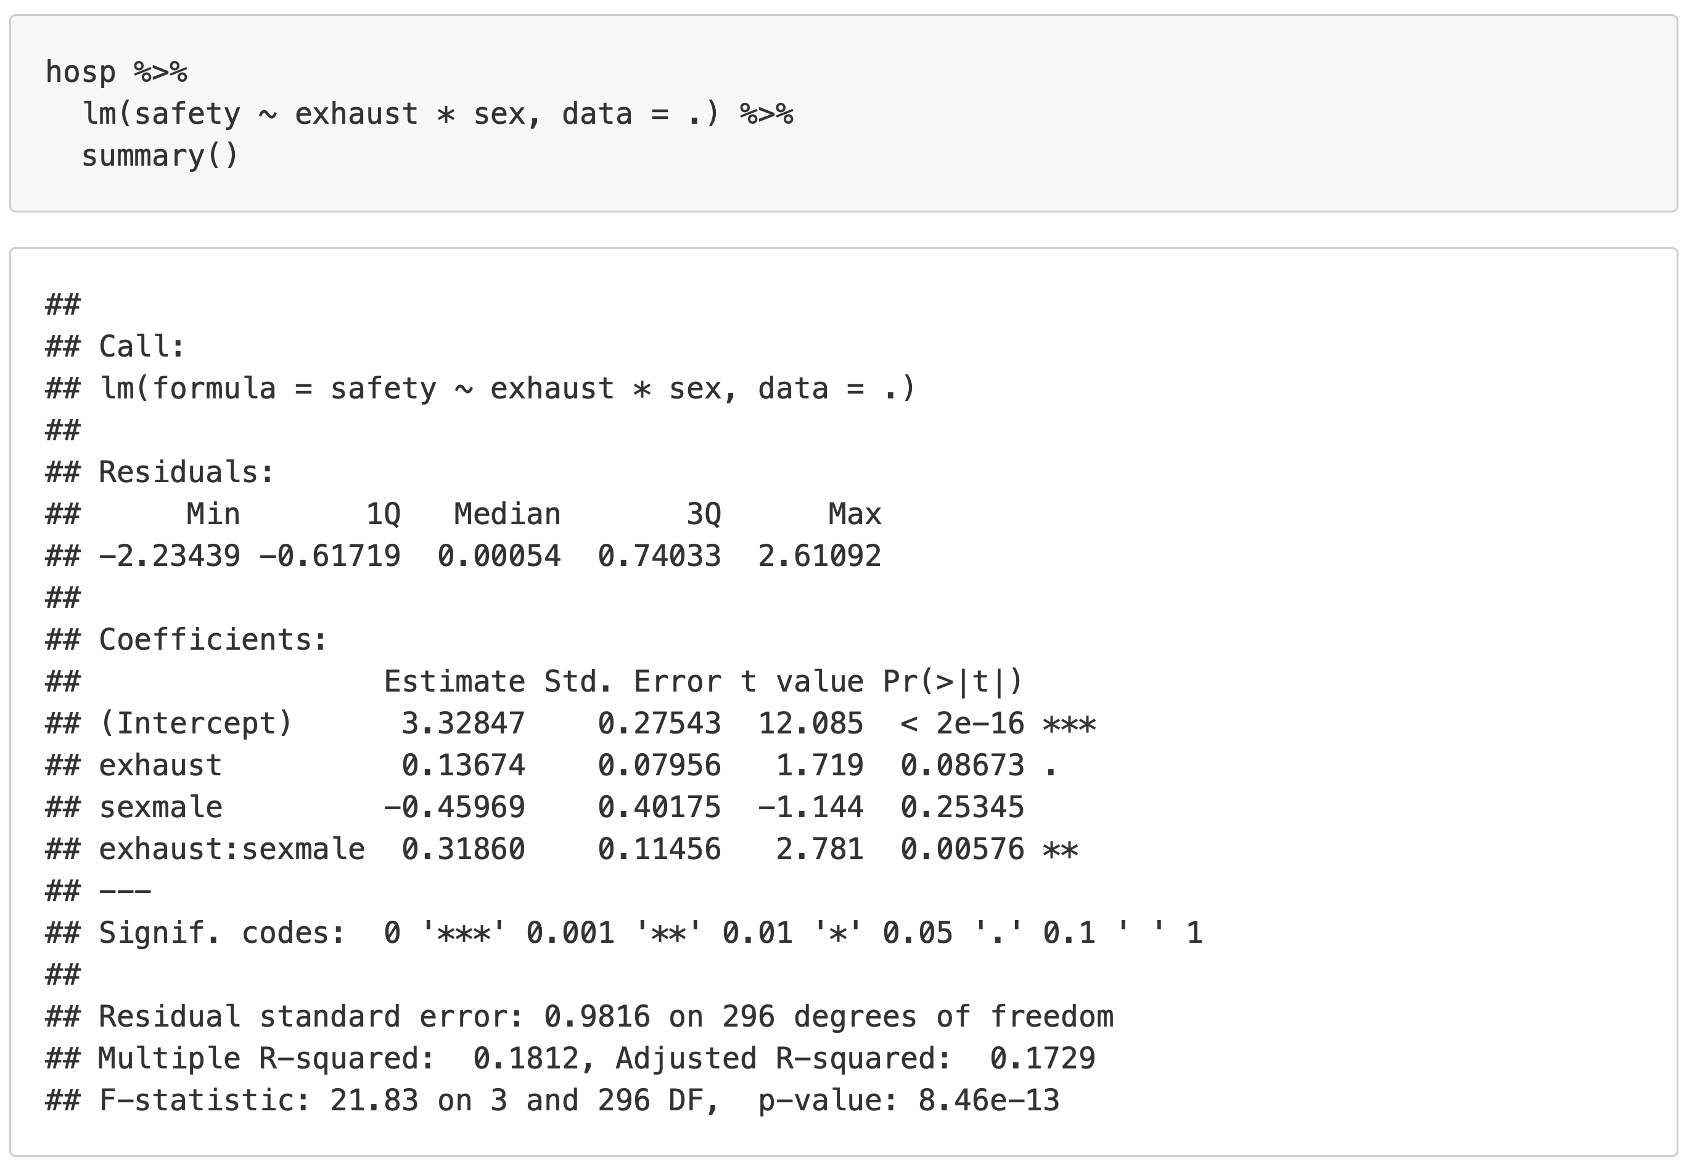
A General Example: Numeric with Dichotomous
The conditional effect of D₁ when X₁ equals zero
The intercept (the average Y value when all variables are zero)
quantifies how much the conditional effect of X₁ changes as D₁ changes by one unit
The conditional effect of X₁ when D₁ equals zero
Cross-product (interaction)
Notes:
To make b1 and b2 more meaningful, the dummy variable should be coded as 0 and 1

Slide 15
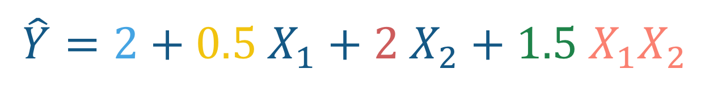
Interaction between two numeric variables
$$\hat{Y}=2+0.5 X_{1}+2 X_{2}+1.5 X_{1}X_{2}$$
The conditional effect of X₂ when X₁ equals zero
Cross-product (interaction)
The intercept (the average Y value when all variables are zero)
quantifies how much the conditional effect of X₁ changes as X₂ changes by one unit
The conditional effect of X₁ when X₂ equals zero
Notes:
The b1 and b2 are only meaningful if zero is meaningful for both X1 and X2

Slide 16
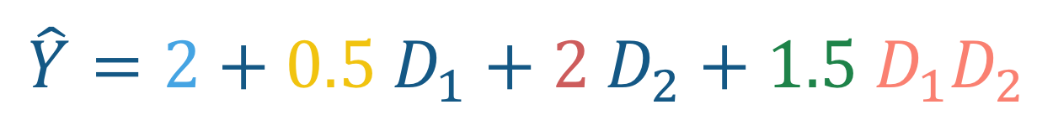
Interaction between two dichotomous variables
$$\hat{Y}=2+0.5 D_{1}+2 D_{2}+1.5 D_{1}D_{2}$$
The conditional effect of D₂ when D₁ equals zero
Cross-product (interaction)
The intercept (the average Y value when all variables are zero)
quantifies how much the conditional effect of D₁ changes as D₂ changes by one unit
The conditional effect of D₁ when D₂ equals zero

Slide 17
Recommendation: Always use a figure

Slide 18
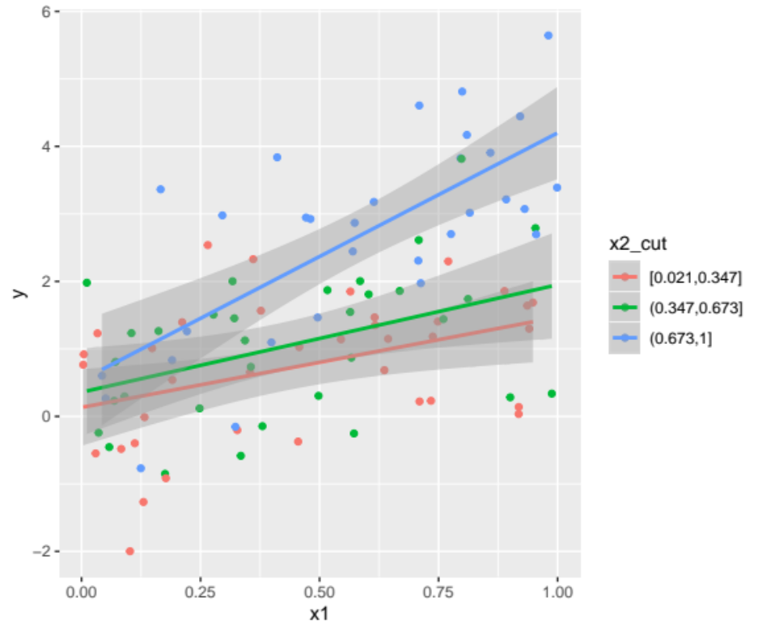
When we visualize an interaction with two numeric variable, we need to group one of them into some groups to better see it
With a numeric variable and a dichotomous variable, we use the dichotomous as the grouping variable
Notes:
library(tidyverse)
set.seed(843)
numnum <- data_frame(
x1 = runif(100),
x2 = runif(100),
y = x1 + x2 + 2*x1*x2 + rnorm(100)
)
numdum <- data_frame(
x1 = runif(100),
x2 = rbinom(100, 1, .5),
y = x1 + x2 + 2*x1*x2 + rnorm(100)
)
dumdum <- data_frame(
x1 = rbinom(100, 1, .5),
x2 = rbinom(100, 1, .5),
y = x1 + x2 + 2*x1*x2 + rnorm(100)
)
multinum <- data_frame(
x1 = runif(100),
x2 = sample(c(1,2,3), replace = TRUE, size = 100),
y = x1 + x2 + 2*x1*x2 + rnorm(100)
)
numnum %>%
mutate(x2_cut = cut_interval(x2, n = 3)) %>%
ggplot(aes(x1, y, group = x2_cut, color = x2_cut)) +
geom_point() +
geom_smooth(method = "lm")
multinum %>%
mutate(x2_cat = factor(x2,
levels = c(1,3,2),
labels = c("Group 1", "Group 2", "Group 3"))) %>%
ggplot(aes(x1, y, group = x2_cat, color = x2_cat)) +
geom_point() +
geom_smooth(method = "lm")
dumdum %>%
mutate(x2_cat = factor(x2)) %>%
ggplot(aes(factor(x1), y, group = x2_cat, color = x2_cat)) +
stat_summary() +
stat_summary(geom = "line")

Slide 19
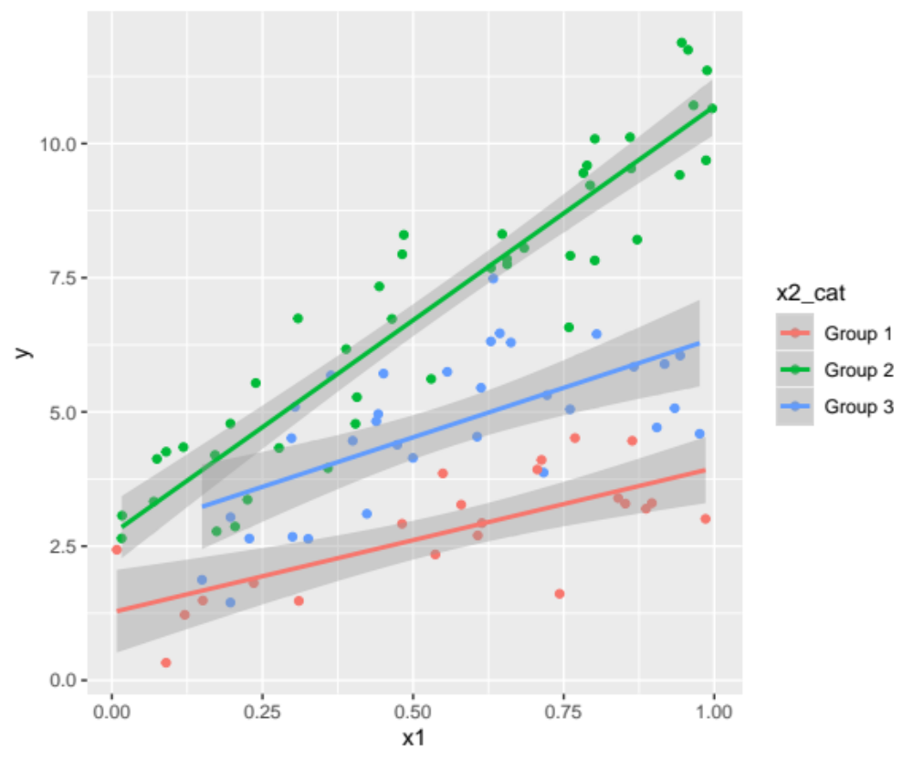
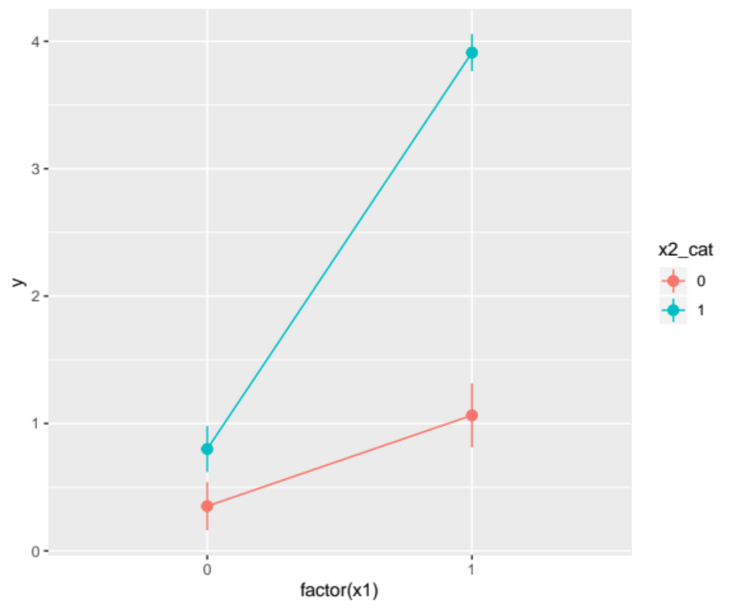
When we visualize an interaction with a numeric variable and multi-categorical, we can use the multi-cat variable as the grouping variable
With two dichotomous variables, we can use either dummy variable as the grouping variable

Slide 20
Let’s Try an Example…
You’ve been doing more binge-watching on Netflix and decide to analyze a dataset based on your new favorite show: Married at First Sight
You decide to examine whether the length of these reality TV couples’ relationships (outcome) can be predicted by their age gap (predictor), and whether this effect is moderated by which “Love Expert” the couple worked with most often on the show
Here we have a numerical variable predictor and dichotomous moderator

Slide 21
You run the interaction in R and get the Following Results…
lm(Relation_length ~ Gap * Expert, data = Mafs)
Coefficients Estimate Std. Error t value Pr(>|t|)
(Intercept) 10.565 1.903 5.554 5.80e-07***
Gap 2.864 0.437 6.555 1.11e-08***
Expert_Pepper 15.222 2.554 5.964 1.17e-07***
Gap:Expert_Pepper -4.201 0.579 -7.250 6.77e-10***
Next we plot the interaction to visualize the relationship…

Slide 22
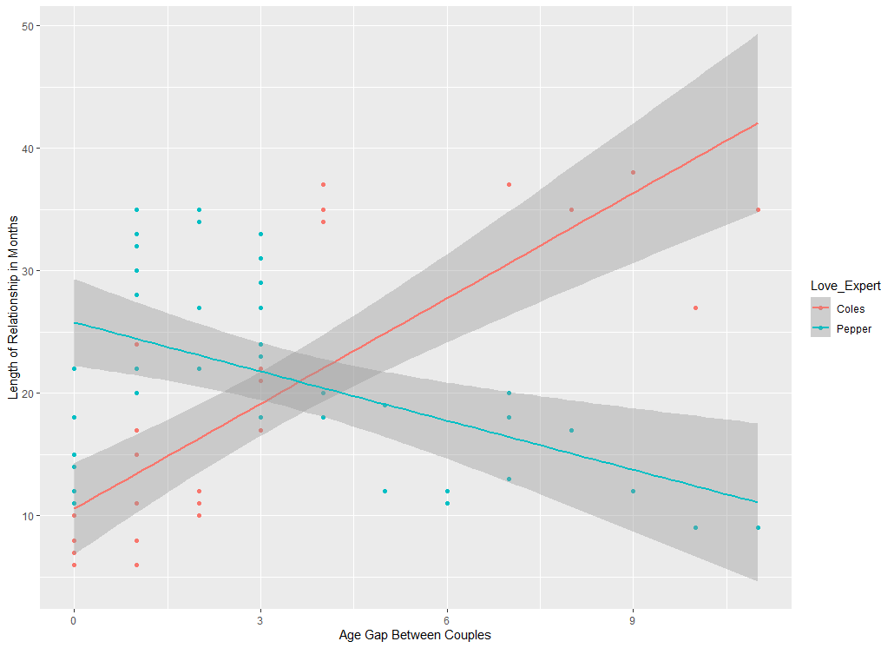
Just from
inspecting the
graph, we can
see a clear
interaction
where the
relationship
b/w age gap
and length
of couples’
relationships
appears to be
impacted by
which love
expert they
worked with

Slide 23
Interpretation
Intercept: When couples work with Dr. Coles and have 0 years of age gap, their expected relationship duration is 10.56 months
Gap: For each one year increase in age gap, there is an associated 2.86 month increase in relationship duration for couples who work with Dr. Coles
Expert_Pepper: When there is no age gap and couples work with Dr. Pepper, the expected relationship duration is 15.22 months higher than with Dr. Coles
Interaction: The effect of age gap on the length of couples’ relationships decreases by 4.20 months when couples’ work with Dr. Pepper compared to when they work with Dr. Coles
In other words, age gap has differential associations with the length of couples’ relationships, depending on which “Love Expert” they worked with on the show

Slide 24
More about interpretation
To make b₁ and b₂ more meaningful, we can shift the center of the predictor/moderator
E.g., we can mean center the variables which makes b₁ and b₂ the effect of the predictor/moderator when the other is at its mean
  This is the conditional effect of the variable at the other variable’s mean
The conditional effect means the effect conditional on the other variable being a certain value

Slide 25
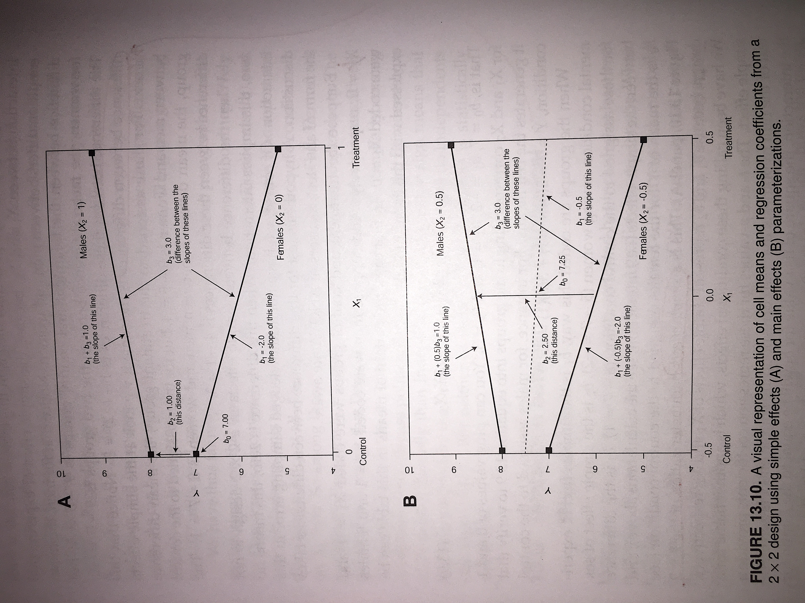
Difference between Regression and ANOVA
There are several similarities (and ultimately are the same) with some minor differences
Regression
ANOVA
Notes:
Only applies to categorical x categorical interactions

Slide 26
Difference between Regression and ANOVA
There are several similarities (and ultimately are the same) with some minor differences
Regression
ANOVA
Dummy Coding
Effect Coding
Notes:
Page 406
Only applies to categorical x categorical interactions

Slide 27
Probing an Interaction
Lots of info, what to focus on?
Lots of information we can glean from a model with an interaction
But much of it relies on p-values and can get excessive
Almost always, a figure can highlight all the important factors more easily, simply, and clearly
  A figure with some specific details is usually the best way to interpret it
  When you have two numeric variables interacting, using the Johnson-Neyman approach is great

Slide 28
More about Conditional Effects
Numeric
Dichotomous
Multi-Categorical
We can center a variable around any value and test if the conditional effect is different than zero
We can switch the reference group by centering it with -1 (if coded 0 and 1)
Like dichotomous, we can switch the reference group by subtracting the value of the group (for group = 2 use -2)
E.g., what is the effect of age on heart disease when the person is a smoker? What about if they aren’t?
E.g., what is the effect of hearing loss on income when age is 20? How about 40? 60?
E.g., what is the effect of liberal views on voting behavior when the individual is black? Asian-American?
Johnson-Neyman Technique does this many times looking for areas of significant differences and non-significant ones (for numeric interactions)
https://cran.r-project.org/web/packages/interactions/vignettes/interactions.html#simple_slopes_analysis_and_johnson-neyman_intervals
Notes:
No need to compare conditional effects – the interaction’s significance tells us everything we need to know about it
https://cran.r-project.org/web/packages/interactions/vignettes/interactions.html#simple_slopes_analysis_and_johnson-neyman_intervals

Slide 29
Issues with Detecting/Interpreting an Interaction
Interactions are difficult to accurately detect
It is low powered
  Easier to detect in experiments
Is it curvilinear or interacting?
Transformations of Y can greatly impact an interaction
No “main effects” in model like in ANOVA
Myths Get Busted (i.e., the truth is stated below):
  Don’t need to mean-center predictors in interaction
  Don’t need to build model hierarchically
  Don’t need to categorize variables in interaction

Slide 30
Read More Here!
Interpreting Interaction Effects:
https://www.theanalysisfactor.com/interpreting-interactions-in-regression/
Interactions between Categorical and Continuous Variables:
https://www.theanalysisfactor.com/interactions-categorical-and-continuous-variables/
Simple Slopes Analysis and Johnson Neyman Intervals in R:
https://cran.r-project.org/web/packages/interactions/vignettes/interactions.html#simple_slopes_analysis_and_johnson-neyman_intervals

Slide 31
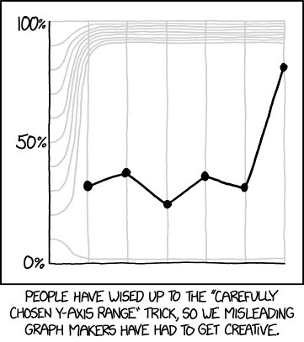
Don’t fall for all their tricks!

Slide 32

Notes:
By Benjamin Davies on Unsplash.com

