Slide 1
Nonlinear Relationships
EDUC 7610
Tyson S. Barrett, PhD
Updated by Carly Fox

Slide 2
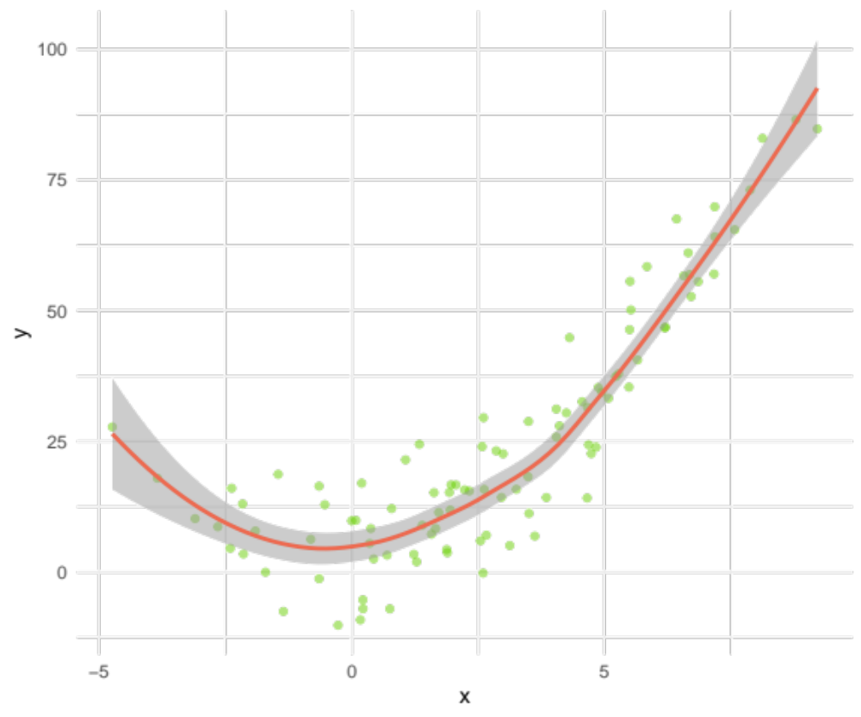
What is meant by “nonlinear”?
When the relationship between a predictor and the outcome isn’t represented well by a straight line
This is an example of a quadratic effect
Notes:
library(tidyverse)
set.seed(843)
df <- data_frame(
x = rnorm(100, 3, 3),
x2 = x^2,
y2 = x + x2 + rnorm(100,5,8),
ysqrt = sqrt(abs(x)) + rnorm(100,2,1)
)
ggplot(df, aes(x,y2)) +
geom_point(color = "chartreuse3",
alpha = .5) +
geom_smooth(formula = y ~ x + x^2,
color = "coral2",
alpha = .5) +
theme_minimal()

Slide 3
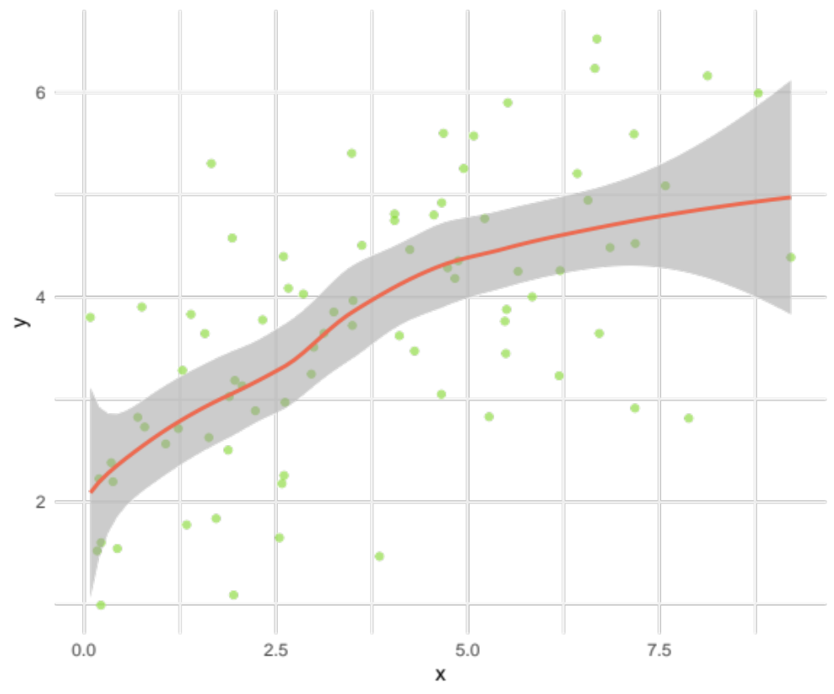
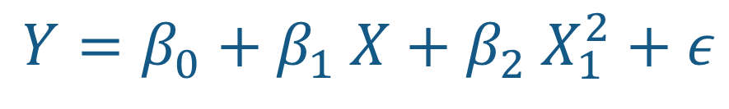
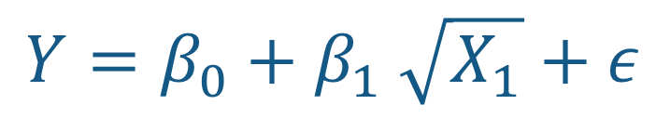
Two examples of nonlinear relations
$$Y=β_{0}+β_{1} \sqrt{X_{1}}+ε$$
$$Y=β_{0}+β_{1} X+β_{2} X_{1}^{2}+ε$$
Notes:
library(tidyverse)
set.seed(843)
df <- data_frame(
x = rnorm(100, 3, 3),
x2 = x^2,
y2 = x + x2 + rnorm(100,5,8),
ysqrt = sqrt(abs(x)) + rnorm(100,2,1)
)
ggplot(df, aes(x,y2)) +
geom_point(color = "chartreuse3",
alpha = .5) +
geom_smooth(formula = y ~ x + x^2,
color = "coral2",
alpha = .5) +
theme_minimal()
ggplot(df %>%
filter(x > 0), aes(x,ysqrt)) +
geom_point(color = "chartreuse3",
alpha = .5) +
geom_smooth(formula = y ~ sqrt(x),
color = "coral2",
alpha = .5) +
theme_minimal() +
labs(y = "y")

Slide 4
Example of questions we can answer in these situations
What value of X produces the lowest value of Y (or highest)?
Where does the effect of X wear off? Where is it the largest?

Slide 5
How do we know if there is a nonlinear effect?
In simple regression, look at scatterplot (we should be looking at this early on anyway)
In multiple regression, the residual scatterplot can be very informative
A regular scatterplot can hide any nonlinearities
Still can be difficult to see graphically so we can test it
  I always suggest using graphical methods first

Slide 6
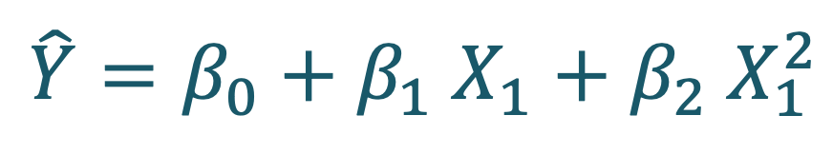
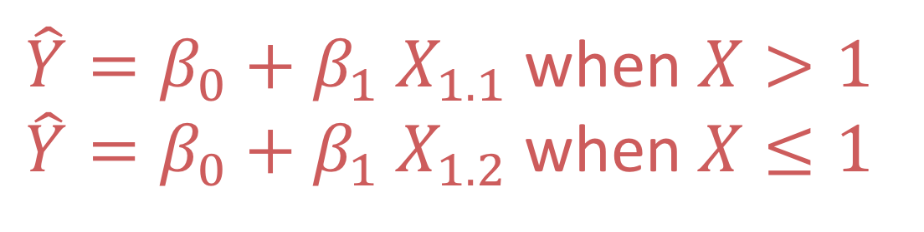
Two Approaches
To test for and interpret nonlinear relations
Polynomial Regression
Spline Regression
$$\hat{Y}=β_{0}+β_{1} X_{1}+β_{2} X_{1}^{2}$$
$\hat{Y}=β_{0}+β_{1} X_{1.1}$ when $X>1$
$\hat{Y}=β_{0}+β_{1} X_{1.2}$ when $X≤1$

Slide 7
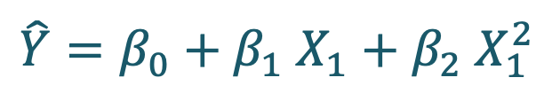
Polynomial Regression
$$\hat{Y}=β_{0}+β_{1} X_{1}+β_{2} X_{1}^{2}$$
Including “higher order” variables
  X² is a second order variable of X
  X³ is a third order variable of X
Notice that the lower order of X² is included
  Why would we want to include it?

Slide 8

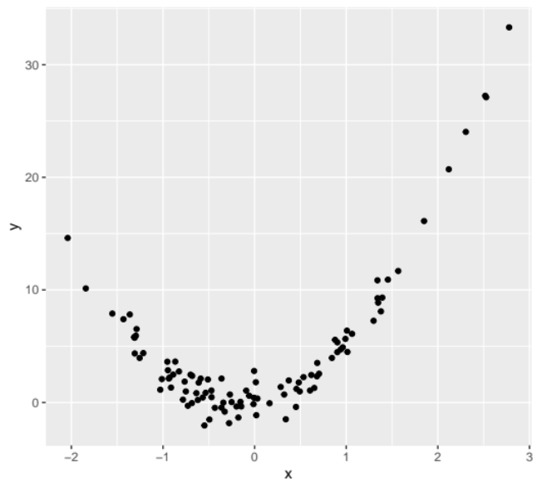
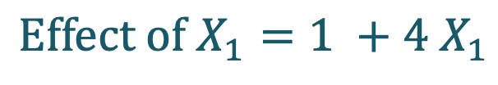
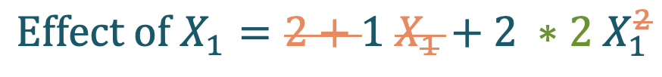
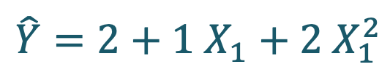
Polynomial Regression
$$\hat{Y}=β_{0}+β_{1} X_{1}+β_{2} X_{1}^{2}$$
Interpretation requires a tiny bit of calculus
$$\hat{Y}=2+1 X_{1}+2 X_{1}^{2}$$
Take the derivative with respect to X₁
$$Effect of X_{1}=2+1 X_{1}+2 ∗2 X_{1}^{2}$$
$$Effect of X_{1}=1 +4{ X}_{1}$$
The effect of X₁ depends on the value of X₁

Slide 9
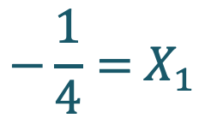
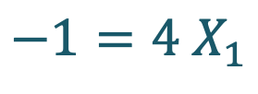
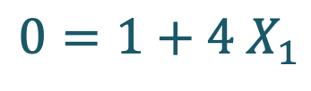
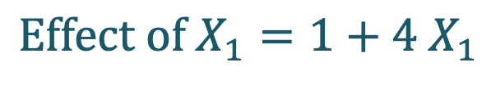
Polynomial Regression
$$\hat{Y}=β_{0}+β_{1} X_{1}+β_{2} X_{1}^{2}$$
$$Effect of X_{1}=1+4{ X}_{1}$$
To find the min/max point (min in this case)
Set it equal to zero (the min/max is where the effect of X is zero)
Solve for X
$$−\frac{1}{4}={ X}_{1}$$
$$0=1+4{ X}_{1}$$
$$−1=4{ X}_{1}$$

Slide 10
Polynomial Regression
$$\hat{Y}=β_{0}+β_{1} X_{1}+β_{2} X_{1}^{2}$$
Steps to use polynomial regression:
Center any variable that will have higher orders
Include higher orders, based on visualizations, theory, or hypothesis tests (I recommend the first two)
Run the regression like other regressions we’ve run before

Slide 11
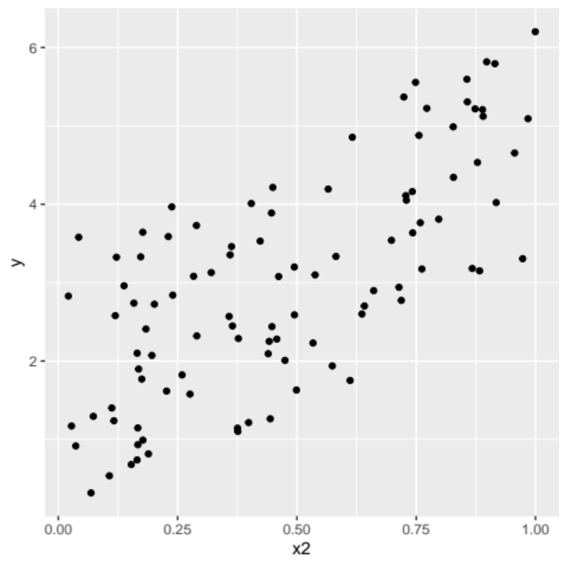
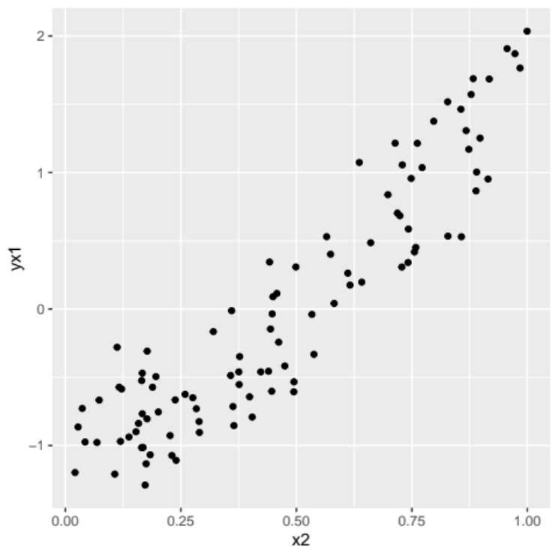
Polynomial Regression
$$\hat{Y}=β_{0}+β_{1} X_{1}+β_{2} X_{1}^{2}$$
Note
Basic Relationship
Controlling for Covariates
Non-linear relations can sometimes be hard to find, even visually
May have to look at outcome/predictor with covariate controlled for/removed
Notes:
library(tidyverse)
set.seed(843)
df <- data_frame(
x1 = runif(100),
x2 = runif(100),
y = 3*x1 + 1*x2 + 2*x2^2 + runif(100)
)
ggplot(df, aes(x2, y)) +
geom_point()
df %>%
mutate(yx1 = resid(lm(y ~ x1))) %>%
ggplot(aes(x2, yx1)) +
geom_point()

Slide 12

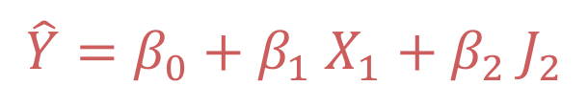
Spline Regression
$\hat{Y}=β_{0}+β_{1} X_{1.1}$ when $X>1$
$\hat{Y}=β_{0}+β_{1} X_{1.2}$ when $X≤1$
$$\hat{Y}=β_{0}+β_{1} X_{1}+β_{2} J_{2}$$
“Mini” regression models for different sections of X
Cut off points can be decided based on visualizations, theory, or ask an algorithm :)
If section is not significant, then that can be removed from the model

Slide 13
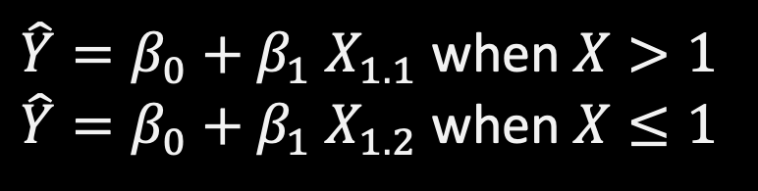
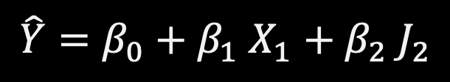
Spline Regression
$\hat{Y}=β_{0}+β_{1} X_{1.1}$ when $X>1$
$\hat{Y}=β_{0}+β_{1} X_{1.2}$ when $X≤1$
Example:
We want to set a joint at x = 2, then
X is the same
J = X – 2 when X > 2, otherwise it is 0
Then the model is
Y ~ X + J
$$\hat{Y}=β_{0}+β_{1} X_{1}+β_{2} J_{2}$$
Steps
Define all the “joints”
Create the ”J” variables
Include all the J variables in the model
Run the regression as we’ve done before

Slide 14
Spline Regression
$\hat{Y}=β_{0}+β_{1} X_{1.1}$ when $X>1$
$\hat{Y}=β_{0}+β_{1} X_{1.2}$ when $X≤1$
$$\hat{Y}=β_{0}+β_{1} X_{1}+β_{2} J_{2}$$
Steps
Define all the “joints”
Create the ”J” variables
Include all the J variables in the model
Run the regression as we’ve done before
Or you can let an algorithm decide the best fit

Slide 15
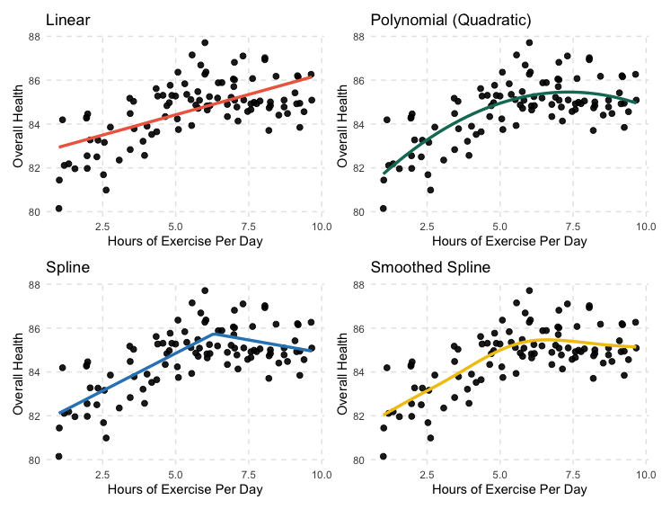
Polynomial and Spline
Notes:
library(tidyverse)
set.seed(84321)
df = tibble(
exercise = runif(100, 1, 10),
health = 80 + 1.5*I(exercise) - .1*I((exercise)^2) + rnorm(100)
)
theme_set(
theme_minimal() +
theme(panel.grid.minor = element_blank(),
panel.grid.major = element_line(linetype = "dashed", color = "grey90"))
)
df %>%
ggplot(aes(exercise, health)) +
geom_point(size = 2, alpha = .9) +
labs(x = "Hours of Exercise Per Day",
y = "Overall Health")
p1 = df %>%
ggplot(aes(exercise, health)) +
geom_point(size = 2, alpha = .9) +
geom_smooth(method = "lm",
color = "coral2",
se = FALSE,
alpha = .9,
size = 1.2) +
labs(x = "Hours of Exercise Per Day",
y = "Overall Health",
title = "Linear")
p2 = df %>%
ggplot(aes(exercise, health)) +
geom_point(size = 2, alpha = .9) +
geom_smooth(method = "lm",
formula = y ~ poly(x,2),
color = "#117A65",
se = FALSE,
alpha = .9,
size = 1.2) +
labs(x = "Hours of Exercise Per Day",
y = "Overall Health",
title = "Polynomial (Quadratic)")
p3 = df %>%
ggplot(aes(exercise, health)) +
geom_point(size = 2, alpha = .9) +
geom_smooth(method = "gam",
formula = y ~ x + case_when(x > 6.3 ~ x-6.3,
TRUE ~ 0),
color = "#2E86C1",
se = FALSE,
alpha = .9,
size = 1.2) +
labs(x = "Hours of Exercise Per Day",
y = "Overall Health",
title = "Spline")
p4 = df %>%
ggplot(aes(exercise, health)) +
geom_point(size = 2, alpha = .9) +
geom_smooth(method = "gam",
formula = y ~ s(x),
color = "#F1C40F",
se = FALSE,
alpha = .9,
size = 1.2) +
labs(x = "Hours of Exercise Per Day",
y = "Overall Health",
title = "Smoothed Spline")
library(patchwork)
(p1 + p2) / (p3 + p4)

Slide 16
Polynomial and Spline
How would you interpret these?
Notes:
library(tidyverse)
set.seed(84321)
df = tibble(
exercise = runif(100, 1, 10),
health = 80 + 1.5*I(exercise) - .1*I((exercise)^2) + rnorm(100)
)
theme_set(
theme_minimal() +
theme(panel.grid.minor = element_blank(),
panel.grid.major = element_line(linetype = "dashed", color = "grey90"))
)
df %>%
ggplot(aes(exercise, health)) +
geom_point(size = 2, alpha = .9) +
labs(x = "Hours of Exercise Per Day",
y = "Overall Health")
p1 = df %>%
ggplot(aes(exercise, health)) +
geom_point(size = 2, alpha = .9) +
geom_smooth(method = "lm",
color = "coral2",
se = FALSE,
alpha = .9,
size = 1.2) +
labs(x = "Hours of Exercise Per Day",
y = "Overall Health",
title = "Linear")
p2 = df %>%
ggplot(aes(exercise, health)) +
geom_point(size = 2, alpha = .9) +
geom_smooth(method = "lm",
formula = y ~ poly(x,2),
color = "#117A65",
se = FALSE,
alpha = .9,
size = 1.2) +
labs(x = "Hours of Exercise Per Day",
y = "Overall Health",
title = "Polynomial (Quadratic)")
p3 = df %>%
ggplot(aes(exercise, health)) +
geom_point(size = 2, alpha = .9) +
geom_smooth(method = "gam",
formula = y ~ x + case_when(x > 6.3 ~ x-6.3,
TRUE ~ 0),
color = "#2E86C1",
se = FALSE,
alpha = .9,
size = 1.2) +
labs(x = "Hours of Exercise Per Day",
y = "Overall Health",
title = "Spline")
p4 = df %>%
ggplot(aes(exercise, health)) +
geom_point(size = 2, alpha = .9) +
geom_smooth(method = "gam",
formula = y ~ s(x),
color = "#F1C40F",
se = FALSE,
alpha = .9,
size = 1.2) +
labs(x = "Hours of Exercise Per Day",
y = "Overall Health",
title = "Smoothed Spline")
library(patchwork)
(p1 + p2) / (p3 + p4)

Slide 17
Monotonic Transformations
We can also transform the outcome/predictors to make the relationship more linear (very common)
Common Monotonic Transformations:
Logarithmic
Box-Cox
Log-Lin
Log-Log
Lin-Log
Uses powers of the predictor to make it linear (e.g., square root, square, etc.)

Slide 18
Monotonic Transformations
Monotonic means that the transformation doesn’t change the order of the data points
We can also transform the outcome/predictors to make the relationship more linear (very common)
Common Monotonic Transformations:
Logarithmic
Box-Cox
Log-Lin
Log-Log
Lin-Log
Uses powers of the predictor to make it linear (e.g., square root, square, etc.)

Slide 19
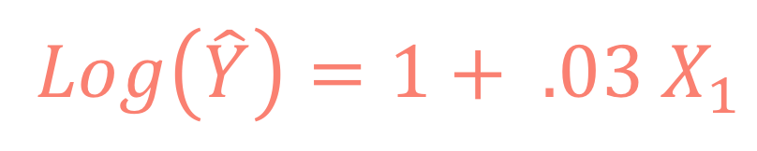
Log Transformations
A few things to know:
When we say log transformation, we almost always mean using the natural log (ln)
The estimate, mathemagically, approximates to the percent change in the outcome
$$Log\left(\hat{Y}\right)=1+ .03 X_{1}$$
For a one-unit change in X, there is an associated 3% change in Y

Slide 20
Additional Resources!
http://www.sthda.com/english/articles/40-regression-analysis/162-nonlinear-regression-essentials-in-r-polynomial-and-spline-regression-models/

Slide 21



Slide 22

Notes:
Photo by Matthew Ronder-Seid on Unsplash

