Slide 1
Generalized Linear Models (GLM)
EDUC 7610
Tyson S. Barrett, PhD
Updated by Carly Fox

Slide 2
Lots of Types of Outcomes
Not all outcomes are continuous and nicely distributed
Type | Example | Method to Handle It
Dichotomous | Smoker/Non-Smoker Depressed/Not Depressed | Logistic Regression
Count | Number of times visited hospital this month | Poisson Regression, Negative Binomial Regression
Ordinal | Low, Mid, High levels of anxiety | Ordinal Logistic Regression
Time to Event | Time until heart attack | Survival Analysis
Notes:
library(tidyverse)
set.seed(843)
df <- data_frame(
x1 = runif(100),
x2 = rbinom(100, 1, .5),
y = x1 + x2 + 2*x1*x2 + rnorm(100)
)
df %>%
mutate(x2_cat = factor(x2)) %>%
ggplot(aes(x1, y, group = x2_cat, color = x2_cat)) +
geom_point() +
geom_smooth(method = "lm")

Slide 3
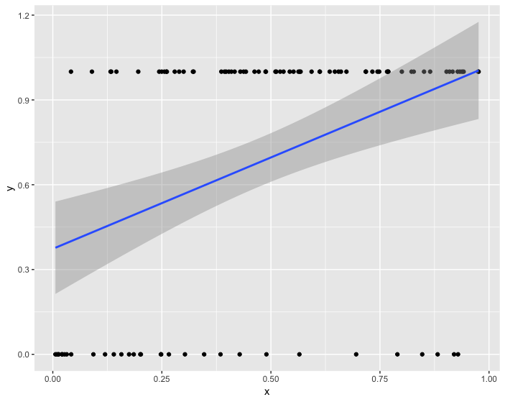
What if we just used OLS?
Any issues with this scenario?
Notes:
library(tidyverse)
set.seed(843)
df <- data_frame(
x1 = runif(100),
x2 = rbinom(100, 1, .5),
y = x1 + x2 + 2*x1*x2 + rnorm(100)
)
df %>%
mutate(x2_cat = factor(x2)) %>%
ggplot(aes(x1, y, group = x2_cat, color = x2_cat)) +
geom_point() +
geom_smooth(method = "lm")

Slide 4
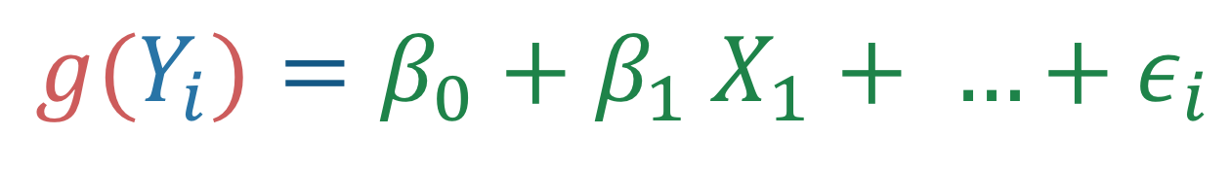
The Gist of GLMs
We model the expected value of the model in a different way than regular regression
$$g(Y_{i})=β_{0}+β_{1} X_{1}+ …+ε_{i}$$
Link function
Predictors
(same as in regular regression)
Outcome response
Notes:
library(tidyverse)
set.seed(843)
df <- data_frame(
x1 = runif(100),
x2 = rbinom(100, 1, .5),
y = x1 + x2 + 2*x1*x2 + rnorm(100)
)
df %>%
mutate(x2_cat = factor(x2)) %>%
ggplot(aes(x1, y, group = x2_cat, color = x2_cat)) +
geom_point() +
geom_smooth(method = "lm")

Slide 5
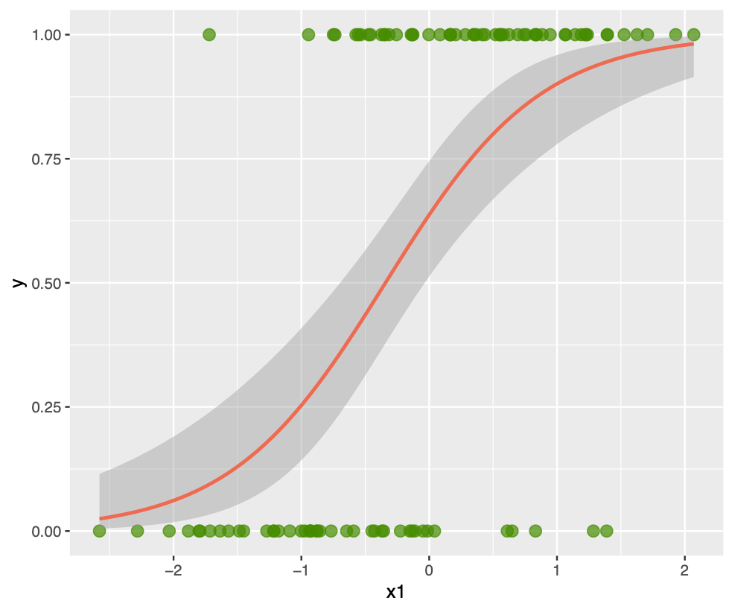
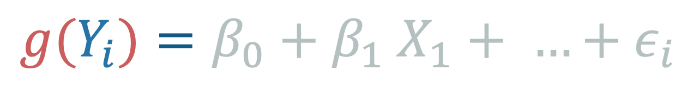
The Gist of GLMs
We model the expected value of the model in a different way than regular regression
$$g(Y_{i})=β_{0}+β_{1} X_{1}+ …+ε_{i}$$
Link function
Predictors
(same as in regular regression)
Outcome response
Notes:
library(tidyverse)
set.seed(843)
df <- data_frame(
x1 = runif(100),
x2 = rbinom(100, 1, .5),
y = x1 + x2 + 2*x1*x2 + rnorm(100)
)
df %>%
mutate(x2_cat = factor(x2)) %>%
ggplot(aes(x1, y, group = x2_cat, color = x2_cat)) +
geom_point() +
geom_smooth(method = "lm")

Slide 6
The Gist of GLMs
We model the expected value of the model in a different way than regular regression
$$g(Y_{i})=β_{0}+β_{1} X_{1}+ …+ε_{i}$$
Model | Link | Distribution
Linear Regression | Identity | Normal
Logistic Regression | Logit | Binomial
Poisson Regression | Log | Poisson
Loglinear | Log | Poisson
Probit Regression | Probit | Normal
Beta Regression | Logit | Beta
Notes:
library(tidyverse)
set.seed(843)
df <- data_frame(
x1 = runif(100),
x2 = rbinom(100, 1, .5),
y = x1 + x2 + 2*x1*x2 + rnorm(100)
)
df %>%
mutate(x2_cat = factor(x2)) %>%
ggplot(aes(x1, y, group = x2_cat, color = x2_cat)) +
geom_point() +
geom_smooth(method = "lm")

Slide 7
The Linear Models and GLMs
There are so much in common between linear models and generalized linear models
Model specification
Diagnostics
Simple and multiple
Continuous and categorical predictors
Similar assumptions
Notes:
library(tidyverse)
set.seed(843)
df <- data_frame(
x1 = runif(100),
x2 = rbinom(100, 1, .5),
y = x1 + x2 + 2*x1*x2 + rnorm(100)
)
df %>%
mutate(x2_cat = factor(x2)) %>%
ggplot(aes(x1, y, group = x2_cat, color = x2_cat)) +
geom_point() +
geom_smooth(method = "lm")

Slide 8
The most common GLM: Logistic
Logistic regression is a particular type of GLM
The outcome is binary (dichotomous)
The predicted values (predicted probabilities) are along an S shaped curve
Makes it so the predictions are never less than 0 or more than 1
Often matches how probabilities probably work
Notes:
library(tidyverse)
set.seed(843)
df <- data_frame(
x1 = rnorm(100),
x2 = runif(100),
z = 2*x1 + x2,
pr = 1/(1+exp(-z)),
y = rbinom(100,1,pr)
)
df %>%
ggplot(aes(x1, y)) +
geom_point(color = "chartreuse4",
alpha = .7,
size = 3) +
geom_smooth(method = "glm",
method.args = list(family = "binomial"),
color = "coral2")

Slide 9
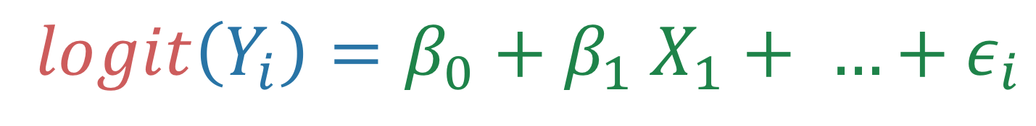
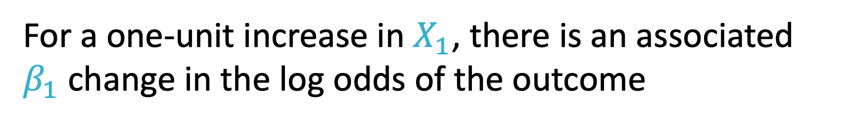
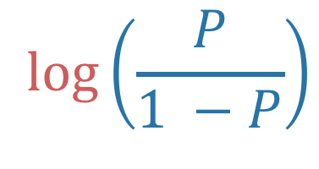
The most common GLM: Logistic
Logistic regression is a particular type of GLM
$$logit\left(Y_{i}\right)=β_{0}+β_{1} X_{1}+ …+ε_{i}$$
$$\log\left(\frac{P}{1 −P}\right)$$
The results then are in terms of ”logits” or the ”log-odds” of a positive response (gives us the S shape for the predicted values)
For a one-unit increase in $X_{1}$, there is an associated $β_{1}$ change in the log odds of the outcome

Slide 10
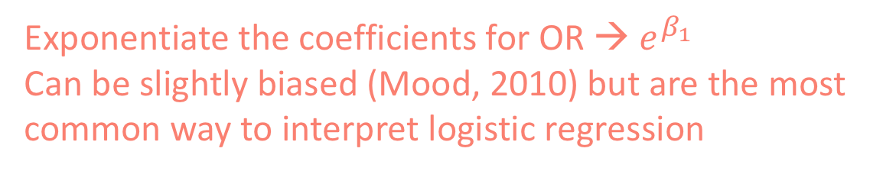
Logistic Regression
Since log-odds is not all that intuitive, let’s talk about other ways to interpret the results
Predicted Probabilities
Odds Ratios
Exponentiate the coefficients for OR → $e^{β_{1}}$
Can be slightly biased (Mood, 2010) but are the most common way to interpret logistic regression
Average Marginal Effects
Use AMEs to get the average effect in the sample
Are less biased than odds ratios (Mood, 2010)

Slide 11
Example
You’ve now turned to binge-watching movies on Netflix have noticed that many of the “blockbuster” films don’t feature women in leading roles. You come across a Bechdel Test (a for the representation of women in fiction) dataset and decide to examine whether budget (numeric predictor) predicts passing (or failing) the Bechdel test (dichotomous outcome).
First you run a linear regression using budget to predict whether the movie passed the Bechdel test and get the following results:
lm(result ~ budget, data = bechdel)
Coefficients: Estimate std. Error t value Pr(t>|t|)
(Intercept) 5.450e-01 1.708e-02 31.901 < 2e-16 ***
budget -1.638e-04 2.477e-05 -6.614 5.08e-11 ***
Looks fine right? But as a serious stats student, you know that you should ALWAYS PLOT YOUR RESIDUALS (when using a linear regression)!

Slide 12
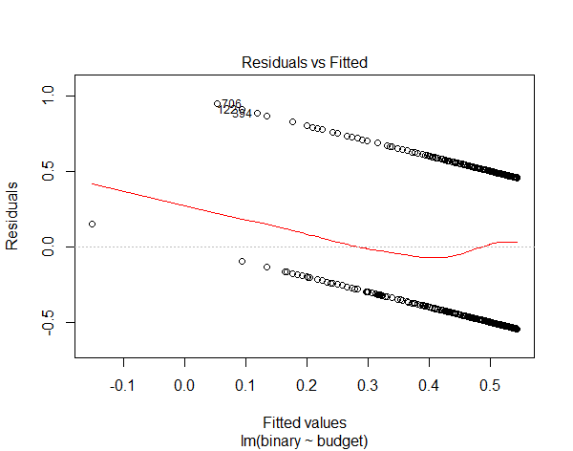
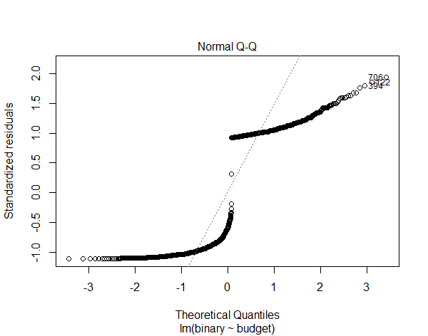
Example
You’ve now turned to binge-watching movies on Netflix have noticed that many of the “blockbuster” films don’t feature women in leading roles. You come across a Bechdel Test (a for the representation of women in fiction) dataset and decide to examine whether budget (numeric predictor) predicts passing (or failing) the Bechdel test (dichotomous outcome).
First you run a linear regression using budget to predict whether the movie passed the Bechdel test and get the following results:
lm(result ~ budget, data = bechdel)
Coefficients: Estimate std. Error t value Pr(t>|t|)
(Intercept) 5.450e-01 1.708e-02 31.901 < 2e-16 ***
budget -1.638e-04 2.477e-05 -6.614 5.08e-11 ***
Looks fine right? But as a serious stats student, you know that you should ALWAYS PLOT YOUR RESIDUALS (when using a linear regression)!
Okay, so we’re definitely violating some assumptions…

Slide 13
Example
You realize that because you have a binary outcome variable, that you should use logistic regression! You rerun the model, now using the glm() function and get the following:
glm(result ~ budget, data = bechdel, family = “binomial”)
Coefficients: Estimate Std. Error z value Pr(>|z|)
(Intercept) 0.201 0.072 2.803 0.005
Budget -0.001 1.133e-04 -6.354 2.1e-10 ***
Seems like production budget is a significant predictor of whether a movie will pass the Bechdel Test, p < 0.05. But how might we interpret these results?
Notes:
May want to explain why we don’t do residuals plot for LR

Slide 14
Example - Interpretations
Log-Odds
For each $1,000,000 increase in budget, there is an associated 0.001 decrease in the log-odds of passing the Bechdel Test
Odds Ratio (exponentiate the log-odds)
For each $1,000,000 increase in budget, the odds of passing the Bechdel Test decreases by a factor of 0.999
Predicted Probability (convert the log-odds to a probability)
When the budget is $50,000,000 the expected probability of a movie passing the Bechdel Test is 54%. At a budget of around $300,000,000, the probability of passing the Bechdel test changes from greater than 50% to less than 50%.
AME (calculate the average marginal effect)
On average, for each $1,000,000 increase in budget, the chance of passing the Bechdel test decreases by 0.02 percentage points

Slide 15
Some Additional GLMs
Poisson Regression
Ordinal Logistic Regression
For count outcomes
For ordinal outcomes
Survival Analysis
Beta Regression
For time to event outcomes
For bounded outcomes
Negative Binomial
For count outcomes with lots of zeroes

Slide 16
Check out these resources!
Logistic Regression in R Tutorial
A nice explanation of interpreting odds-ratio on stack-overflow
Advanced Reading on GLMs, special scenarios, running diagnostics
Ordinal Logistic Regression in R Tutorial (Likert outcome variable)

Slide 17

Do whatever is needed to finish…

Slide 18

Notes:
By Debbie Pan on Unsplash.com

