Slide 1
Logistic Regression
(GLM with binomial distribution and logit link)
EDUC 7610
Tyson S. Barrett, PhD
Updated by Carly Fox
Notes:
Code for example:
# example
library(educ7610)
library(tidyverse)
library(broom)
library(janitor)
# Data:
state_pop = data.frame(
stringsAsFactors = FALSE,
V1 = c(".Alabama",".Alaska",
".Arizona",".Arkansas",".California",".Colorado",
".Connecticut",".Delaware",".District of Columbia",".Florida",
".Georgia",".Hawaii",".Idaho",".Illinois",".Indiana",
".Iowa",".Kansas",".Kentucky",".Louisiana",".Maine",
".Maryland",".Massachusetts",".Michigan",".Minnesota",
".Mississippi",".Missouri",".Montana",".Nebraska",
".Nevada",".New Hampshire",".New Jersey",".New Mexico",
".New York",".North Carolina",".North Dakota",".Ohio",
".Oklahoma",".Oregon",".Pennsylvania",".Rhode Island",
".South Carolina",".South Dakota",".Tennessee",
".Texas",".Utah",".Vermont",".Virginia",".Washington",
".West Virginia",".Wisconsin",".Wyoming"),
V2 = c(4779736,710231,6392017,
2915918,37253956,5029196,3574097,897934,601723,18801310,
9687653,1360301,1567582,12830632,6483802,3046355,
2853118,4339367,4533372,1328361,5773552,6547629,
9883640,5303925,2967297,5988927,989415,1826341,2700551,
1316470,8791894,2059179,19378102,9535483,672591,
11536504,3751351,3831074,12702379,1052567,4625364,
814180,6346105,25145561,2763885,625741,8001024,6724540,
1852994,5686986,563626),
V3 = c(4780125,710249,6392288,
2916031,37254519,5029319,3574147,897937,601767,18804564,
9688729,1360307,1567657,12831572,6484051,3046871,
2853123,4339333,4533487,1328358,5773794,6547785,
9884116,5303927,2968130,5988950,989407,1826305,2700677,
1316462,8791978,2059199,19378144,9535751,672576,
11536751,3751582,3831079,12702868,1052964,4625366,
814198,6346276,25146091,2763891,625737,8001049,6724540,
1853018,5687285,563775)
)
state_pop <- state_pop %>%
set_names(c("state", "census", "estimate")) %>%
mutate(state = gsub(".", "", state, fixed = TRUE),
state = tolower(state))
d <- educ7610::poverty %>%
clean_names() %>%
mutate(state = gsub("_", " ", state, fixed = TRUE),
state = tolower(state)) %>%
mutate(high_violence = case_when(violent_crime > median(violent_crime) ~ "Higher",
violent_crime <= median(violent_crime) ~ "Lower"),
high_violence = factor(high_violence, levels = c("Lower", "Higher")),
high_teen_birth = case_when(teen_birth > median(teen_birth) ~ "Higher",
teen_birth <= median(teen_birth) ~ "Lower"),
high_teen_birth = factor(high_teen_birth, levels = c("Higher", "Lower")))
d <- full_join(d, state_pop, by = "state")
fit_logit <- glm(high_violence ~ poverty_pct + census + high_teen_birth, data = d, family = "binomial")
summary(fit_logit)
educ7610::oddsratios(fit_logit)
# Get data out of our model and a few other things
fit_data <- augment(fit_logit)
fit_data <- fit_data %>%
mutate(probs = predict(fit_logit, type = "response"))
# show influential points (label top 3)
plot(fit_logit, which = 4, id.n = 3)
# check predictors with logit
c1 = fit_data %>%
ggplot(aes(poverty_pct, .fitted))+
geom_point(size = 0.5, alpha = 0.5) +
geom_smooth(method = "loess") +
theme_bw()
c2 = fit_data %>%
ggplot(aes(census, .fitted))+
geom_point(size = 0.5, alpha = 0.5) +
geom_smooth(method = "loess") +
theme_bw()
c3 = fit_data %>%
ggplot(aes(high_teen_birth, .fitted))+
geom_point(size = 0.5, alpha = 0.5) +
geom_smooth(method = "loess") +
theme_bw()
library(patchwork)
c1 + c2 + c3
# Multicollinearity
car::vif(fit_logit)
# As a rule of thumb, a VIF value that exceeds 5 or 10 indicates a problematic amount of collinearity. In our example, there is no collinearity: all variables have a value of VIF well below 5.
# Residuals
c4 = fit_data %>%
ggplot(aes(poverty_pct, .std.resid, color = )) +
geom_point(size = 0.5, alpha = 0.5) +
geom_hline(yintercept = 0, linetype = "dashed") +
geom_smooth(method = "loess") +
theme_bw()
c5 = fit_data %>%
ggplot(aes(census, .std.resid)) +
geom_point(size = 0.5, alpha = 0.5) +
geom_hline(yintercept = 0, linetype = "dashed") +
geom_smooth(method = "loess") +
theme_bw()
c6 = fit_data %>%
ggplot(aes(high_teen_birth, .std.resid)) +
geom_point(size = 0.5, alpha = 0.5) +
geom_hline(yintercept = 0, linetype = "dashed") +
geom_smooth(method = "loess") +
theme_bw()
c4 + c5 + c6
hist(fit_data$.std.resid)
plot(fit_data$.hat, type = "h")
# Accuracy
probs <- predict(fit_logit, type = "response")
probs01 <- ifelse(probs > .5, "Higher", "Lower")
probs01 <- factor(probs01, levels = c("Lower", "Higher"))
table(fit_data$high_violence, probs01)
library(ROCit)
measureit(score = probs,
class = fit_data$high_violence,
measure = c("ACC", "MIS", "SENS", "SPEC", "PPV", "NPV"))
binomial_smooth <- function(...) {
geom_smooth(method = "glm", method.args = list(family = "binomial"), ...)
}
p1 = fit_data %>%
ggplot(aes(poverty_pct, probs)) +
geom_point(aes(y = as.numeric(high_violence)-1)) +
binomial_smooth() +
theme_bw() +
labs(x = "Percentage Poverty",
y = "Predicted Probability")
p2 = fit_data %>%
ggplot(aes(as.numeric(high_teen_birth)-1, probs)) +
geom_jitter(aes(y = as.numeric(high_violence)-1),
width = .2, height = .1) +
binomial_smooth() +
theme_bw() +
labs(x = "Teen Birth Rate",
y = "Predicted Probability")
p1 + p2

Slide 2
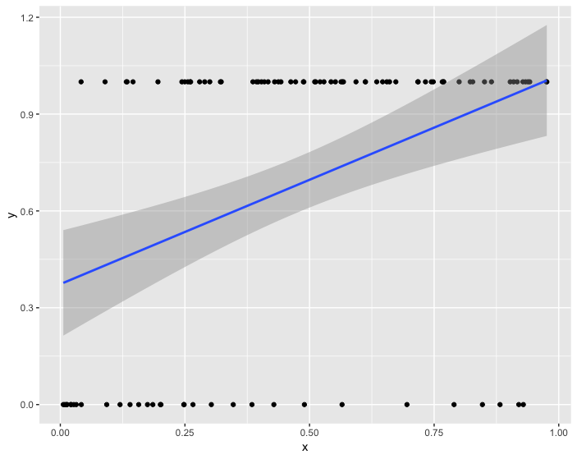
What if we just used OLS?
Any issues with this scenario?
Notes:
library(tidyverse)
set.seed(843)
df <- data_frame(
x1 = runif(100),
x2 = rbinom(100, 1, .5),
y = x1 + x2 + 2*x1*x2 + rnorm(100)
)
df %>%
mutate(x2_cat = factor(x2)) %>%
ggplot(aes(x1, y, group = x2_cat, color = x2_cat)) +
geom_point() +
geom_smooth(method = "lm")

Slide 3
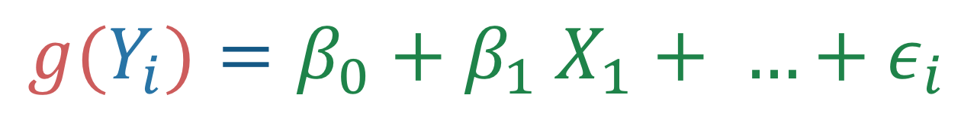
Review The Gist of GLMs
We model the expected value of the model in a different way than regular regression
$$g(Y_{i})=β_{0}+β_{1} X_{1}+ …+ε_{i}$$
Link function
Predictors
(same as in regular regression)
Outcome response
Notes:
library(tidyverse)
set.seed(843)
df <- data_frame(
x1 = runif(100),
x2 = rbinom(100, 1, .5),
y = x1 + x2 + 2*x1*x2 + rnorm(100)
)
df %>%
mutate(x2_cat = factor(x2)) %>%
ggplot(aes(x1, y, group = x2_cat, color = x2_cat)) +
geom_point() +
geom_smooth(method = "lm")

Slide 4
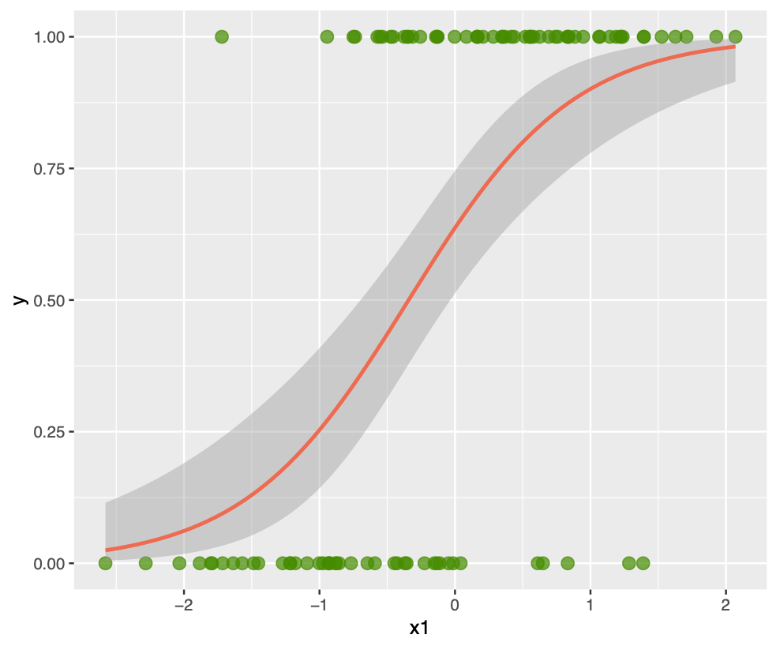

Review The Gist of GLMs
We model the expected value of the model in a different way than regular regression
$$g(Y_{i})=β_{0}+β_{1} X_{1}+ …+ε_{i}$$
Link function
Predictors
(same as in regular regression)
Outcome response
Notes:
library(tidyverse)
set.seed(843)
df <- data_frame(
x1 = runif(100),
x2 = rbinom(100, 1, .5),
y = x1 + x2 + 2*x1*x2 + rnorm(100)
)
df %>%
mutate(x2_cat = factor(x2)) %>%
ggplot(aes(x1, y, group = x2_cat, color = x2_cat)) +
geom_point() +
geom_smooth(method = "lm")

Slide 5
Review Logistic Regression
Logistic regression is a particular type of GLM
The outcome is binary (dichotomous)
The predicted values (predicted probabilities) are along an S shaped curve
Makes it so the predictions are never less than 0 or more than 1
Often matches how probabilities probably work
Notes:
library(tidyverse)
set.seed(843)
df <- data_frame(
x1 = rnorm(100),
x2 = runif(100),
z = 2*x1 + x2,
pr = 1/(1+exp(-z)),
y = rbinom(100,1,pr)
)
df %>%
ggplot(aes(x1, y)) +
geom_point(color = "chartreuse4",
alpha = .7,
size = 3) +
geom_smooth(method = "glm",
method.args = list(family = "binomial"),
color = "coral2")

Slide 6


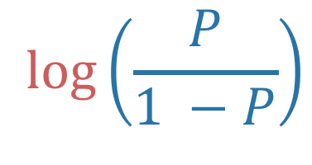
Review Logistic Regression
Logistic regression is a particular type of GLM
$$logit\left(Y_{i}\right)=β_{0}+β_{1} X_{1}+ …+ε_{i}$$
$$\log\left(\frac{P}{1 −P}\right)$$
The results then are in terms of ”logits” or the ”log-odds” of a positive response (gives us the S shape for the predicted values)
For a one-unit increase in $X_{1}$, there is an associated $β_{1}$ change in the log odds of the outcome

Slide 7
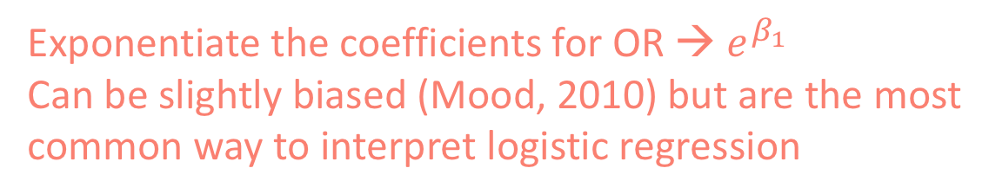
Logistic Regression
Since log-odds is not all that intuitive, let’s talk about other ways to interpret the results
Odds Ratios
Exponentiate the coefficients for OR → $e^{β_{1}}$
Can be slightly biased (Mood, 2010) but are the most common way to interpret logistic regression
What are odds?
What are the odds of winning if your probability of winning is 60%?
Odds Ratio is a ratio of odds
What is the OR of winning when you are older than 65 (prob = 60%) compared to when you are younger than 65 (prob = 20%)?
Notes:
Odds = .6/(1-.6) = 1.5
OR = 1.5/.25 = 6

Slide 8
Logistic Regression
Since log-odds is not all that intuitive, let’s talk about other ways to interpret the results
Predicted Probabilities
Odds Ratios
Exponentiate the coefficients for OR → $e^{β_{1}}$
Can be slightly biased (Mood, 2010) but are the most common way to interpret logistic regression
Average Marginal Effects
Use AMEs to get the average effect in the sample
Are less biased than odds ratios (Mood, 2010)

Slide 9
How Good Is It?
Two main ways to understand how good the model fits the data
These try to act like R² for logistic regression
There are a few types (https://stats.idre.ucla.edu/other/mult-pkg/faq/general/faq-what-are-pseudo-r-squareds/)
Psuedo-R²
Accuracy
Sensitivity
Specificity
Positive predictive value
Negative predictive value
ROC
Assumptions
Prediction Accuracy*
* https://cran.r-project.org/web/packages/ROCit/vignettes/my-vignette.html

Slide 10
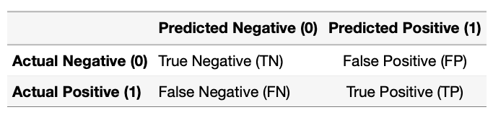


Prediction Accuracy
https://cran.r-project.org/web/packages/ROCit/vignettes/my-vignette.html

Slide 11




Prediction Accuracy
https://cran.r-project.org/web/packages/ROCit/vignettes/my-vignette.html
how many of the actual positives do we classify as positive?
how many of the predicted positives are actually positive?
how many of the actual negatives do we classify as negative?
how many of the predicted negatives are actually negative?

Slide 12
Example
You are approached by a distinguished researcher who wants you to help her analyze data on poverty, violent crime, and teen birth rates in the United States. You enthusiastically say “Of course!”
You find out you are trying to predict high vs low violent crime (binary outcome) with the state’s population (continuous predictor), poverty level (continuous predictor), and high vs low teen birth rate (binary predictor).
What approach do we use?
Of course, logistic regression (since that is the topic of the lecture)

Slide 13
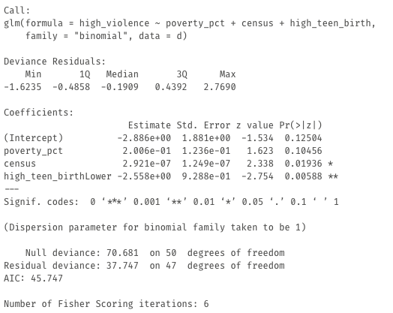
Model
Output

Slide 14

Interpretations!
Odds Ratios
For a one-unit increase in poverty percentage, there is a 1.22 times change in the odds of having high violence (note this effect is not significant)
educ7610::oddsratios(fit_logit)
Compared to Higher Teen Birth, Lower Teen Birth states have odds that are 0.08 times the odds of having high violence.

Slide 15
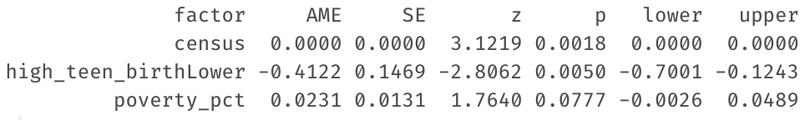
Interpretations!
Odds Ratios
Average Marginal Effect
educ7610::oddsratios(fit_logit)
margins::margins(fit_logit) %>% summary()
Compared to Higher Teen Birth, Lower Teen Birth states have a probability .41 units lower of having high violence
For a one-unit increase in poverty percentage, there is a .02 increase in the probability of high violence

Slide 16
Interpretations!
Odds Ratios
Average Marginal Effect
educ7610::oddsratios(fit_logit)
margins::margins(fit_logit) %>% summary()
Predicted Probabilities
predict(fit_logit, type = "response")

Slide 17
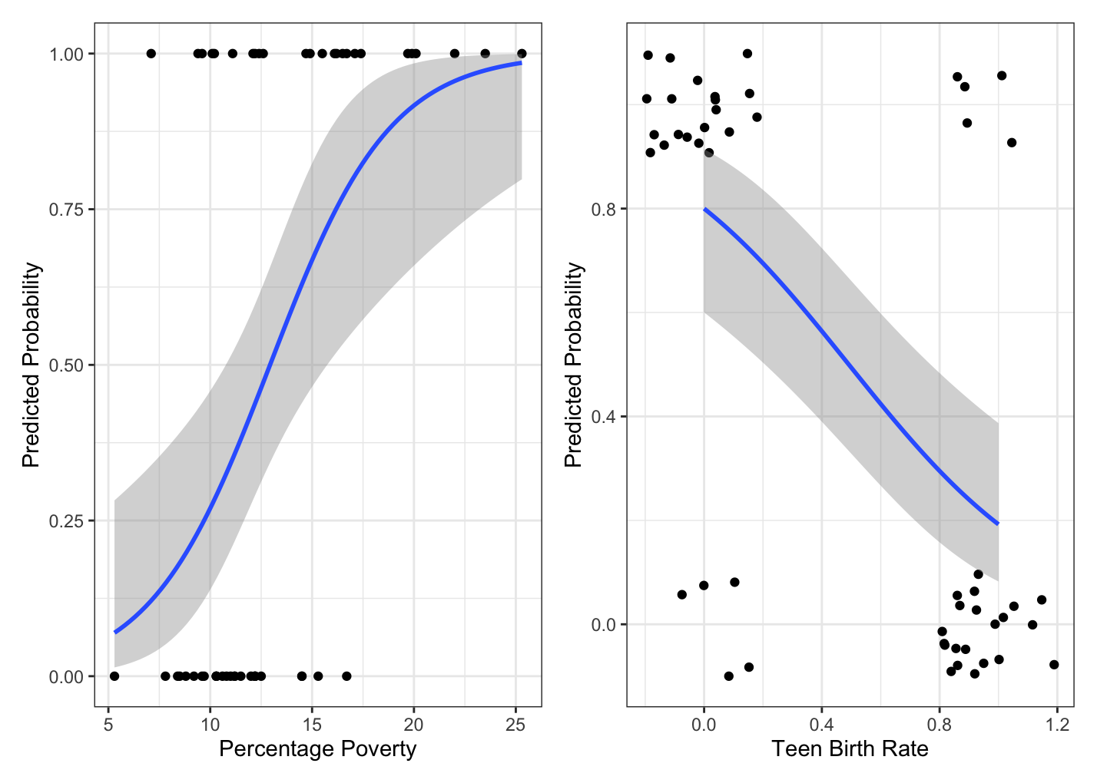
Interpretations!
Odds Ratios
Average Marginal Effect
educ7610::oddsratios(fit_logit)
margins::margins(fit_logit) %>% summary()
Predicted Probabilities
The line is the predicted probability
predict(fit_logit, type = "response")

Slide 18
How good is this model though?
Let’s check model fit, assumptions, and extreme values!!

Slide 19
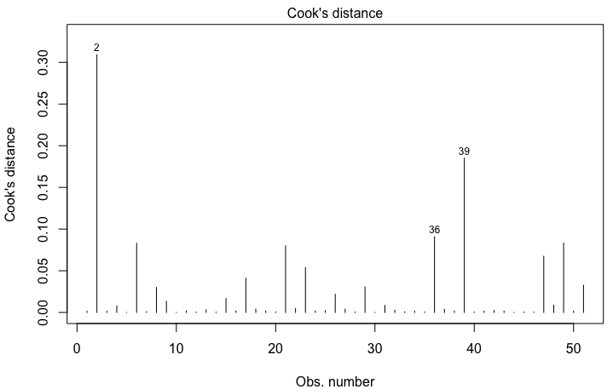
How good is this model though?
plot(fit_logit, which = 4, id.n = 3)
Shows us our Cook’s Distance
Alaska

Slide 20
How good is this model though?
fit_data <- augment(fit_logit)
Gives us our model’s residual, std residual, hat value, predicted values

Slide 21
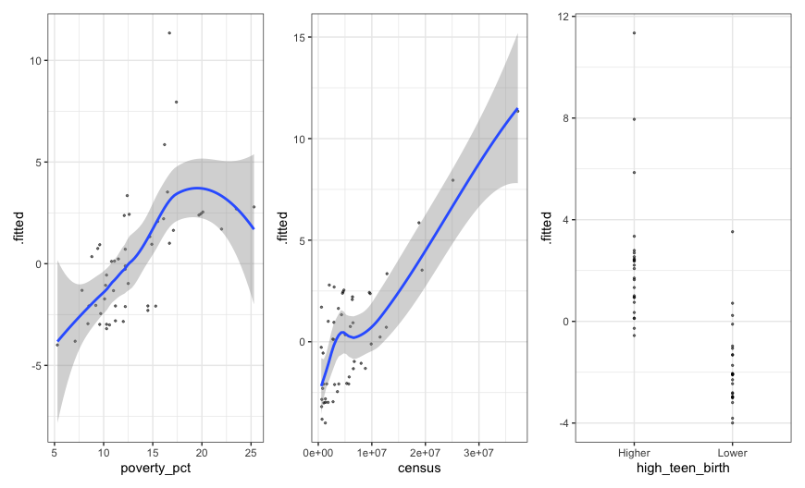
How good is this model though?
fit_data <- augment(fit_logit)
Gives us our model’s residual, std residual, hat value, predicted values

Slide 22
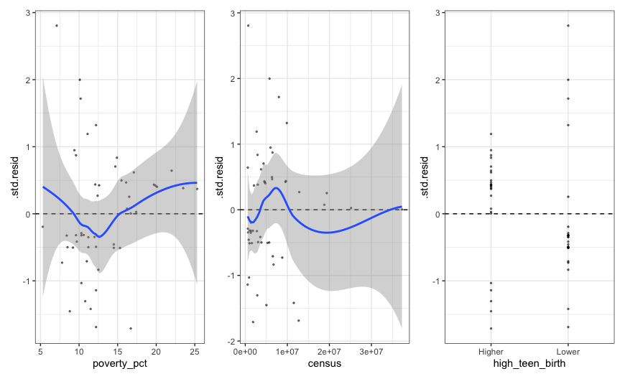
How good is this model though?
fit_data <- augment(fit_logit)
Gives us our model’s residual, std residual, hat value, predicted values

Slide 23
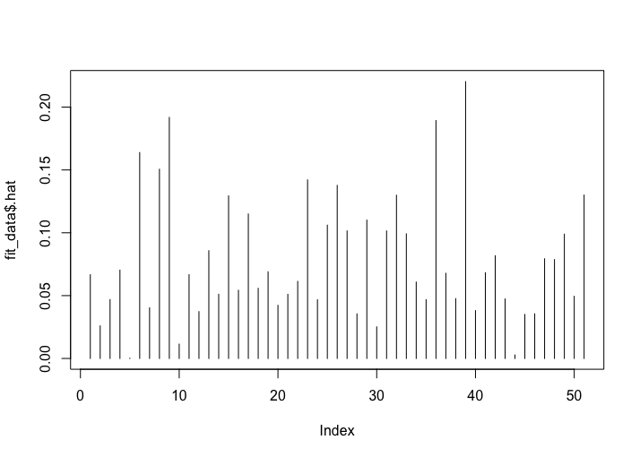
How good is this model though?
plot(fit_data$.hat, type = "h")
Plots the hat values

Slide 24

How good is this model though?
table(outcome, predicted)
Gives us our cross tabulation (confusion matrix)
Incorrect
Correct

Slide 25
How good is this model though?
https://cran.r-project.org/web/packages/ROCit/vignettes/my-vignette.html
library(ROCit)
measures <- measureit(
score = pred_probs,
class = outcome,
measure = c("ACC", "MIS", "SENS",
"SPEC", "PPV", "NPV"))
This will provide the accuracy measures for every cut-off (not just the .5 probability cutoff)

Slide 26
How good is this model though?
https://cran.r-project.org/web/packages/ROCit/vignettes/my-vignette.html
Our values around the .5 cutoff:
ACC = 0.83
MIS = 0.17
SENS = 0.84
SPEC = 0.81
PPV = 0.81
NPV = 0.84
library(ROCit)
measures <- measureit(
score = pred_probs,
class = outcome,
measure = c("ACC", "MIS", "SENS",
"SPEC", "PPV", "NPV"))
This will provide the accuracy measures for every cut-off (not just the .5 probability cutoff)
These aren’t always mirroring each other

Slide 27
How good is this model though?
https://cran.r-project.org/web/packages/ROCit/vignettes/my-vignette.html
Important to remember:
These values are on data the model used
Like peaking at all the cards before playing a card game
Cross-validation can help if you are interested in generalizability of the model predictions
library(ROCit)
measures <- measureit(
score = pred_probs,
class = outcome,
measure = c("ACC", "MIS", "SENS",
"SPEC", "PPV", "NPV"))
This will provide the accuracy measures for every cut-off (not just the .5 probability cutoff)

Slide 28

Notes:
By Debbie Pan on Unsplash.com

