Slide 1
Other GLMs
Probit, Poisson, Beta, Zero-Inflated Regressions
EDUC 7610
Tyson S. Barrett, PhD
Updated by Carly Fox
Notes:
# GLMs Examples
library(tidyverse)
library(educ7610)
library(broom)
data("gss")
# Poisson Regression
fit_poi <- glm(tvhours ~ age + income06 + educ, data = gss, family = "poisson")
summary(fit_poi)
margins::margins(fit_poi) %>% summary()
set.seed(84321)
poi_distribution = tibble(
lambda1 = rpois(1000, 1),
lambda2 = rpois(1000, 2),
lambda4 = rpois(1000, 4),
lambda16 = rpois(1000, 16)
) %>%
pivot_longer(cols = everything()) %>%
mutate(name =
factor(name,
levels = c("lambda1", "lambda2", "lambda4", "lambda16"),
labels = c("1", "2", "4", "16")))
poi_distribution %>%
ggplot(aes(value, color = name, group = name, fill = name)) +
geom_density(kernel = "cosine",
adjust = 2.2,
alpha = .1,
outline.type = "upper",
size = 1.2) +
labs(color = "Lambda Value",
fill = "Lambda Value",
x = "Value",
y = "Distribution") +
theme_classic() +
theme(legend.position = c(.8,.8)) +
scale_color_viridis_d() +
scale_fill_viridis_d()
# Beta Regression
library(betareg)
data("poli")
poli <- poli %>%
mutate(percent_know = (pknow+.01)/max(pknow+.02)) %>%
mutate(party = factor(party))
fit_beta <- betareg(percent_know ~ income + educ + age, data = poli)
summary(fit_beta)
margins::margins(fit_beta) %>% summary()
set.seed(84321)
beta_distribution = tibble(
smallab = rbeta(1000, .5, .5),
a1b1 = rbeta(1000, 1, 1),
a2b2 = rbeta(1000, 2, 2),
a2b1 = rbeta(1000, 2, 1),
a1b2 = rbeta(1000, 1, 2),
) %>%
pivot_longer(cols = everything()) %>%
mutate(name =
factor(name,
levels = c("smallab", "a1b1", "a2b2", "a2b1", "a1b2"),
labels = c("A = B = .5", "A = B = 1", "A = B = 2", "A = 2, B = 1", "A = 1, B = 2")))
beta_distribution %>%
ggplot(aes(value, color = name, group = name, fill = name)) +
geom_density(adjust = 1.7,
alpha = .1,
outline.type = "upper",
size = 1.2) +
labs(color = "Lambda Value",
fill = "Lambda Value",
x = "Value",
y = "Distribution") +
theme_classic() +
theme(legend.position = "none") +
scale_color_viridis_d() +
scale_fill_viridis_d() +
facet_wrap(~name)
# Zero-Inflated Poisson
library(pscl)
# https://stats.idre.ucla.edu/r/dae/zinb/
fish <- data.table::fread("https://stats.idre.ucla.edu/stat/data/fish.csv")
fit_zero <- zeroinfl(count ~ child + camper + livebait + persons, data = fish)
summary(fit_zero)
margins::margins(fit_zero, vce = "bootstrap") %>% summary()
# Probit, the same example as logit
# Data:
state_pop = data.frame(
stringsAsFactors = FALSE,
V1 = c(".Alabama",".Alaska",
".Arizona",".Arkansas",".California",".Colorado",
".Connecticut",".Delaware",".District of Columbia",".Florida",
".Georgia",".Hawaii",".Idaho",".Illinois",".Indiana",
".Iowa",".Kansas",".Kentucky",".Louisiana",".Maine",
".Maryland",".Massachusetts",".Michigan",".Minnesota",
".Mississippi",".Missouri",".Montana",".Nebraska",
".Nevada",".New Hampshire",".New Jersey",".New Mexico",
".New York",".North Carolina",".North Dakota",".Ohio",
".Oklahoma",".Oregon",".Pennsylvania",".Rhode Island",
".South Carolina",".South Dakota",".Tennessee",
".Texas",".Utah",".Vermont",".Virginia",".Washington",
".West Virginia",".Wisconsin",".Wyoming"),
V2 = c(4779736,710231,6392017,
2915918,37253956,5029196,3574097,897934,601723,18801310,
9687653,1360301,1567582,12830632,6483802,3046355,
2853118,4339367,4533372,1328361,5773552,6547629,
9883640,5303925,2967297,5988927,989415,1826341,2700551,
1316470,8791894,2059179,19378102,9535483,672591,
11536504,3751351,3831074,12702379,1052567,4625364,
814180,6346105,25145561,2763885,625741,8001024,6724540,
1852994,5686986,563626),
V3 = c(4780125,710249,6392288,
2916031,37254519,5029319,3574147,897937,601767,18804564,
9688729,1360307,1567657,12831572,6484051,3046871,
2853123,4339333,4533487,1328358,5773794,6547785,
9884116,5303927,2968130,5988950,989407,1826305,2700677,
1316462,8791978,2059199,19378144,9535751,672576,
11536751,3751582,3831079,12702868,1052964,4625366,
814198,6346276,25146091,2763891,625737,8001049,6724540,
1853018,5687285,563775)
)
state_pop <- state_pop %>%
set_names(c("state", "census", "estimate")) %>%
mutate(state = gsub(".", "", state, fixed = TRUE),
state = tolower(state))
d <- educ7610::poverty %>%
clean_names() %>%
mutate(state = gsub("_", " ", state, fixed = TRUE),
state = tolower(state)) %>%
mutate(high_violence = case_when(violent_crime > median(violent_crime) ~ "Higher",
violent_crime <= median(violent_crime) ~ "Lower"),
high_violence = factor(high_violence, levels = c("Lower", "Higher")),
high_teen_birth = case_when(teen_birth > median(teen_birth) ~ "Higher",
teen_birth <= median(teen_birth) ~ "Lower"),
high_teen_birth = factor(high_teen_birth, levels = c("Higher", "Lower")))
d <- full_join(d, state_pop, by = "state")
# probit
fit_probit <- glm(high_violence ~ poverty_pct + census + high_teen_birth, data = d, family = binomial(link = "probit"))
summary(fit_probit)
# Get data out of our model and a few other things
fit_data <- augment(fit_probit)
fit_data <- fit_data %>%
mutate(probs = predict(fit_logit, type = "response"))
# show influential points (label top 3)
plot(fit_logit, which = 4, id.n = 3)
# check predictors with logit
c1 = fit_data %>%
ggplot(aes(poverty_pct, .fitted))+
geom_point(size = 0.5, alpha = 0.5) +
geom_smooth(method = "loess") +
theme_bw()
c2 = fit_data %>%
ggplot(aes(census, .fitted))+
geom_point(size = 0.5, alpha = 0.5) +
geom_smooth(method = "loess") +
theme_bw()
c3 = fit_data %>%
ggplot(aes(high_teen_birth, .fitted))+
geom_point(size = 0.5, alpha = 0.5) +
geom_smooth(method = "loess") +
theme_bw()
library(patchwork)
c1 + c2 + c3
# Multicollinearity
car::vif(fit_logit)
# As a rule of thumb, a VIF value that exceeds 5 or 10 indicates a problematic amount of collinearity. In our example, there is no collinearity: all variables have a value of VIF well below 5.
# Residuals
c4 = fit_data %>%
ggplot(aes(poverty_pct, .std.resid, color = )) +
geom_point(size = 0.5, alpha = 0.5) +
geom_hline(yintercept = 0, linetype = "dashed") +
geom_smooth(method = "loess") +
theme_bw()
c5 = fit_data %>%
ggplot(aes(census, .std.resid)) +
geom_point(size = 0.5, alpha = 0.5) +
geom_hline(yintercept = 0, linetype = "dashed") +
geom_smooth(method = "loess") +
theme_bw()
c6 = fit_data %>%
ggplot(aes(high_teen_birth, .std.resid)) +
geom_point(size = 0.5, alpha = 0.5) +
geom_hline(yintercept = 0, linetype = "dashed") +
geom_smooth(method = "loess") +
theme_bw()
c4 + c5 + c6
hist(fit_data$.std.resid)
plot(fit_data$.hat, type = "h")
# Accuracy
probs <- predict(fit_logit, type = "response")
probs01 <- ifelse(probs > .5, "Higher", "Lower")
probs01 <- factor(probs01, levels = c("Lower", "Higher"))
table(fit_data$high_violence, probs01)
library(ROCit)
measureit(score = probs,
class = fit_data$high_violence,
measure = c("ACC", "MIS", "SENS", "SPEC", "PPV", "NPV"))
binomial_smooth <- function(...) {
geom_smooth(method = "glm", method.args = list(family = "binomial"), ...)
}
p1 = fit_data %>%
ggplot(aes(poverty_pct, probs)) +
geom_point(aes(y = as.numeric(high_violence)-1)) +
binomial_smooth() +
theme_bw() +
labs(x = "Percentage Poverty",
y = "Predicted Probability")
p2 = fit_data %>%
ggplot(aes(as.numeric(high_teen_birth)-1, probs)) +
geom_jitter(aes(y = as.numeric(high_violence)-1),
width = .2, height = .1) +
binomial_smooth() +
theme_bw() +
labs(x = "Teen Birth Rate",
y = "Predicted Probability")
p1 + p2

Slide 2
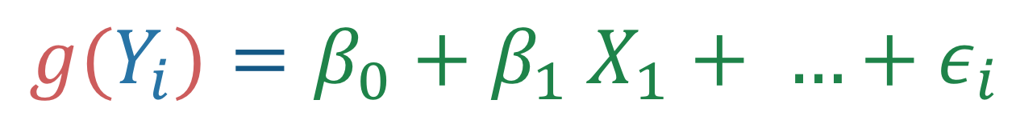
Review The Gist of GLMs
We model the expected value of the model in a different way than regular regression
$$g(Y_{i})=β_{0}+β_{1} X_{1}+ …+ε_{i}$$
Link function
Predictors
(same as in regular regression)
Outcome response
Notes:
library(tidyverse)
set.seed(843)
df <- data_frame(
x1 = runif(100),
x2 = rbinom(100, 1, .5),
y = x1 + x2 + 2*x1*x2 + rnorm(100)
)
df %>%
mutate(x2_cat = factor(x2)) %>%
ggplot(aes(x1, y, group = x2_cat, color = x2_cat)) +
geom_point() +
geom_smooth(method = "lm")

Slide 3

Review The Gist of GLMs
We model the expected value of the model in a different way than regular regression
$$g(Y_{i})=β_{0}+β_{1} X_{1}+ …+ε_{i}$$
The link and distribution we pick are based on our theoretical understanding of what our outcome variable is like
Link function
Predictors
(same as in regular regression)
Outcome response

Slide 4
Review The Gist of GLMs
We model the expected value of the model in a different way than regular regression
Outcome Distribution | Link | Distribution
Binary | Probit | Binomial
Count | Log | Poisson
Bounded | Logit | Beta
Zero-Inflated Count | Log | Binomial and Poisson
$$g(Y_{i})=β_{0}+β_{1} X_{1}+ …+ε_{i}$$
Link function
Predictors
(same as in regular regression)

Slide 5

Probit Regression
Binomial distributed
Similar to logistic, but with a different link
probit$(Y_{i})=β_{0}+β_{1} X_{1}+ …+ε_{i}$
Used a ton in economics but not as much in the other social sciences
Notes:
Probit is related to the normal distribution

Slide 6
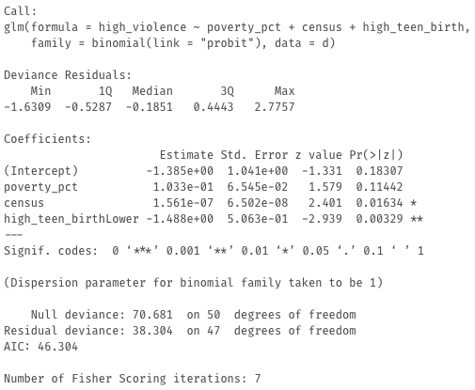

Probit Regression
Binomial distributed
Similar to logistic, but with a different link
Interpretation
Just like logistic, can get predicted probabilities and average marginal effects.
The coefficients, when positive, mean that for an increase in that variable, there is an increase in the predicted probability of the outcome (e.g., for a one-unit increase in poverty percentage, there is an increase in the probability of having high violence, controlling for population and teen birth.
For the categorical predictor: For states with lower teen birth rates, there is a decrease in the probability of high violence than states with high teen birth rates, controlling for poverty and population.
probit$(Y_{i})=β_{0}+β_{1} X_{1}+ …+ε_{i}$
Notes:
https://stats.idre.ucla.edu/stata/output/probit-regression/

Slide 7

Poisson Regression
Poisson distributed
For count outcomes (counts without a ton of zero counts)
log$(Y_{i})=β_{0}+β_{1} X_{1}+ …+ε_{i}$
The count variable here should not have a ton of zero’s and shouldn’t have high numbers (although the cut-offs are not clear).
Also, the amount of time for each count should be the same across individuals (if not, we need to adjust for it, or use a survival analysis)

Slide 8
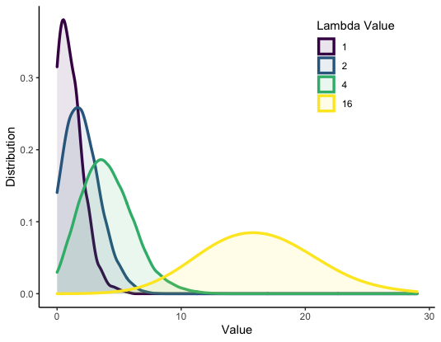
Poisson
Distribution
Poisson distributed
Note the lambda value is both the mean and the variance in a Poisson distribution

Slide 9
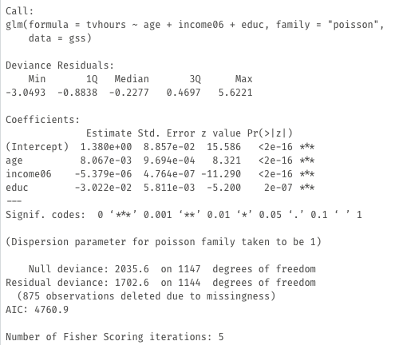

Poisson Regression
Poisson distributed
For count outcomes (counts without a ton of zero counts)
log$(Y_{i})=β_{0}+β_{1} X_{1}+ …+ε_{i}$
Interpretation
The coefficients themselves are the change in the logs of the outcome for a one-unit increase in the predictor. This approximates to percent change (i.e., for a one-unit year increase in education, there is a 3% decrease in the hours of tv watched per day).
Notes:
https://stats.idre.ucla.edu/stata/output/poisson-regression/

Slide 10

Poisson Regression
For count outcomes (counts without a ton of zero counts)
log$(Y_{i})=β_{0}+β_{1} X_{1}+ …+ε_{i}$
Interpretation
Just like logistic, can get average marginal effects.
The AME is interpreted as: “For a one-unit year increase in education, there is an associated .09 hour decrease in hours of watching tv per day.”
Notes:
https://stats.idre.ucla.edu/stata/output/poisson-regression/

Slide 11

Beta Regression
Beta distributed
For bounded outcomes (e.g., between 0 and 100)
$$logit(Y_{i})=β_{0}+β_{1} X_{1}+ …+ε_{i}$$
This is a super flexible distribution for basically any type of bounded outcome.
Outcome cannot be at the bounds (e.g., 0 or 100 can be be everything in between). If it is at the bounds, we have to make a small adjustments to the outcome.

Slide 12
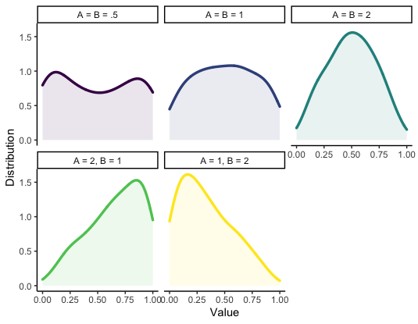
Beta
Distribution
Beta distributed
Note the A and B are parameters that the regression model estimates based on the data

Slide 13
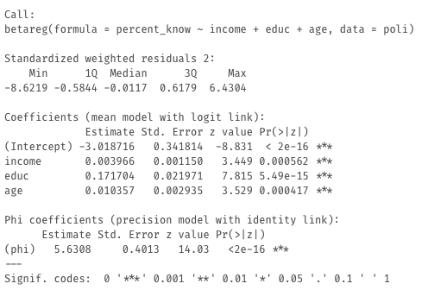
Beta Regression
Interpretation
The coefficients are the exact same as in logistic regression, meaning we can get the Odds Ratio, AME, and Predicted Probabilities.
For example, a one year increase in education was associated with a exp(.1717) = 1.187 increase in the odds of that the person got all question correct.
Note, this uses the betareg package
Notes:
https://stats.stackexchange.com/questions/63350/how-to-interpret-the-coefficients-from-a-beta-regression

Slide 14

Beta Regression
Interpretation
The AME is interpreted as: “For a one-year increase in education, there was an associated .04 unit increase in the outcome. That is, for every one-year increase in education, the individual got 4 percentage points higher on the political knowledge scale.”
Notes:
https://stats.stackexchange.com/questions/63350/how-to-interpret-the-coefficients-from-a-beta-regression

Slide 15

Zero-Inflated Count Regression
For counts with tons of zeros
Binomial and Poisson
$$log(Y_{i})=β_{0}+β_{1} X_{1}+ …+ε_{i}$$
When your outcome is a count outcome but many people have zeros
Another option: Zero-inflated Negative Binomial Regression – Negative binomial regression does better with over dispersed data, i.e. variance much larger than the mean.

Slide 16
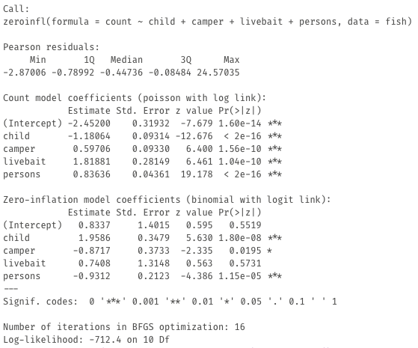
Zero-Inflated Count Regression
More information on the data: https://stats.idre.ucla.edu/r/dae/zinb/
Interpretation
There are two parts, the count model and the zero-inflation model. The count model is interpreted like Poisson while the zero-inflated is just like logistic.
Note, this uses the pscl package
Notes:
https://stats.stackexchange.com/questions/63350/how-to-interpret-the-coefficients-from-a-beta-regression

Slide 17

Zero-Inflated Count Regression
margins::margins(fit_zero, vce = "bootstrap") %>% summary()
Interpretation
The AME combines both parts into one estimate. For example, for a one-unit increase in persons, there is a 3.2 increase in the count of fish caught. Or, for a one-unit increase in children, there is a 4.9 unit decrease in the count of fish caught (no surprise!).
Note, this uses the pscl package
Notes:
https://stats.stackexchange.com/questions/63350/how-to-interpret-the-coefficients-from-a-beta-regression

Slide 18
There Are Many Others
Regression is so flexible that it can be used for so many situations, we are only introducing some of the common ones here.
Structural Equation Modeling
Multilevel Modeling
Survival Analysis
Other GLMs
Factor Analyses
Machine Learning

Slide 19
Check out these Resources!
Poisson Regression in R Tutorial
More on Beta Regression with some Examples in R
Zero-Inflated Count Regression in R Tutorial

Slide 20

Notes:
Photo by Simon Berger on Unsplash

